Slide 1



Short-Term and Long-Term Wind Power Production Forecasting
K. Szostek
07.09.2026

Slide 2

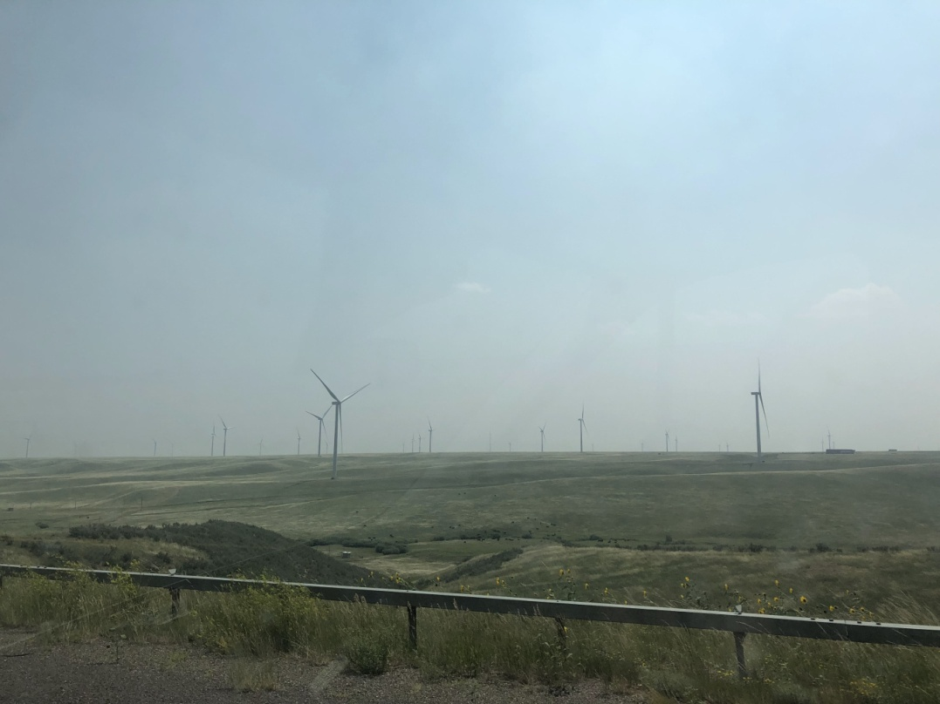
Generation Instability
Stochastic nature of wind: Power generation depends heavily on atmospheric conditions that fluctuate continuously from minute to minute.
Grid stability risks: Sudden generation drops can strain transmission networks or lead to severe imbalances and power outages.
Operational reserve requirements: Conventional backup plants (such as coal and gas) must remain on spinning reserve, resulting in high CO₂ emission costs and underutilization of renewable energy potential.

Slide 3

Forecasting Horizons: Why Both Matter?
Short-Term Forecasting (minutes to 48 hours): Critical for Transmission System Operators (TSOs) and Distribution System Operators (DSOs) for day-ahead markets, real-time grid security, and spinning reserve management. Enables fast response to unexpected wind ramps and prevents localized network overloads.
Long-Term Forecasting (months to years): Essential for strategic investment planning, grid infrastructure expansion, and regional capacity adequacy assessments. Provides a solid foundation for long-term generation mix optimization and policy making.

Slide 4
Long Term: Methodology & Model Overview
Analysis of Wind Time Series: Evaluation of forecasting effectiveness based on actual wind farm generation data.
ARIMA / SARIMA Models: Classical statistical approaches; SARIMA is specifically utilized to handle seasonal components (diurnal and annual patterns) in wind data.
SVR (Support Vector Regression): A machine learning (ML) model capable of capturing complex, non-linear relationships inherent in meteorological and wind power datasets.

Slide 5
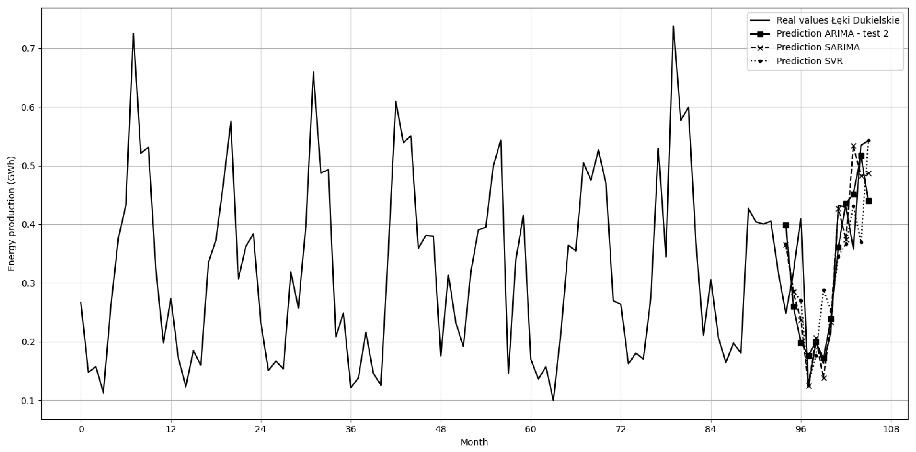

Slide 6

Current Research: Expanding into Short-Term Forecasting
Transitioning from Theory to Operations: Moving beyond long-term statistical models to address high-frequency operational challenges and real-time wind power prediction.
Leveraging Advanced Data Sources: Incorporating high-frequency measurements directly from SCADA systems.
Optimizing Model Responsiveness: Integrating machine learning architectures to minimize prediction latency and handle sudden atmospheric ramps.

Slide 7
Short-Term Forecasting Methodologies
Deep Learning Sequence Models: Deploying architectures like Long Short-Term Memory (LSTM) and Gated Recurrent Units (GRU) to capture complex temporal dependencies and sequential patterns in high-frequency operational data.
Multi-Source Data Fusion: Combining localized operational measurements directly from wind farm SCADA systems with external regional weather data to create a unified, comprehensive input for short-term forecasting.
Hybrid Machine Learning Frameworks: Combining physical wind modeling with adaptive algorithms (such as XGBoost or neural networks) to dynamically correct real-time prediction errors and handle atmospheric volatility.

Slide 8
Challenges and Limitations in Short-Term Forecasting
Extreme Weather Events and Anomalies: The impact of sudden weather disruptions, storms, and turbine blade icing on unpredictable, sharp deviations in power generation.
Limitations of Classical Models: The inadequacy of statistical algorithms (such as ARIMA/SARIMA) during emergency situations and sudden wind ramps, which strictly necessitates the implementation of deep learning architectures.
High-Dimensional Data Complexity: The increased analytical difficulty of processing and synchronizing heterogeneous, multi-source inputs—simultaneously handling high-frequency SCADA turbine metrics, real-time meteorological feeds, and historical generation records without introducing latency or noise.

Slide 9
Future Directions
Probabilistic Forecasting and Uncertainty Quantification: Moving beyond deterministic point predictions to generate prediction intervals and uncertainty bounds, capturing the inherent stochasticity of atmospheric physics for robust offline decision-making.
Dynamic Model Adaptation and Continuous Learning: Implementing adaptive frameworks that automatically update model parameters based on incoming data streams, allowing the forecasting system to evolve over time rather than relying on fixed configurations.
Multi-Horizon Attention Mechanisms: Integrating advanced transformer-based architectures with attention layers to simultaneously capture multi-step temporal dependencies and variable interactions across complex forecasting horizons.

Slide 10

Thank you for your attention.

