Slide 1
Dielectric and Thermal performance of nanofluids for High-Voltage Applications
Matej Vaľko
matej.valko@tuke.sk
DEPE FEI, TUKE
07.09.2026

Slide 2
CONTENTS
Importance of the Research in the Field of Interest
Activities to Date
Future Outlook

Slide 3
1. IMPORTANCE OF THE RESEARCH IN THE FIELD OF INTEREST
Compliance with Commission Regulation (EU) No. 548/2014 on the implementation of the Ecodesign Directive for transformers
Modification of biodegradable transformer oils with different types of nanoparticles can match or even significantly improve their dielectric performance when compared to traditionally used types of transformer oils (e.g., mineral oils)
A significant proportion of the transformer faults are of a dielectric nature

Slide 4
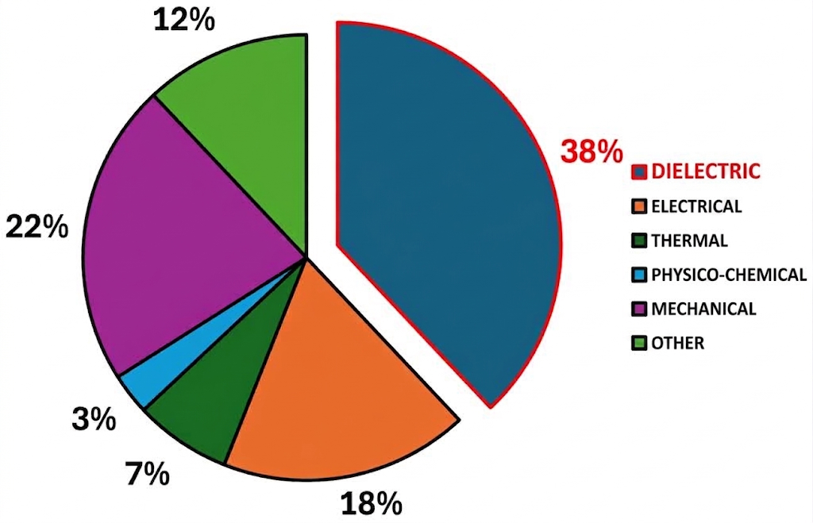
TYPES OF TRANSFORMER FAILURES IN SUBSTATIONS
Data source: CIGRÉ WG A2.37, Transformer Reliability Survey
Number of serious failures: 799
Transformer voltage range: 60 kV – 700 kV
Period under review: 1996 – 2010

Slide 5
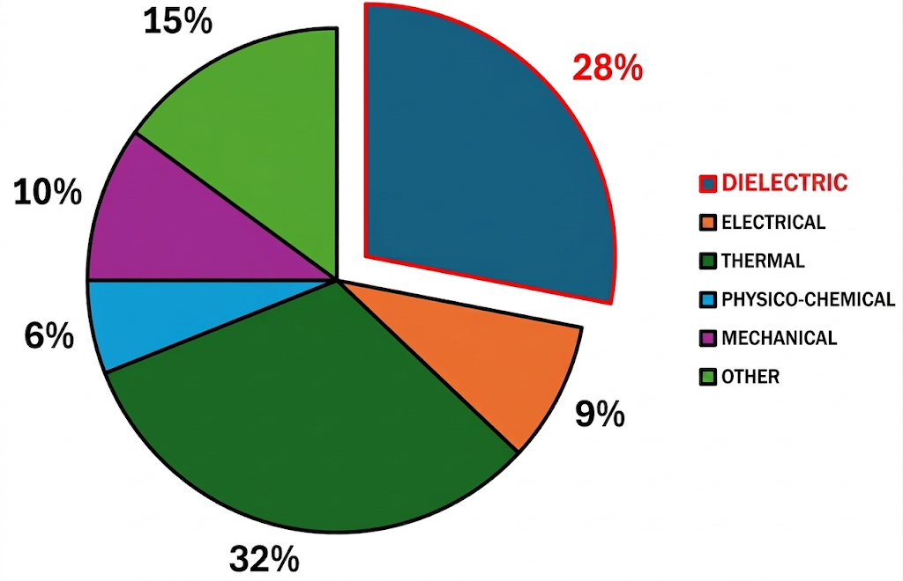
TYPES OF TRANSFORMER FAILURES IN POWER PLANTS (GSUs)
Data source: CIGRÉ WG A2.37, Transformer Reliability Survey
Number of serious failures: 165
Transformer voltage: 60 kV – 700 kV
Period under review: 1996 – 2010

Slide 6


2. ACTIVITIES TO DATE
1st year of study: Multiple confernce attendances and published articles
Most signficant activity to date: International internship at FEL UWB in Pilsen, Czech Republic
Dates: April 20, 2026 – July 19, 2026 (total of 3 months)
Person responsible at UWB: prof. Ing. Pavel Trnka, Ph.D., MBA
Person responsible at TUKE: prof. Ing. Juraj Kurimský, PhD.
Objective: Experimental research into the dielectric properties and resistance of insulating oils and nanofluids to partial discharges (PDs)

Slide 7
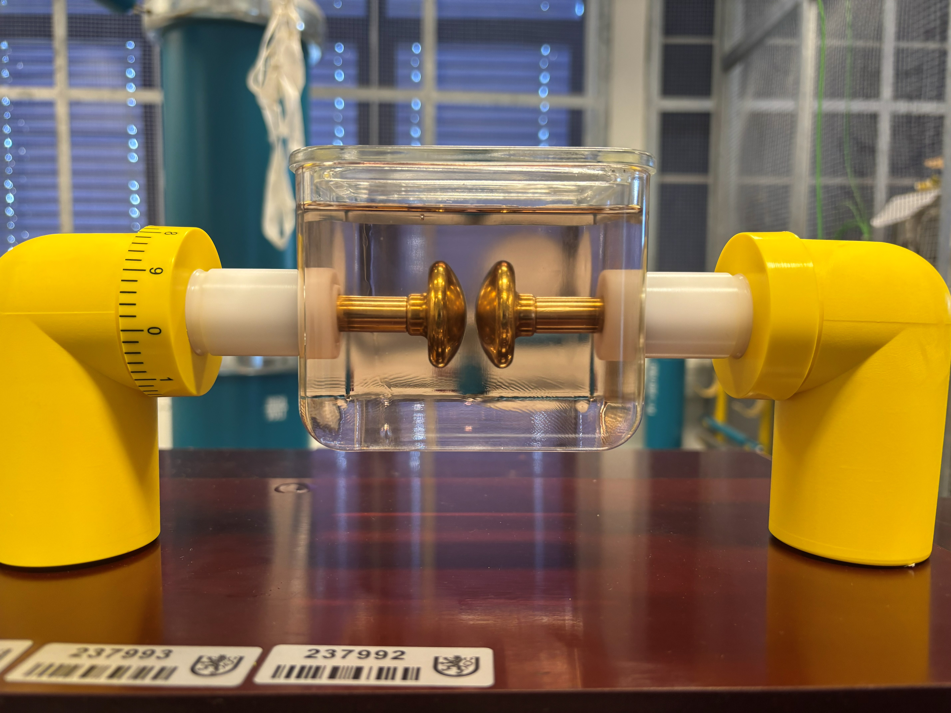
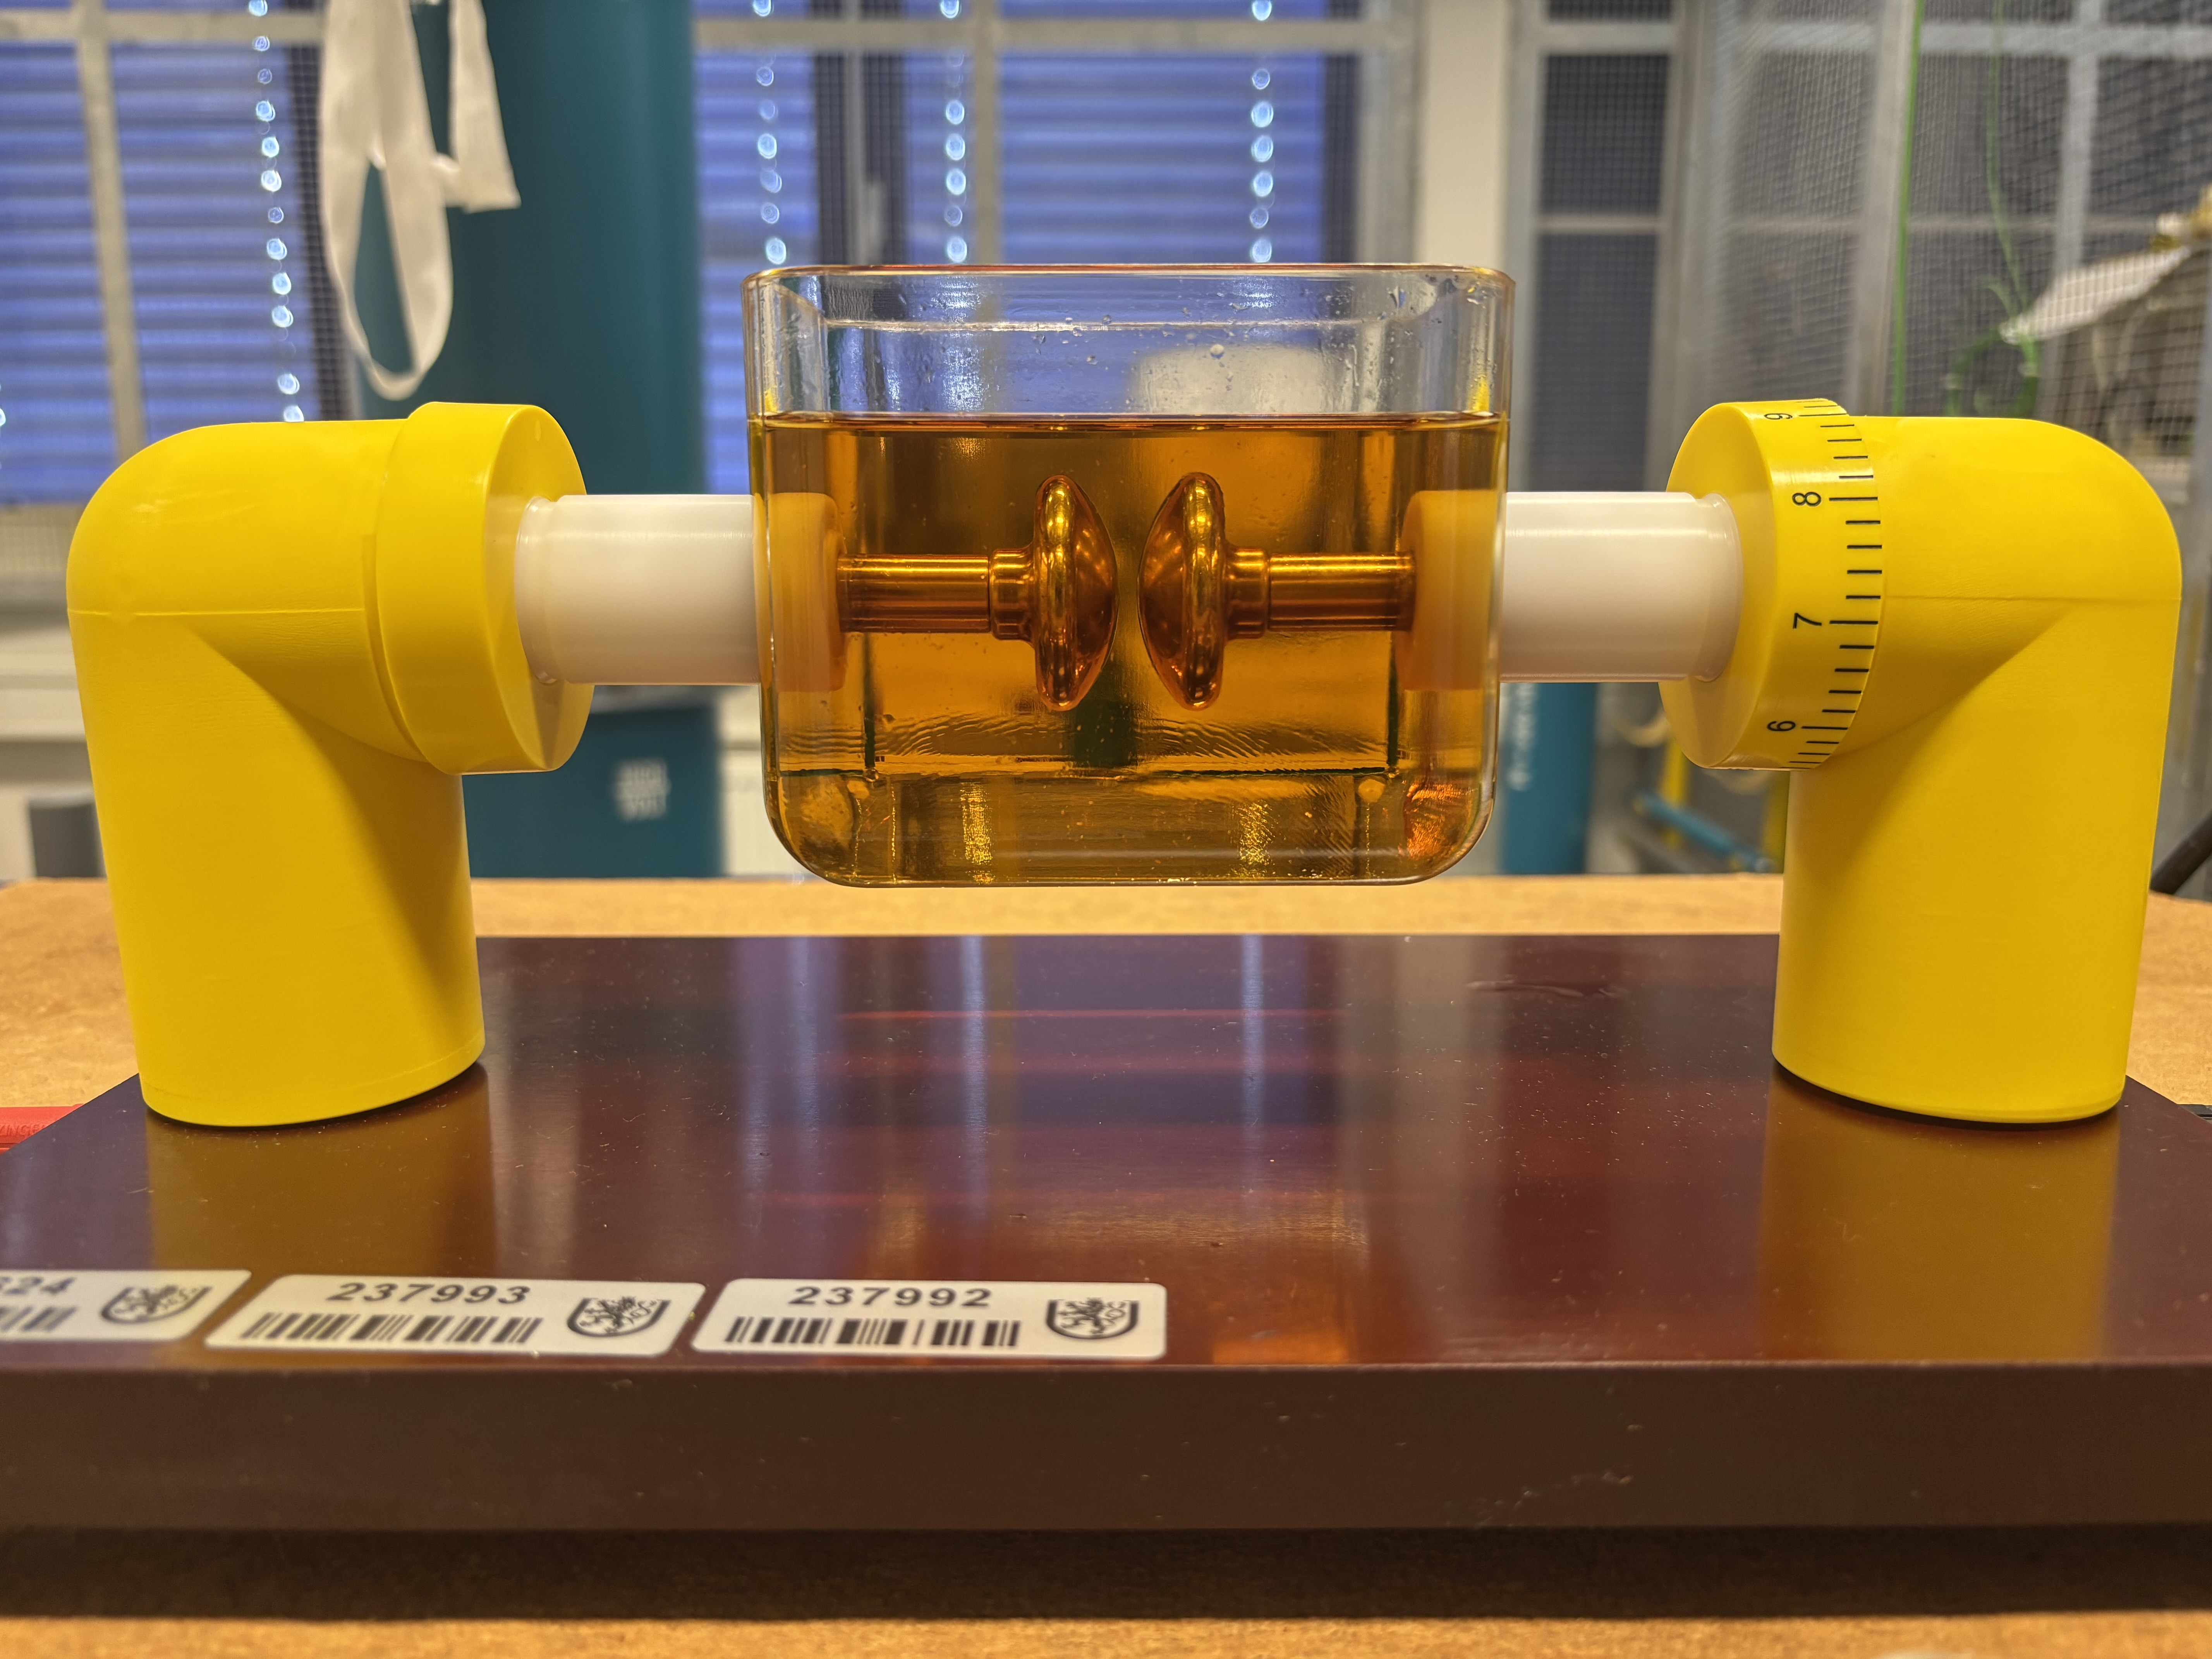
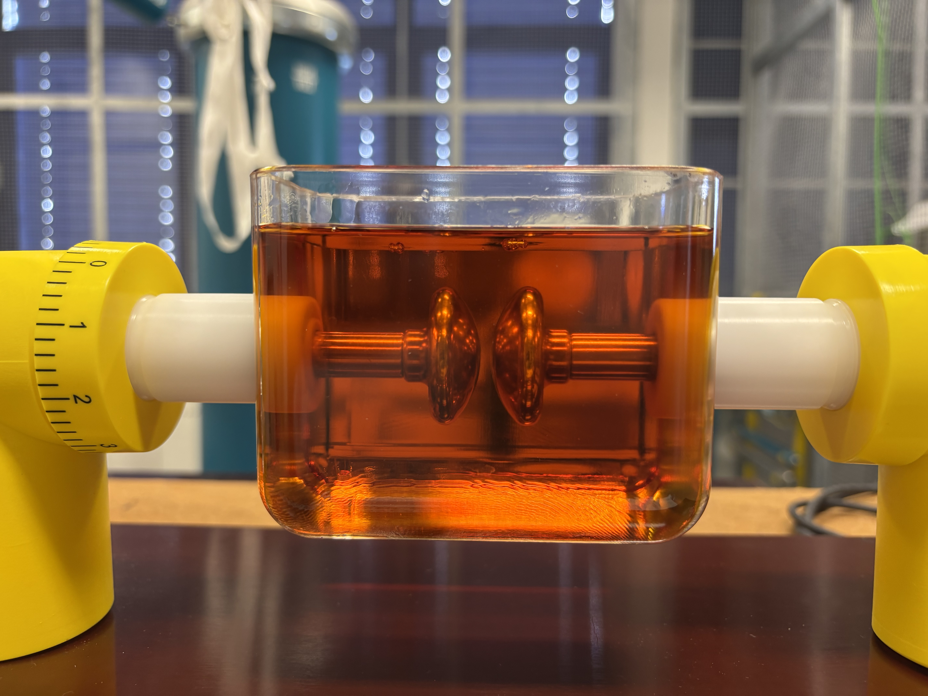
ACTIVITY AT UWB
Samples:
  Shell Diala S5 (pure)
  C₆₀ nanofluid (0,003 % w/V)
  C₆₀ nanofluid (0,03 % w/V)
Sample ageing temperature:116 °C
Sample ageing time:
  reference (0 hours)
  S1 (300 hours)
  S2 (600 hours)
  S3 (900 hours)
  S4 (1200 hours)
  S5 (1500 hours)
Conducted tests:
  Electrical: AC BDV; tg δ = f(T); ε_{r} = f(T), resitivitym PD activity
  Non – electrical: water content, dynamic visosity, mechanical testing of transformer paper, STGA
  Optical: FT IR
C60; 0,003 % w/V (300 h.)
C60; 0,003 % w/V (300 h.)
C60; 0,003 % w/V (1500 h.)

Slide 8
3. FUTURE OUTLOOK
Short term:
Publishing of joint publications from my stay at FEL UWB
Long term:
Expand the research with the new types of biodegradable nanofluids
Outlining the additional experimental framework for continued research in the field of dielectric liquids (assessment of the influence of different variables on the dielectric parameters – such as changing temperature, pressure, etc.)

Slide 9
THANK YOU FOR YOUR ATTENTION

