Slide 1

Advanced and sustainable materials
for electrical engineering
Research and project activities at UNIZA
V4 EnergyNet Online Workshop
7 September 2026
Ing. Štefan Hardoň, PhD.
stefan.hardon@uniza.sk
University of Žilina · FEIT · Department of Physics
UNIZA
V4 EnergyNet
Notes:
Thank the organizers and TUKE FEIT for the invitation. State that the talk is intentionally concise and focused on research activities, current cooperation and possible synergies.

Slide 2
Talk focus
Materials reliability is a small but critical layer of modern power systems.
Electrical insulation
Diagnostics
Circular materials
Projects
UNIZA research: polymer-based electrical insulation and functional composites.
Experimental focus: dielectric response, resistivity, thermal behaviour and material processing.
Project focus: V4 networking, Horizon cooperation, and follow-up proposals.
Professional development: participation in the Horizon Europe Summer School focused on project preparation and international research cooperation.
Message for today
Sustainable material concepts can support grid reliability, power electronics and transformer technologies - but they require careful diagnostics before application.
V4 EnergyNet online workshop · University of Žilina
2
Notes:
Explain the structure: first the research area, then equipment and examples, then cooperation ideas. Emphasize connection to V4 EnergyNet: materials are enabling technologies for reliable renewable and smart power systems.

Slide 3
Research platform at UNIZA
Commercial polymer matrices
Functional fillers
Electro-thermal diagnostics
2C polyurethane systems
Epoxy and PEI matrices
Potting / encapsulation use cases
Halloysite nanotubes
Al₂O₃, ZnO, MgO
Recycled PUR foam particles
Broadband dielectric spectroscopy
Volume resistivity
Thermal conductivity, DSC, DMA
Additional characterization methods: SEM, FTIR and NMR spectroscopy
Core question: how much functionality or sustainability can be introduced without compromising insulation performance?
V4 EnergyNet online workshop · University of Žilina
3
Notes:
Mention that the platform is intentionally application-oriented: commercial matrices, relevant measurement methods, and comparison between neat systems and modified systems.

Slide 4
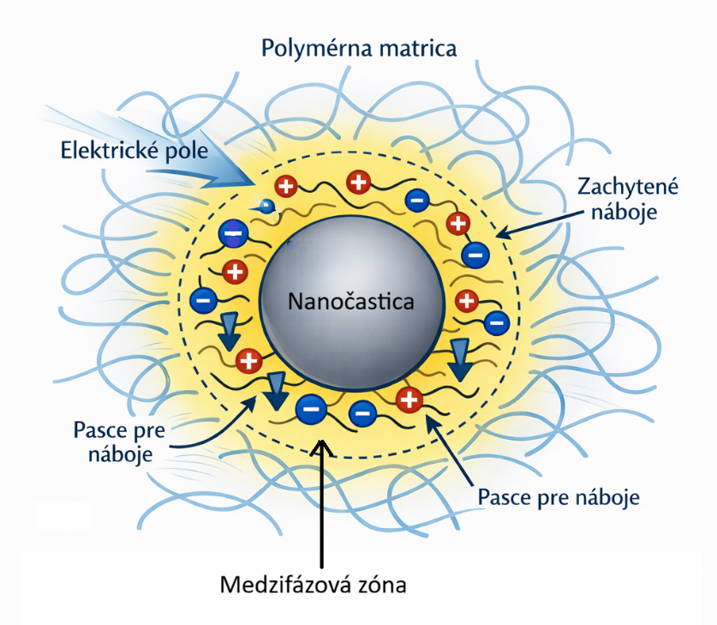
Basic principle of polymer nanocomposites
Nanoparticles create an interfacial region in the polymer matrix, where charge trapping and transport processes influence the dielectric response and electrical insulation performance of the material.
This figure illustrates the basic principle we use in our research.
V4 EnergyNet online workshop · University of Žilina
4
Notes:
Use this slide as the first concrete example. Keep the message simple: a nanofiller can significantly improve electrical resistivity, but the full material profile must be checked.

Slide 5
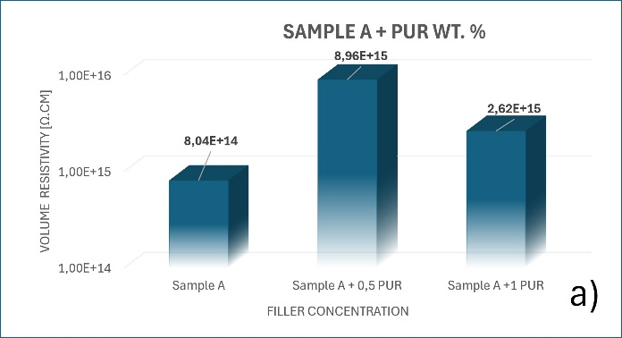
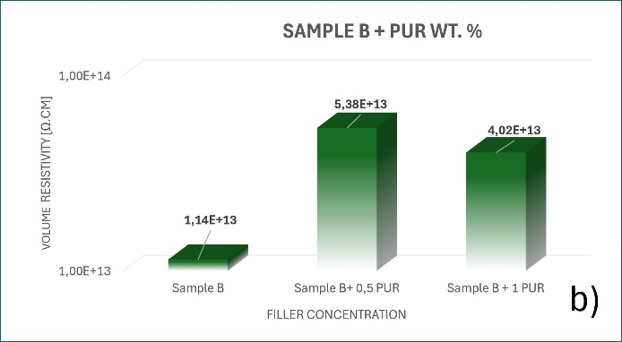
Sustainability route: recycled PUR foam as filler
End-of-life polymer insulation and appliance PUR foam
Milling / preparation of particles
Low wt% addition to commercial PUR matrices
Volume resistivity of PUR composite systems with recycled PUR filler: (a) Sample A, (b) Sample B.
Promising direction for circular-by-design electrical insulating materials.
Critical variables: particle size, purity, moisture and dispersion.
Next step: systematic application-oriented validation.
V4 EnergyNet online workshop · University of Žilina
5
Notes:
Present this as preliminary but important: recycled PUR foam can be used at low weight percentages without destroying the insulation properties. Avoid overclaiming; say the approach needs further validation.

Slide 6
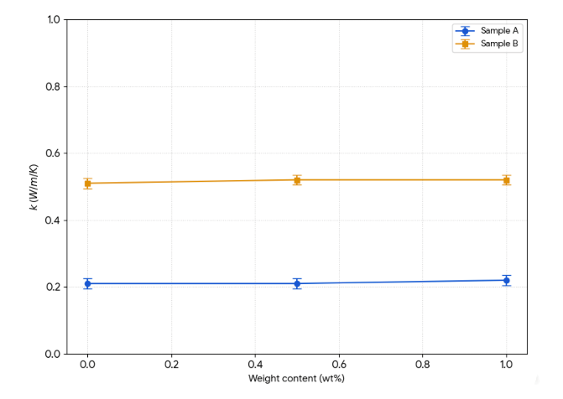
Sustainability route: recycled PUR foam as filler
End-of-life polymer insulation and appliance PUR foam
Milling / preparation of particles
Low wt% addition to commercial PUR matrices
Thermal conductivity of polyurethane systems with recycled PUR filler as a function of filler concentration
Promising direction for circular-by-design electrical insulating materials.
Critical variables: particle size, purity, moisture and dispersion.
Next step: systematic application-oriented validation.
V4 EnergyNet online workshop · University of Žilina
5
Notes:
Present this as preliminary but important: recycled PUR foam can be used at low weight percentages without destroying the insulation properties. Avoid overclaiming; say the approach needs further validation.

Slide 7
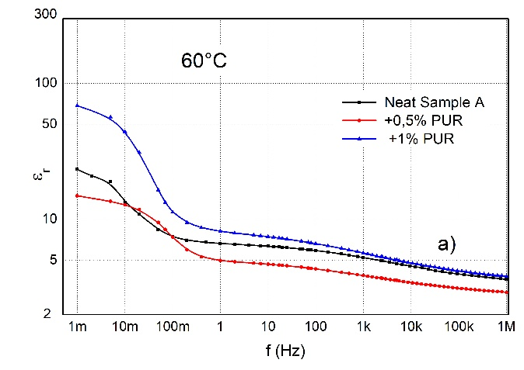
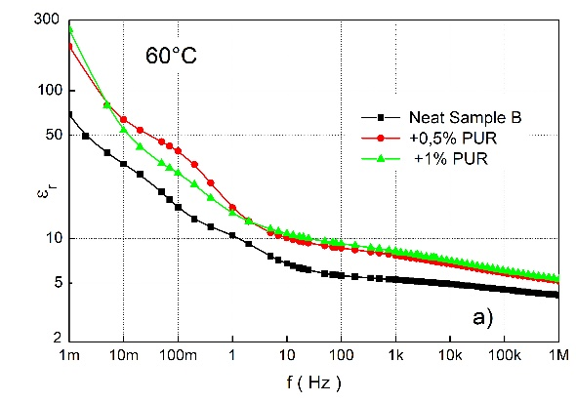
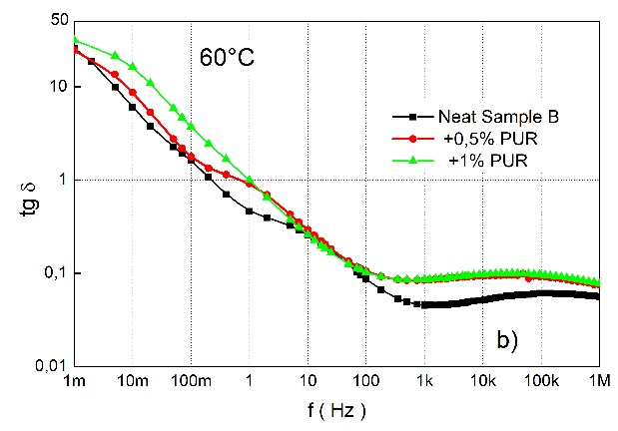
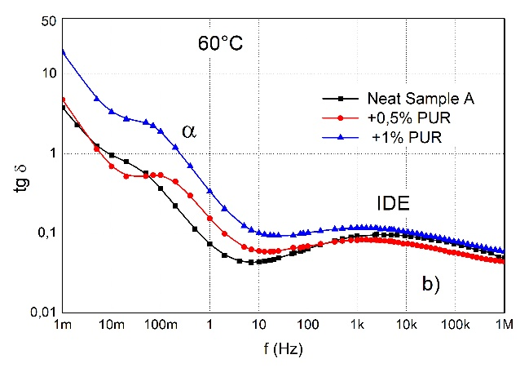
Sustainability route: recycled PUR foam as filler
End-of-life polymer insulation and appliance PUR foam
Milling / preparation of particles
Low wt% addition to commercial PUR matrices
a)Real permittivity of Samples with recycled PUR filler at 60 °C,
b) loss tangent of Samples with recycled PUR filler at 60 °C
V4 EnergyNet online workshop · University of Žilina
5
Notes:
Present this as preliminary but important: recycled PUR foam can be used at low weight percentages without destroying the insulation properties. Avoid overclaiming; say the approach needs further validation.

Slide 8
Project links and cooperation logic
V4 EnergyNet
Horizon cooperation
with TUKE FEIT
Follow-up proposals
and pilot work
Networking platform for renewable energy, electromobility, power systems and electricity markets.
Space for connecting material diagnostics with power-engineering application needs.
Existing collaboration basis with TUKE FEIT.
Shared project environment strengthens trust, mobility and data exchange.
Joint publications and student topics.
Materials for insulation, potting and diagnostics in smart energy infrastructure.
Main bridge
from laboratory material parameters → to system-level reliability questions
V4 EnergyNet online workshop · University of Žilina
6
Notes:
This slide connects the presentation to the project context. State that UNIZA can contribute through material diagnostics, while TUKE FEIT and other partners bring wider power-engineering and system perspectives.

Slide 9
Potential joint activities
Short term
Medium term
Longer term
Exchange of selected research outputs
Student / PhD participation in workshops
Identification of common test cases
Joint conference papers and journal articles
Inter-laboratory comparison of material data
Shared project preparation
Pilot samples with industrial relevance
Circular insulation material concepts
Follow-up Horizon / Eureka / V4 proposals
Practical cooperation should start from concrete samples, concrete measurements and concrete application constraints.
V4 EnergyNet online workshop · University of Žilina
7
Notes:
Use this slide to invite partners to send materials, data needs, or application cases. Keep it constructive and realistic.

Slide 10
Thank you for your attention
Open for discussion and cooperation
Which material-related reliability questions are most relevant for the V4 EnergyNet consortium?
Where could UNIZA diagnostics support joint activities with TUKE FEIT and other partners?
Which project ideas should be developed first?
Štefan Hardoň
University of Žilina · FEIT · Department of Physics
V4 EnergyNet online workshop · University of Žilina
8
Notes:
Close by thanking the organizer again. Invite short discussion and emphasize willingness to cooperate on concrete follow-up topics.

