Slide 1
Coordinated Operation of
Photovoltaic Systems in
Virtual Power Plants
WORKSHOP PRESENTATION – Research direction, proposed methodology and planned validation
V4 EnergyNet: Academic Networking for Renewable Energy and Smart Power Systems
Ing. Kamil Ševc 7.9.2026
Technical University od Košice – Department of High Power Engineering

Slide 2
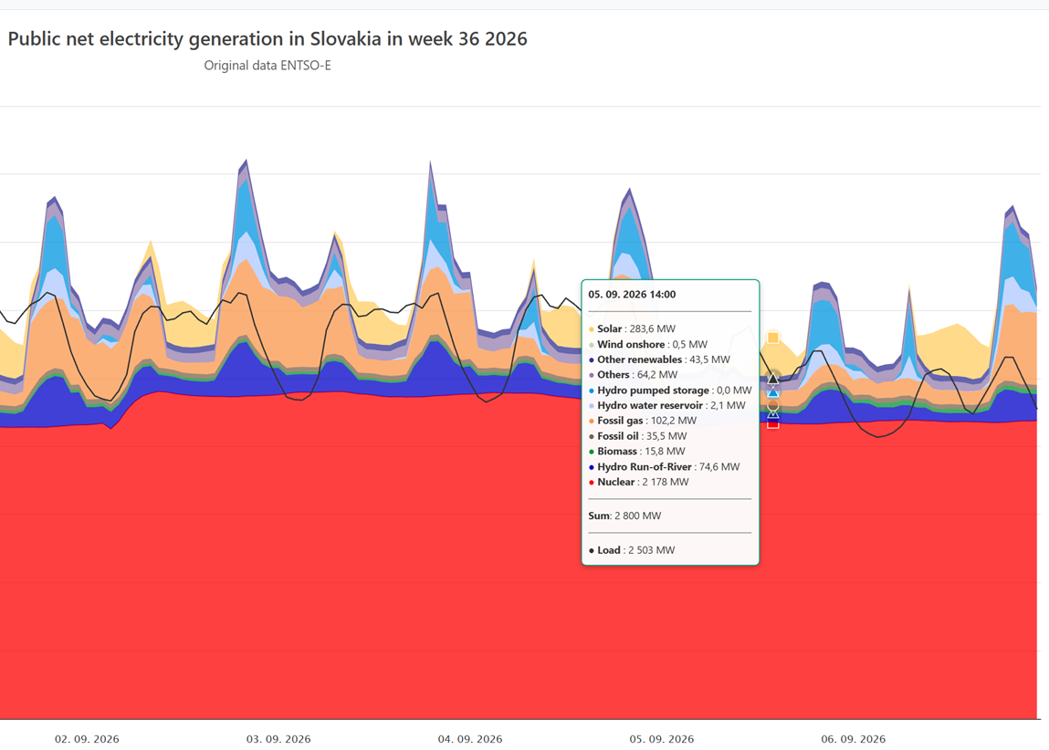
RESEARCH MOTIVATION
PV capacity is growing faster than controllability
The research problem
How can distributed PV, storage and flexible demand be coordinated so that the combined portfolio is predictable, technically feasible and useful to the grid?
Illustrative daily profiles
TECHNICAL UNIVERSITY OF KOŠICE | FACULTY OF ELECTRICAL ENGINEERING AND INFORMATICS

Slide 3
RESEARCH SCOPE
My focus is coordinated operation of distributed PV
Distributed PV
+
Battery storage
+
Flexible demand
↓
Coordinated VPP operation
forecasting · optimisation · dispatch · verification
↓
Grid services
Market participation
Customer value
TECHNICAL UNIVERSITY OF KOŠICE | FACULTY OF ELECTRICAL ENGINEERING AND INFORMATICS

Slide 4
RESEARCH GAP
The research task connects models often studied separately
PV forecasting
Portfolio scheduling
Network feasibility
Market decisions
Weather and spatial correlation
Energy, storage and flexible load
Voltage and thermal constraints
Bids, reserves and uncertainty
↓
My proposed integration task
One framework linking uncertainty, dispatch, flexibility and network limits
Gap statement to be refined during the literature review
TECHNICAL UNIVERSITY OF KOŠICE | FACULTY OF ELECTRICAL ENGINEERING AND INFORMATICS

Slide 5
RESEARCH QUESTIONS
Four questions define the current research direction
RQ1
How should spatially distributed PV systems be aggregated and represented?
RQ2
How can forecast uncertainty be included in VPP scheduling?
RQ3
How much flexibility can storage and responsive loads provide?
RQ4
How do network limits change the technically available flexibility?
TECHNICAL UNIVERSITY OF KOŠICE | FACULTY OF ELECTRICAL ENGINEERING AND INFORMATICS

Slide 6
SYSTEM UNDER STUDY
The model represents energy and controllable flexibility
PV portfolio
Battery system
Flexible demand
VPP controller
→
→
→
Available active power
Forecast uncertainty
State of charge
Power and ageing limits
Shiftable consumption
Comfort or process limits
Schedule and set-points
↓
Model boundaries
Distribution-network constraints and the selected market or service rules
Grid / market interface
TECHNICAL UNIVERSITY OF KOŠICE | FACULTY OF ELECTRICAL ENGINEERING AND INFORMATICS

Slide 7
PROPOSED METHODOLOGY
The methodology follows a reproducible five-stage workflow
1 Data
2 Forecast
3 Optimise
4 Simulate
5 Evaluate
→
→
→
→
PV, load, weather, prices
Expected values and scenarios
Cost, flexibility and constraints
Day-ahead and real-time operation
Technical and economic metrics
Planned comparison
Deterministic baseline ↔ uncertainty-aware VPP operation
TECHNICAL UNIVERSITY OF KOŠICE | FACULTY OF ELECTRICAL ENGINEERING AND INFORMATICS

Slide 8
PLANNED EXPERIMENTS
Staged scenarios isolate the value of each VPP component
Grid supply + unmanaged PV
Reference case
S0
Aggregated PV portfolio
Aggregation effect
S1
PV + battery storage
Time shifting and balancing
S2
PV + BESS + flexible demand
Full VPP coordination
S3
Each scenario adds one source of flexibility while keeping the test conditions comparable.
TECHNICAL UNIVERSITY OF KOŠICE | FACULTY OF ELECTRICAL ENGINEERING AND INFORMATICS

Slide 9
WORKING HYPOTHESES
These are hypotheses to test—not results already obtained
H1
H2
H3
Geographic aggregation reduces short-term PV variability, but correlation limits the benefit.
Storage improves schedule tracking and shifts solar energy toward higher-value periods.
Network constraints reduce the flexibility that appears available in an unconstrained model.
The analysis may confirm, qualify or reject these statements.
TECHNICAL UNIVERSITY OF KOŠICE | FACULTY OF ELECTRICAL ENGINEERING AND INFORMATICS

Slide 10
EVALUATION FRAMEWORK
Technical and economic metrics define performance
Forecast quality
Energy balance
Flexibility
Network impact
Economics
MAE / RMSE
Scenario coverage
Self-consumption
Grid exchange
Available power
Duration and response
Voltage deviations
Thermal violations
Operating cost
Revenue and ageing
Success means improvement without violating technical limits.
TECHNICAL UNIVERSITY OF KOŠICE | FACULTY OF ELECTRICAL ENGINEERING AND INFORMATICS

Slide 11
CURRENT STATUS
The project is moving toward an executable model
Completed
In progress
Next
Later
→
→
→
Initial literature review
Problem and scope definition
Research-gap refinement
Model boundary selection
Dataset and test system
Baseline implementation
Scenario analysis
Validation and sensitivity
Workshop feedback can still shape the model and validation strategy.
TECHNICAL UNIVERSITY OF KOŠICE | FACULTY OF ELECTRICAL ENGINEERING AND INFORMATICS

Slide 12
EXPECTED RESEARCH CONTRIBUTION
The goal is a defensible method for quantifying PV-based VPP flexibility
Integrated model
Comparable scenarios
Engineering guidance
Link PV uncertainty, storage, demand and network feasibility.
Measure the incremental value of each flexibility resource.
Identify when theoretical flexibility is technically deliverable.
Current output: research framework and validation plan — experimental results will follow.
TECHNICAL UNIVERSITY OF KOŠICE | FACULTY OF ELECTRICAL ENGINEERING AND INFORMATICS

Slide 13
THANK YOU FOR YOUR ATTENTION.
Ing. Kamil Ševc
Department of High Power Engineering
FEI TUKE 7.9.2026

Slide 14
Selected literature supporting the research direction
1. Naval & Yusta (2021). Renewable and Sustainable Energy Reviews 149, 111393.
2. Nosratabadi et al. (2017). Renewable and Sustainable Energy Reviews 67, 341–363.
3. Mahmud et al. (2020). Renewable and Sustainable Energy Reviews 127.
4. Naval, Sánchez & Yusta (2020). Renewable Energy 151, 57–69.
5. Power & Verbič (2025). IEEE Transactions on Smart Grid 16(1), 183–193.
6. Yu et al. (2019). Applied Energy 239, 454–470.
7. Shabanzadeh et al. (2016). Applied Energy 169, 663–681.
8. Pandžić et al. (2013). Applied Energy 105, 282–292.
9. Baringo & Baringo (2017). IEEE Transactions on Power Systems 32(5), 3492–3504.
10. Pudjianto et al. (2007). IET Renewable Power Generation 1(1), 10–16.

