Slide 1

R&D Projects
& Collaboration possibilities
Rajesh Jesudoss Hynes Navasingh
Sustainable Materials • AI-Driven Infrastructure • Advanced Bio-Materials & Robotics
1

Slide 2
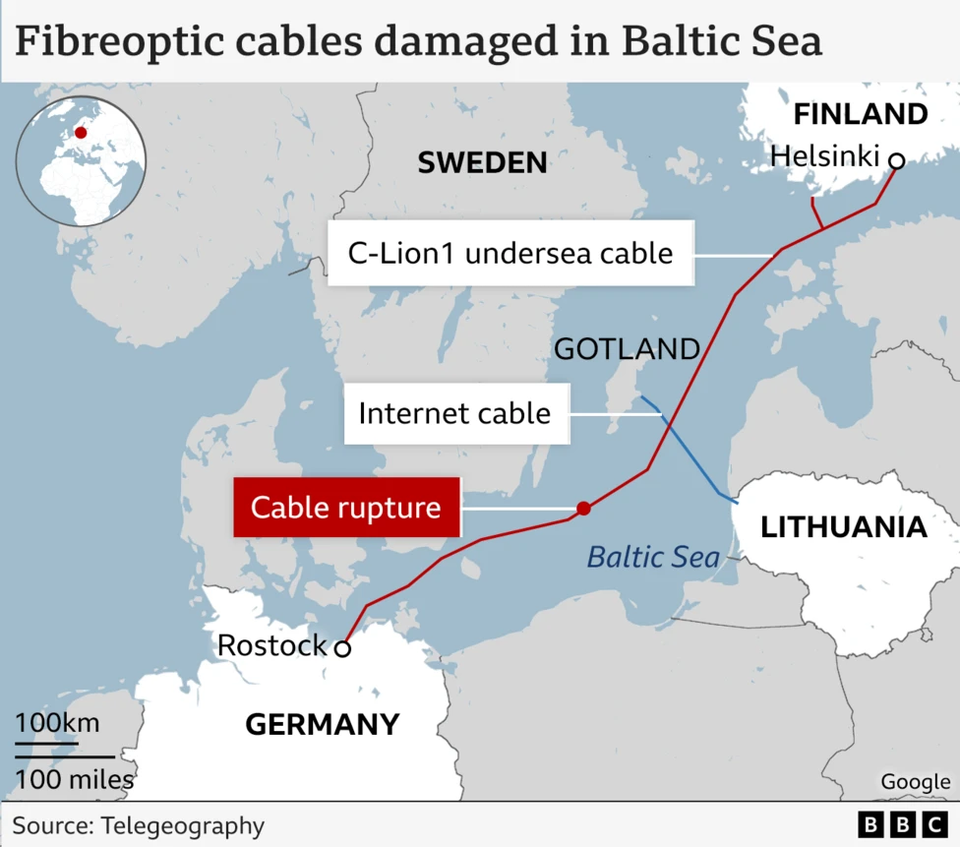
Baltic Sea sabotage
EstLink 2 power link was severed in late 2024 (between Finland and Estonia)
Downtime = 60 days
Operational & Economic Disruption
Expenditure = €60 million
Real cost includes millions in lost revenue, rerouted traffic, and insurance claims

Slide 3


Need for Sustainable Self-Healing Insulating Materials
Insulation critical for high-voltage systems and electronics
Up to 40% energy wasted & Service life is decreased up to 50%
Failures: breakdown, partial discharge, degradation, electrical treeing
Causes: thermal, mechanical, environmental, electrical stresses
Results: cracks, voids, treeing → catastrophic failures
Existing solutions: costly maintenance, downtime
Develop cost-effective, sustainable self-healing insulation
Microencapsulation– release healing agents at damage site
Restore dielectric and mechanical integrity
Reduced maintenance, fewer failures and less unexpected downtime

Slide 4
State of Knowledge
Self-Healing Mechanisms
Extrinsic Methods:
  Microcapsules
  Release healing agents upon cracking
Intrinsic Methods:
  Reversible chemical bonds
  Molecular rearrangements in polymer matrix
Advances in Insulation Materials
Linseed oil capsules → self-repair, corrosion resistance
Epoxy–DCPD composites → dielectric recovery, inhibit treeing
Cable insulation studies → prevent water treeing, breakdown
Limited HV insulation performance studies
Existing methods complex, costly, not scalable
No balance between affordability and performance
Proposed method: eco-friendly, HV-compatible, scalable
Research Gap

Slide 5

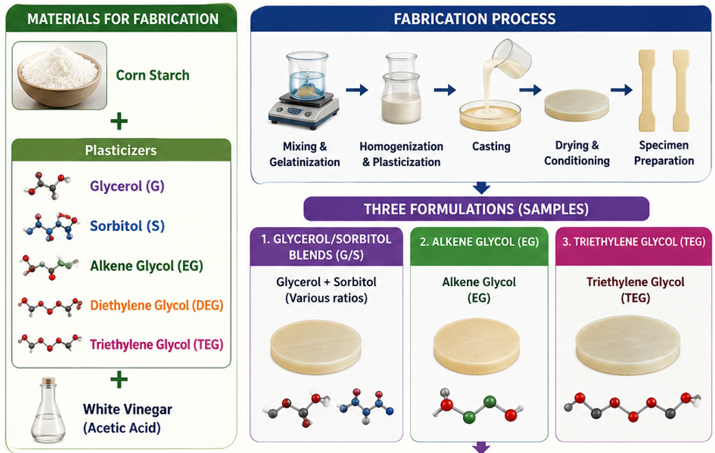
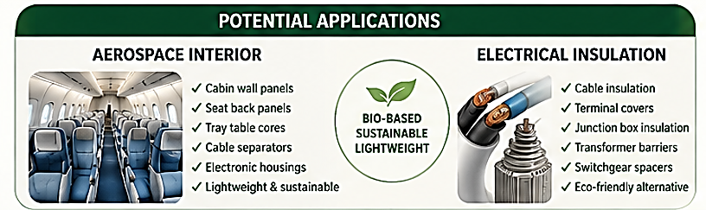

Slide 6
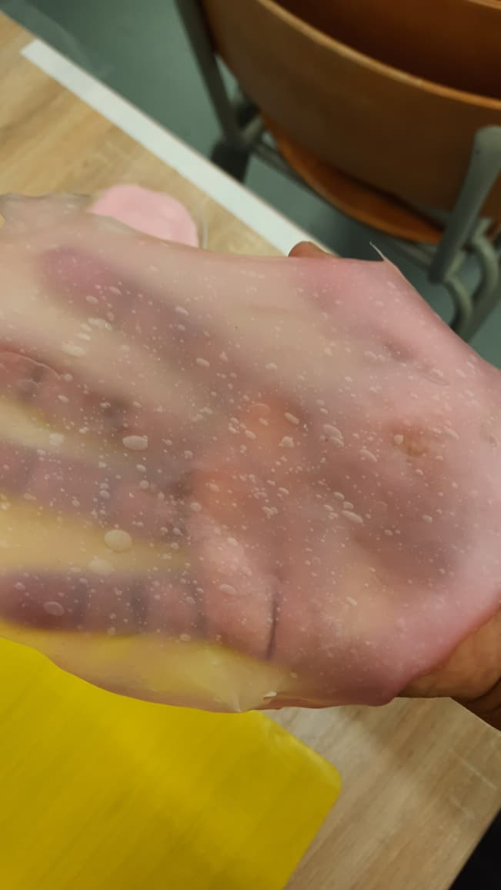
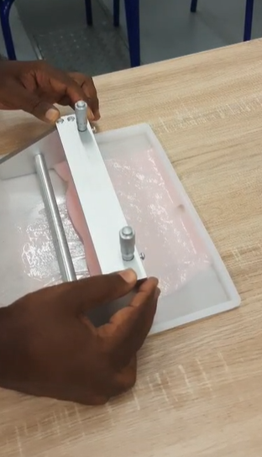
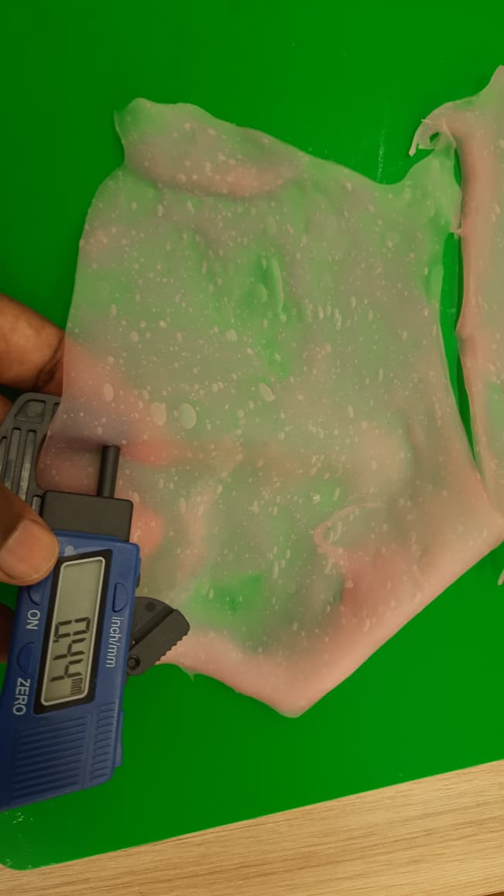
Sustainable Insulation Material developed at
VSB TUO

Slide 7

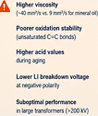
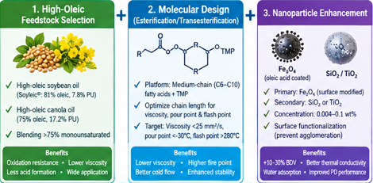
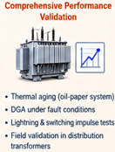



Slide 8
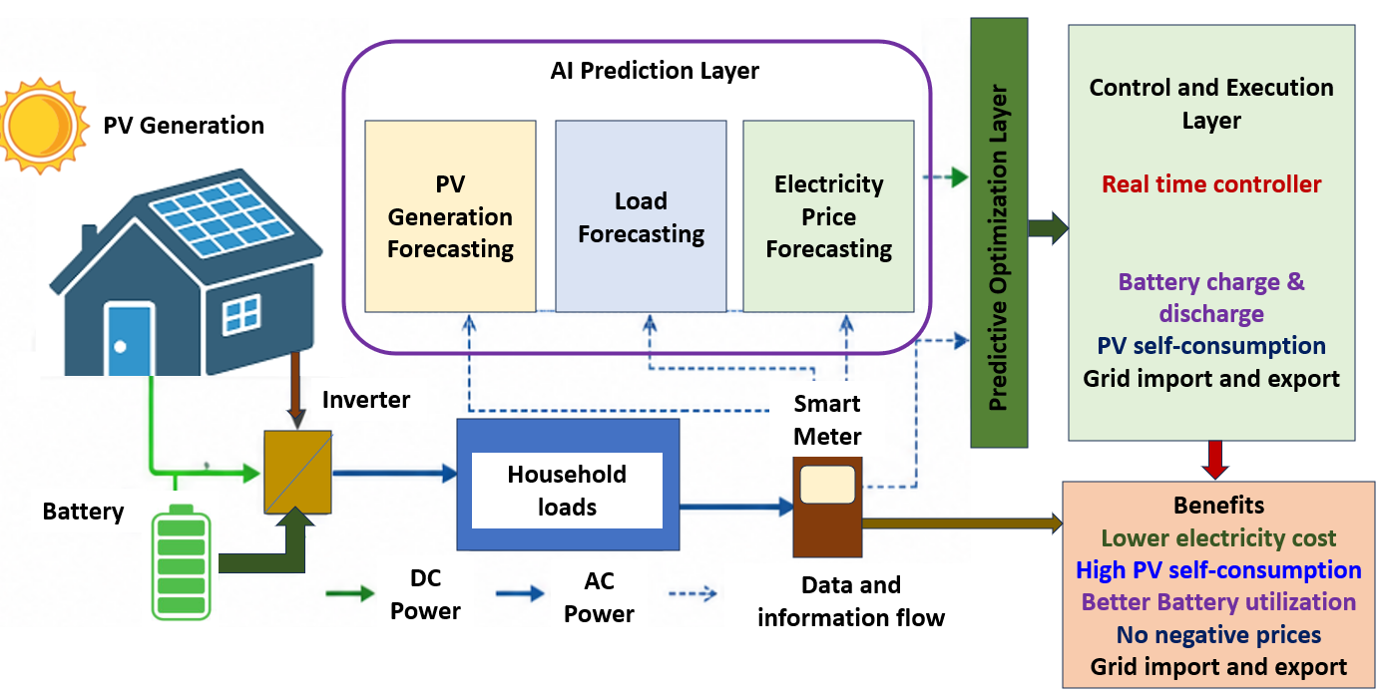
AI-Based Predictive Energy Management of a Photovoltaic-Battery System Under Dynamic Electricity Prices

Slide 9
Pillar II — AI-Driven Smart & Resilient Infrastructure
Dynamic AI architectures optimize energy, safety and municipal systems
1
AI-Based Predictive Energy Management for PV-Battery Systems
Microgrid energy optimization | Predictive AI for charge/discharge under dynamic electricity pricing
Collaborators: R. Hrbáč, R. J. Hynes, A. J. Sujana, J. Jeremiah
2
SMART-ECO-LIGHT: Fog Computing & AI for Rural Infrastructure
Autonomous street lighting | LDR/PIR/Ultrasonic fusion + LSTM prediction at the edge
Collaborators: P. Valíček, T. Novák, A. J. Sujana, J. Jeremiah
3
Visibility & Over-Glare Mitigation in Emergency Signal Lights
Safety engineering | Adaptive luminance for night-time glare and daytime contrast
Collaborators: P. Valíček, T. Novák, A. J. Sujana
4
Transformer-Enhanced Deep Reinforcement Learning for Traffic Control
Intelligent urban systems | DETR-based traffic estimation + DRL for signal routing
Collaborators: T. Novák, A. J. Sujana
6

Slide 10
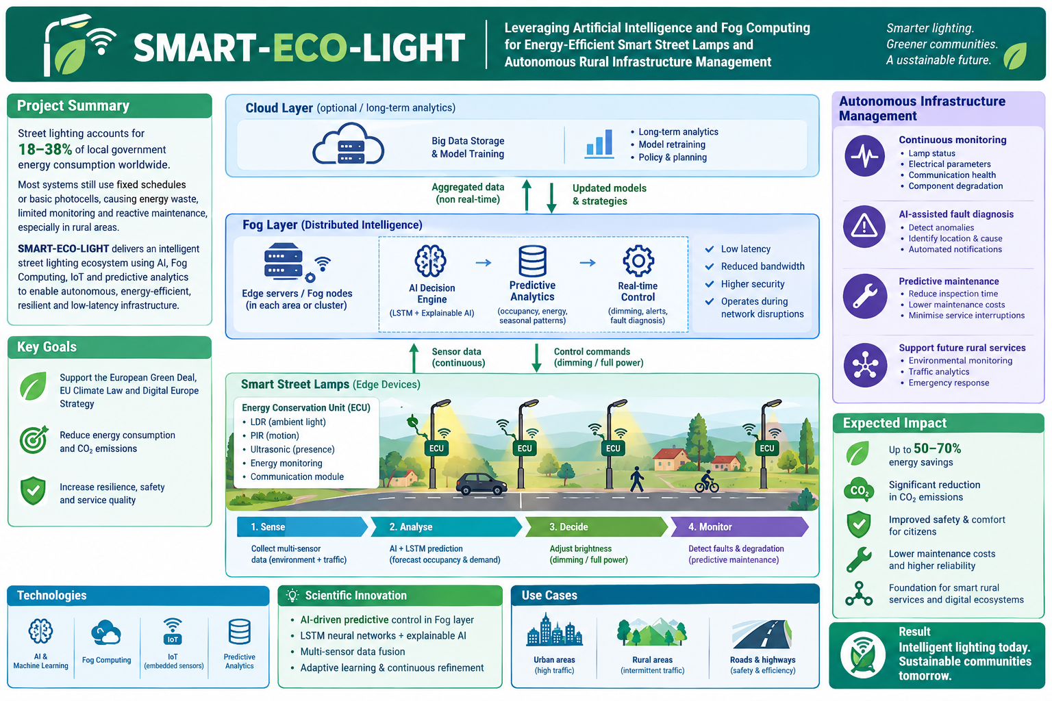

Slide 11
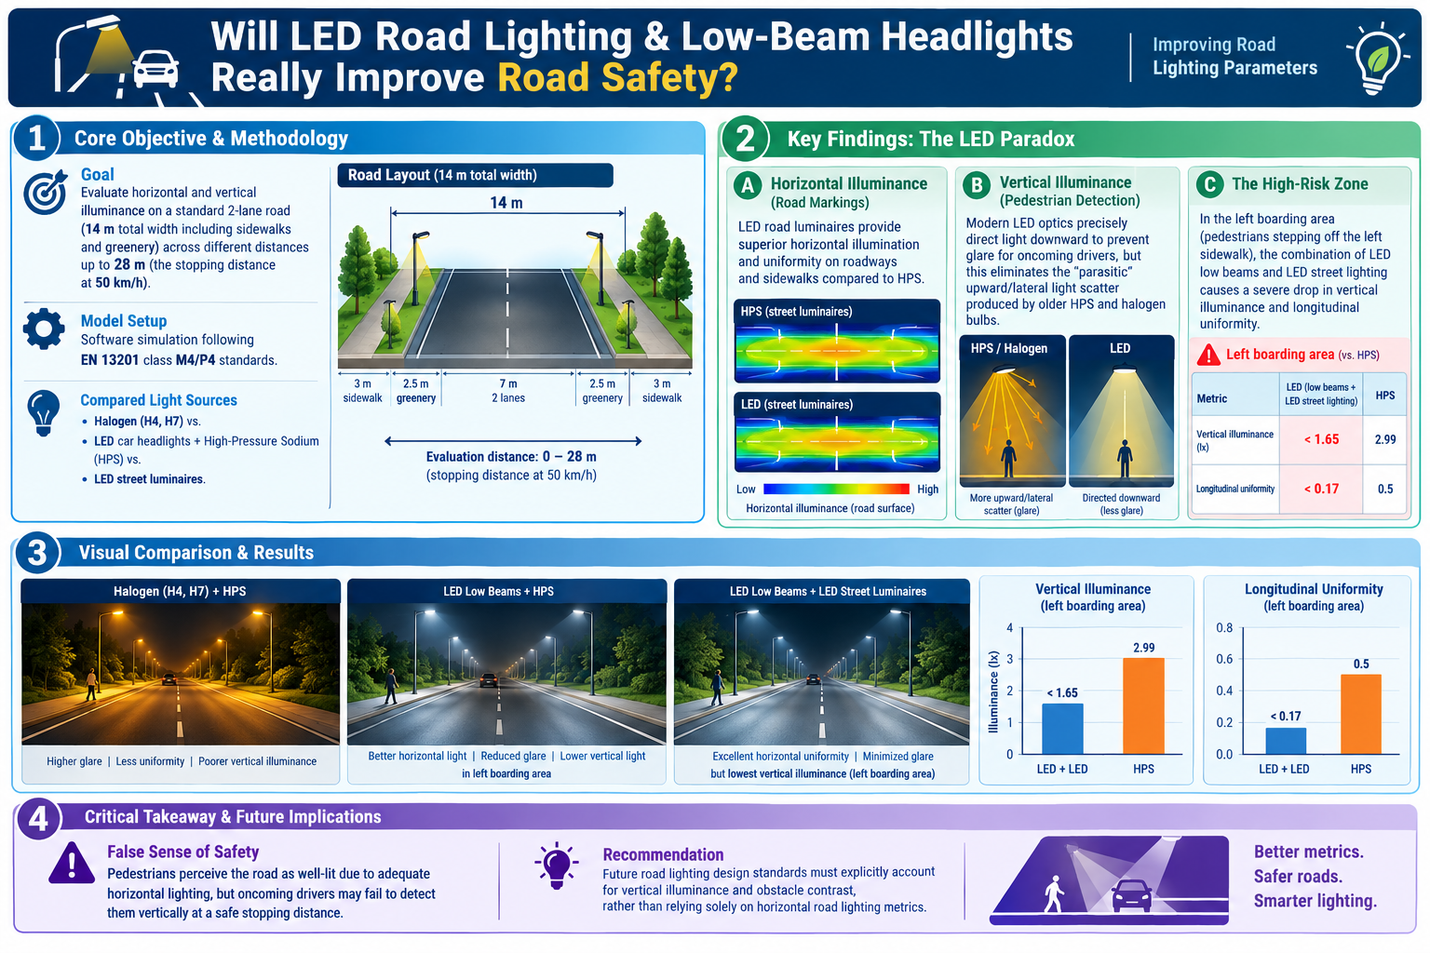

Slide 12
Advanced Bio-Materials, Robotics & Computational Health
Applying core strengths in materials and AI to broader societal challenges
1
SynFormer: 3D Geometric GNNs for Cancer Drug Synergy
3D molecular graphs + Transformer gene-expression encoders; knowledge distillation for
rapid Loewe synergy prediction
2
Antimicrobial Silver Nanoparticle Keypad Coatings
Spherical AgNP surface coatings for high-touch surfaces to inhibit S. aureus and E. coli
3
3D Printable Natural Polymers & Natural Fiber Composites
Cellulose, starch and alginate matrices reinforced with hemp, flax and bamboo within PLA/PP
4
Modular 6-Axis Industrial Robotic Arm
TN-S 230V distribution, WAGO PLC PFC200, stepper drives, Arduino grippers and safety interlocks
8

Slide 13
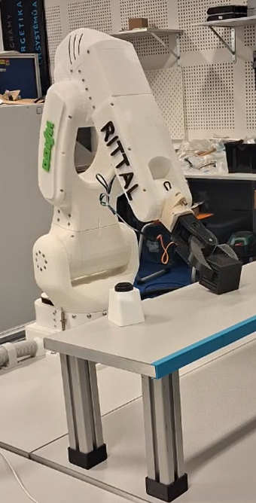

From research concepts to scalable prototypes and deployment
Cross-disciplinary expertise: materials science + AI + automation + electrical systems.
Shared pathway from laboratory validation to real-world pilot demonstrations.
Opportunities for joint publications, proposals, industrial partnerships and technology transfer.
Focus on scalable solutions aligned with sustainability, resilience and smart-city priorities.
We welcome collaborative opportunities, pilot demonstrations and partnerships.
Thank you very much
radomir.gono@vsb.cz
9

