Slide 1



Technical University of Košice
Faculty of Electrical Engineering and Informatics
Department of Electrical Power Engineering
ELECTRIC VEHICLE CHARGING MEASUREMENT
V4 EnergyNet: Academic Networking for Renewable Energy and Smart Power Systems
Online Workshop
Dušan Medveď
7th September 2026

Slide 2
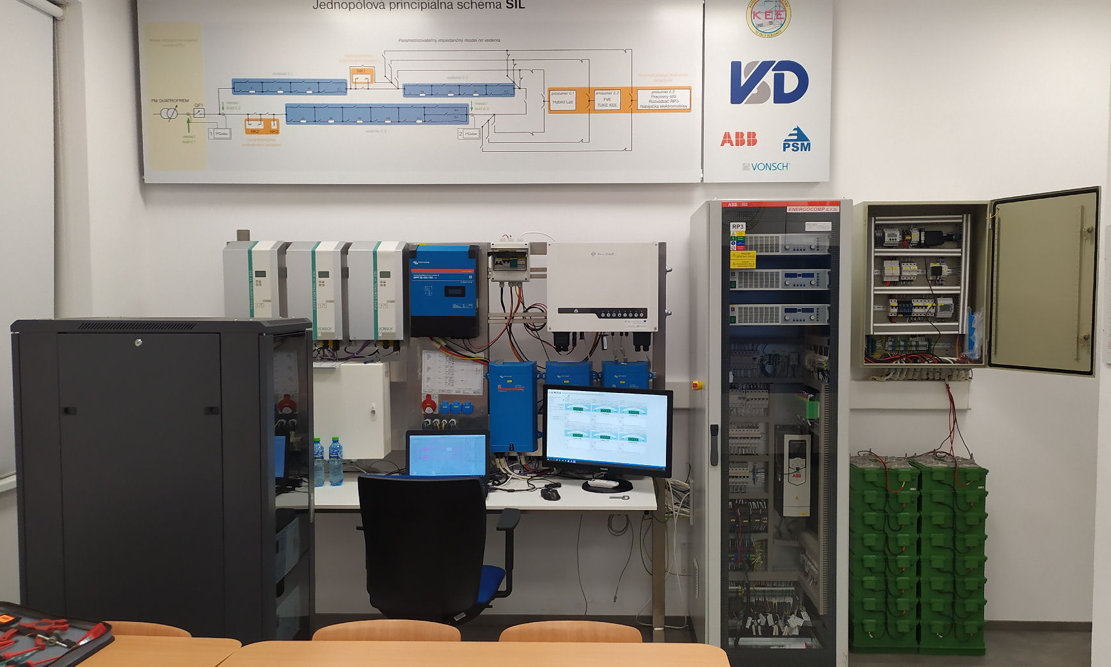
Smart Industry Laboratory
2

Slide 3
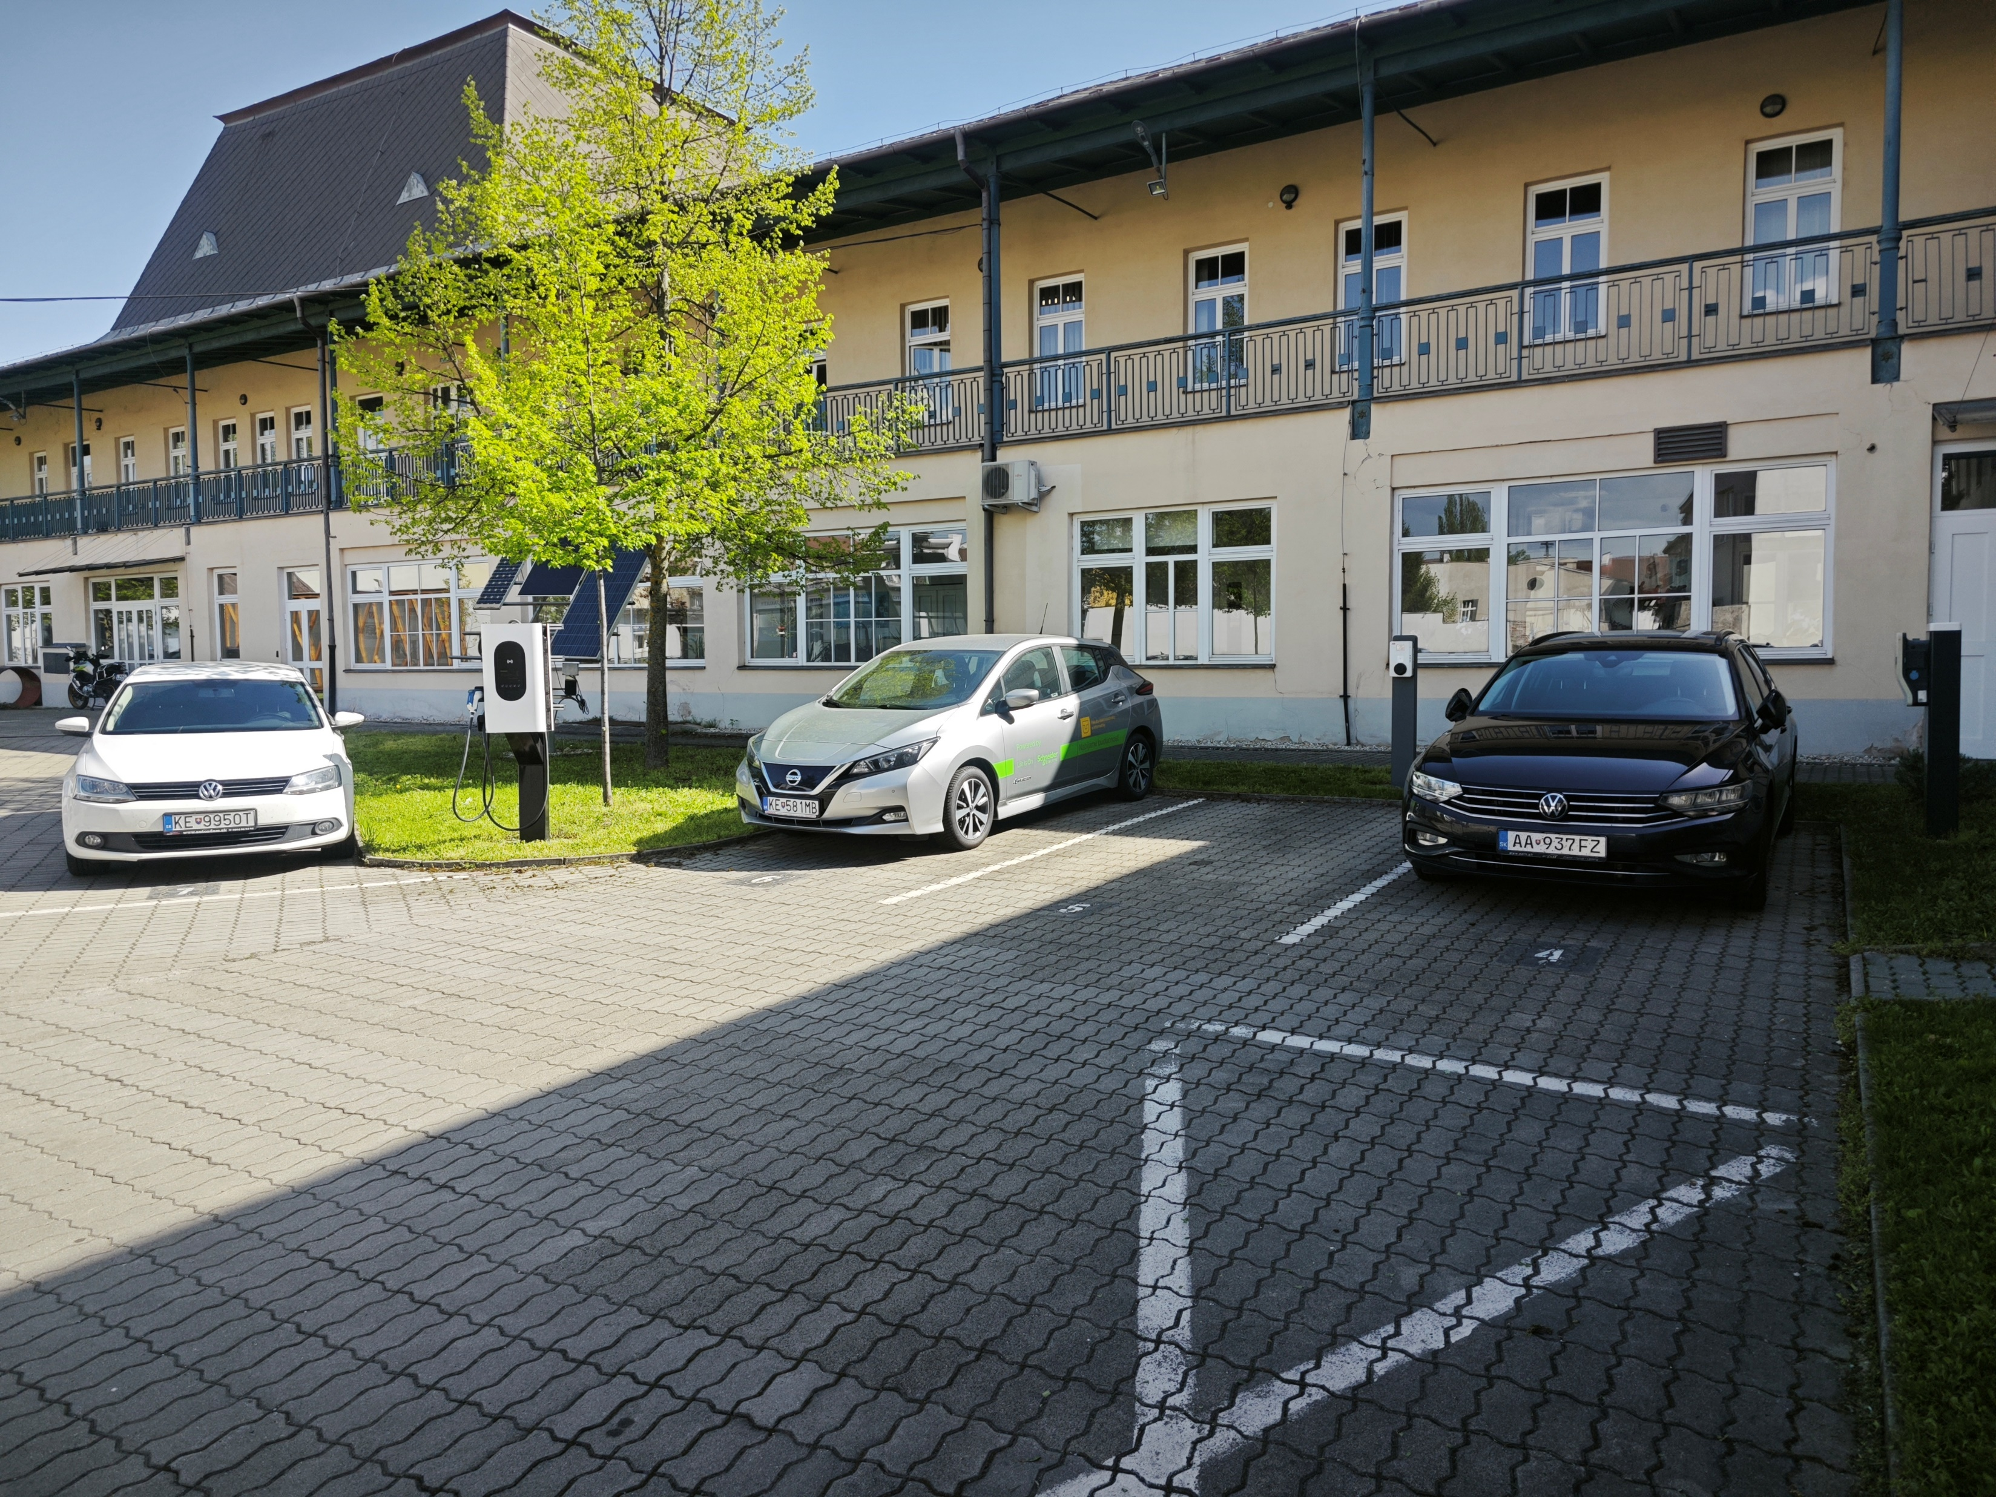
ELECTRIC VEHICLE CHARGING MEASUREMENT
3

Slide 4
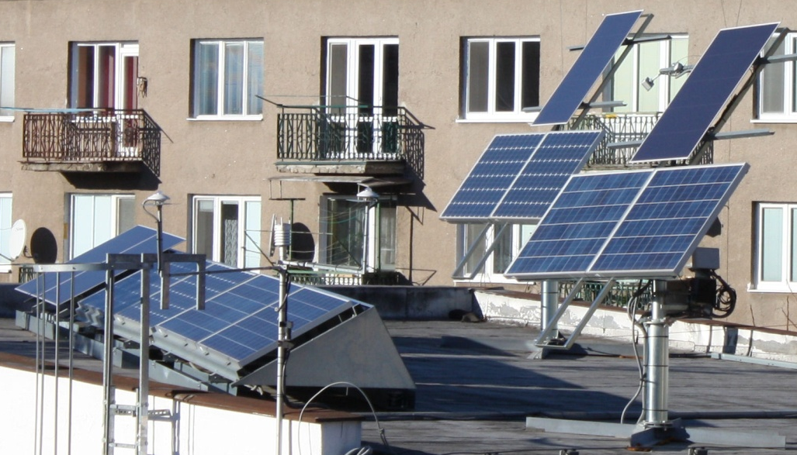
Smart Industry Laboratory – Renewable Energy Sources
4

Slide 5
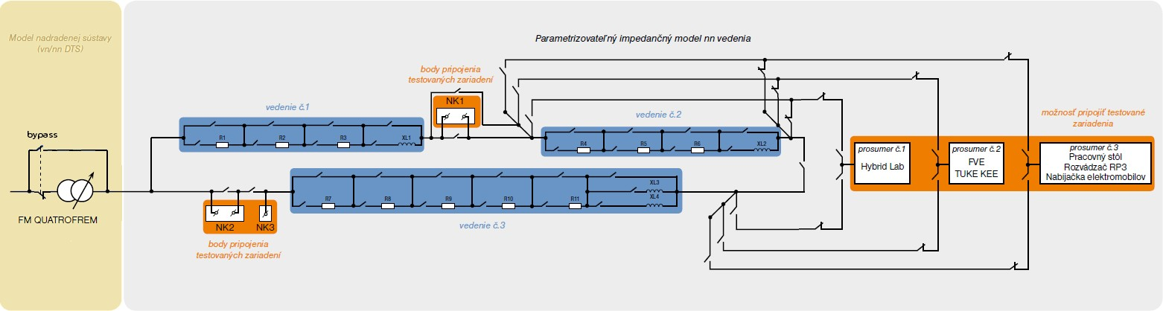



SINGLE-POLE PRINCIPIAL SCHEMATIC SIL
2

Slide 6
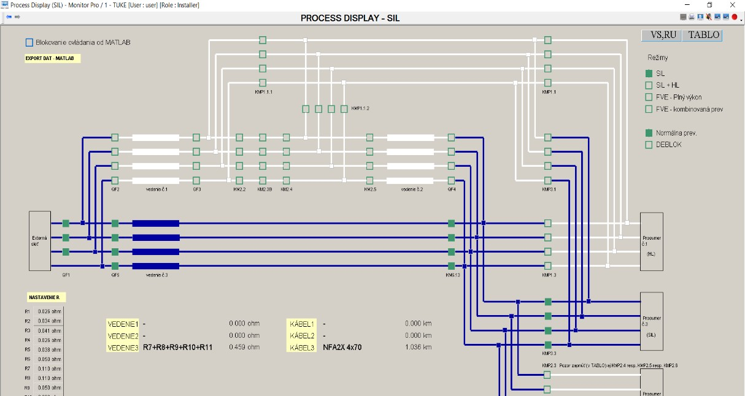
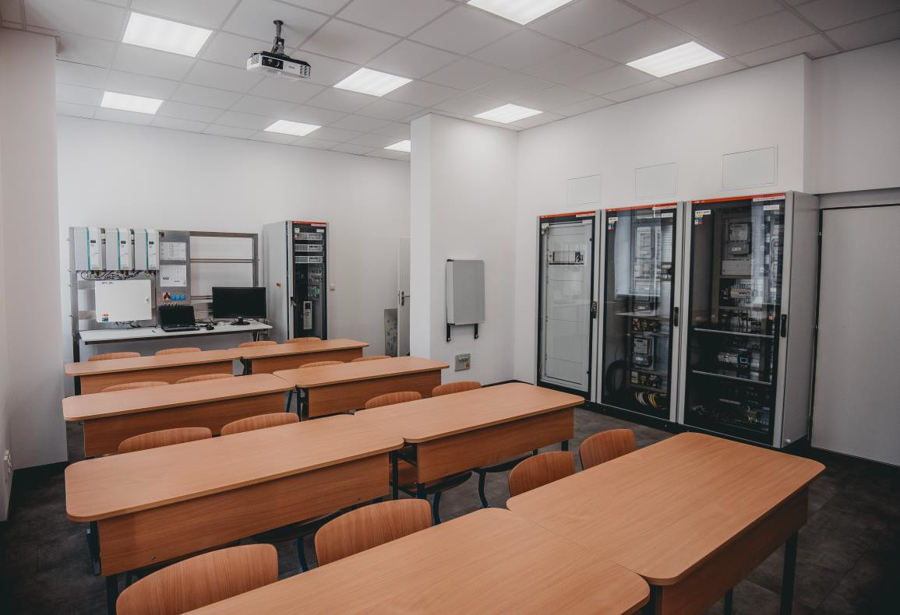
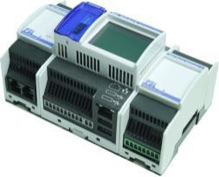
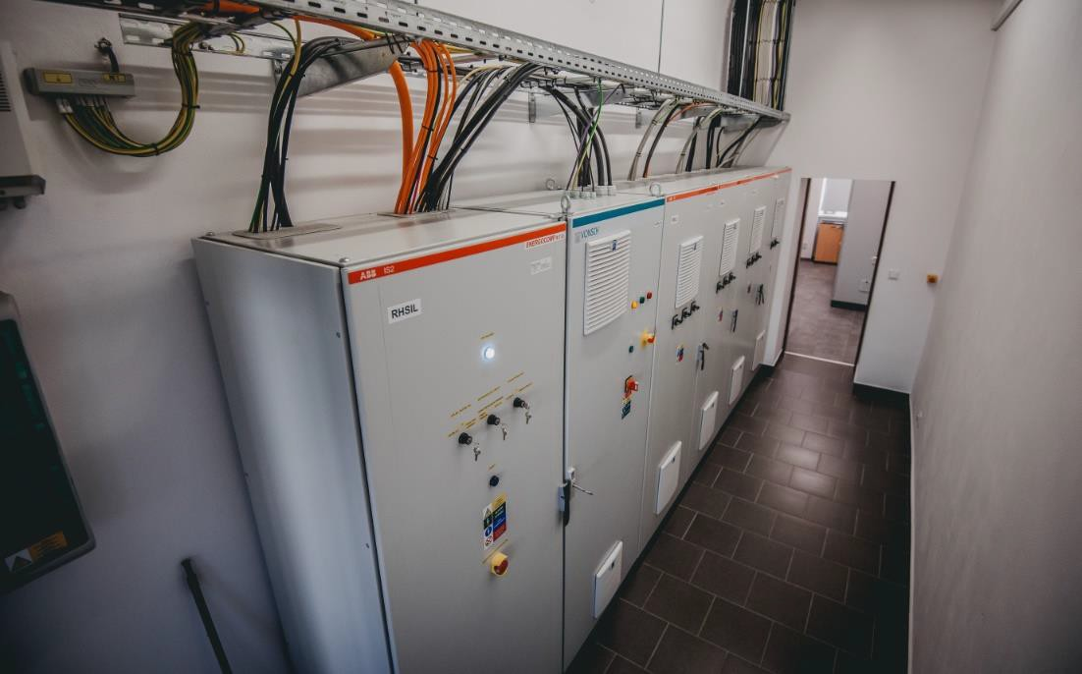
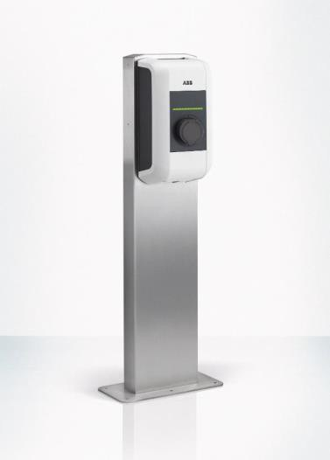
VSD LABORATORY ON THE PREMISES OF TUKE SIL
Class room with model of Prosumer no. 3
4x PQube3
Control system
Prosumer No 3
Preview of the control system screen (SCADA)
2x EV Lunic ABB
"Prosumer" model of family house with two
chargers and photovoltaic panels:
with the possibility of production 3 x 3 kW
Installed group of charging stations (master and slave)
LV line model
Model of superior distribution system
Technical room
3

Slide 7
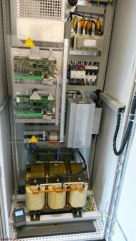
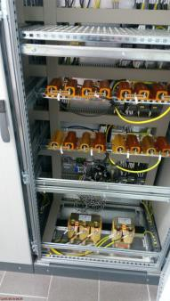
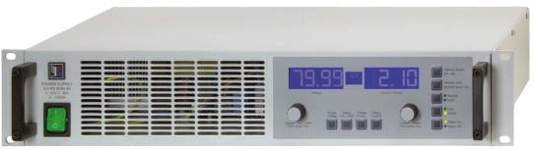
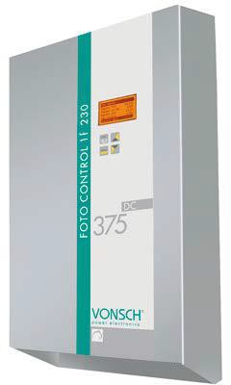
DESCRIPTION OF SMARTINDUSTRYLAB
Model of superior distribution system (QUATROFREM):
  Minimum value of line voltage: 330 V (82% Un).
  Maximum value of line voltage: 450 V (112% Un).
  Minimum value of frequency : 47 Hz (94% fn).
  Maximum value of frequency : 52 Hz (104% fn).
Models of LV lines
  The shortest line: NFA2X 4x70, resp. NAYY-J 4x70, 60 meters.
  The longest line : NAYY-J 4x240, 3.600 meters.
  HS Aluminium Housed Resistors: the resistance does not change by more than 0.0001 Ω
with a change of 1 ° C (reference value 25 ° C).
  Wirewound resistor in alu case: the resistance does not change by more than 0.0003 Ω
with a change of 1 ° C (reference value 25 ° C).
DC voltage source:
  Min - max value of voltage : 0V – 720V (DC)
  Min - max value of real power: 0 W – 3000W
1f invertor:
− AC output: 1x230V ± 10%, 3300 VA
  DC input 200 – 700VDC , input current11,5ADC
7

Slide 8
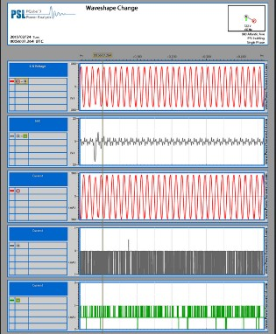
DESCRIPTION OF SMARTINDUSTRYLAB
PQube®3 :
  is an instrument for monitoring electric power systems and environmental conditions
  helps to solve problems that impact the quality and reliability of product or process
  „black box“ for electric power and environment
  a combination of:
    a power/energy meter
    a power disturbance monitor
    a data logger
    a digital fault recorder.
  It’s easy to use. Transfer of the data to computer using a standard flash device like a USB drive or SD card (similar as with a digital camera).
What is recorded:
  records disturbances on the mains circuit: sags/dips, swells, interruptions, frequency variations, impulses, and waveform snapshots.
  records power quality parameters like flicker, unbalance, THD and harmonics.
  generates daily, weekly, and monthly trends/statistics reports automatically
  When equipped with compatible current transformers, PQube 3 also records current waveforms, RMS amps, power and carbon. It measures watts, watt-hours, VAR’s, power factor, and other power-related parameters.
8

Slide 9
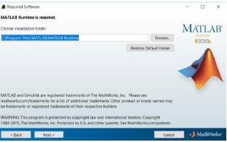
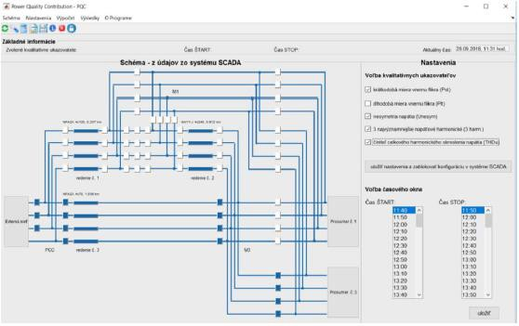
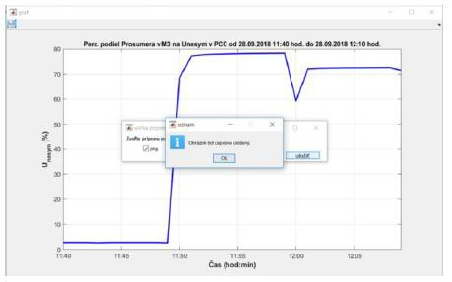
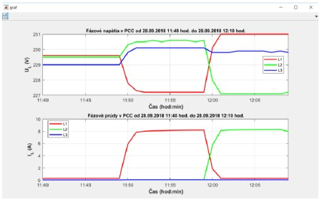
DESCRIPTION OF SMARTINDUSTRYLAB
software PQC :
visualization of the current scheme of the LV electrical network of the SIL laboratory in cooperation with the SCADA system
numerical and graphical representation of the results of measurement of electricity quality indicators and the comparison of the set of indicators with their limit values defined by relevant technical standards or regulations (STN EN 50160)
indicate the exceeding of the limits defined by the relevant technical standards or regulations
Evaluated and visualized quantities :
  the instantaneous flicker value for Incandescent Flicker (Pinst)
  the short term flicker (Pst)
  the mean value of Pinst over previous 2 hours, synchronized
to real-time clock (Plt)
  coefficient of the voltage unbalance (Unes.)
  harmonic voltages (uh)
  total harmonic distortion of supply voltage (THDu)
determination and visualization of percentages of external network , of Prosumer No. 1, of Prosumer No. 2 and of Prosumer No. 3 at the level of electricity quality at the PCC point
export of inputs and output of computations
6

Slide 10
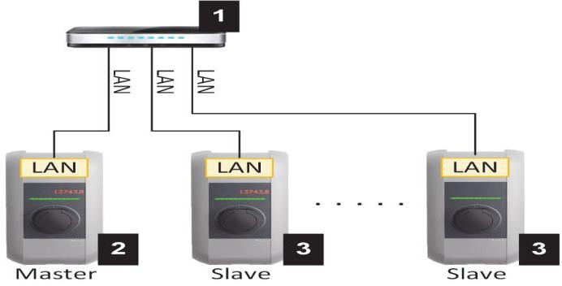
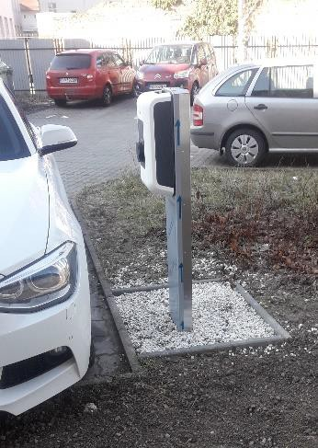
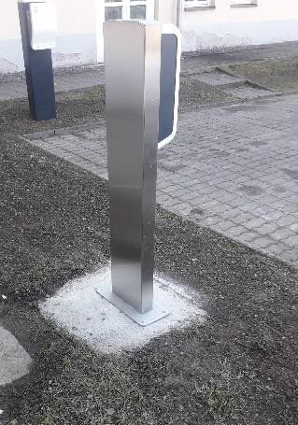
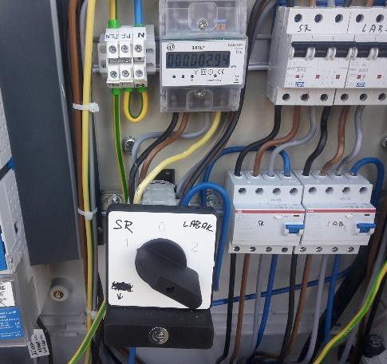
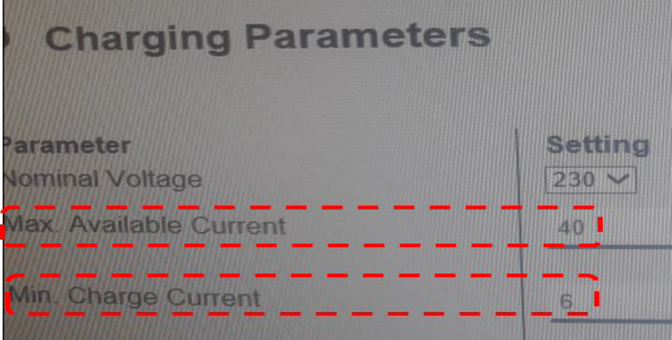
ELECTRIC VEHICLE CHARGING STATIONS
Installed 2 of charging stations ABB 22kWAC. Master:
Powered only by SIL
Data connection via LAN TUKE
Hardware current limit 32 A per phase
Software current limit set in UI for a group of chargers
Activity display and group parameterization via web browser
Master
Slave:
Powered by SIL, or from low voltage switchgear PRIS4
Data connection via LAN TUKE
Hardware current limit 32 A per phase
Activity display via web browser
Slave
Possibility to set min. a max. current for a group of chargers even during charging (without the need to reset the chargers).
It is not possible to change / parameterize the number of phases (3f / 1f) or the
phase sequence (L1, L2, L3 / L2, L3, L1 / ...) during charging.
10

Slide 11
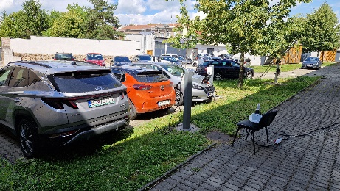
ELECTRIC VEHICLE CHARGING MEASUREMENT
Purpose of measurement :
Obtain the real experience with the operation of a group of charging stations at the same time and on the same section
Monitor the operation of charging stations in the "master - slave" mode
Measure data while charging 1f, 2f, 3f electric cars
11

Slide 12
Monitored control modes of EV
3 types of BEV (battery electric vehicle) with internal charger:
1f – 7.3kW,
2f – 7.3 kW,
3f – 11kW.
Different levels of regulation monitored (e.g. step 5A)
EV safety disconnection at permissible charging current < 6A
Comparison with mode without regulation

Slide 14
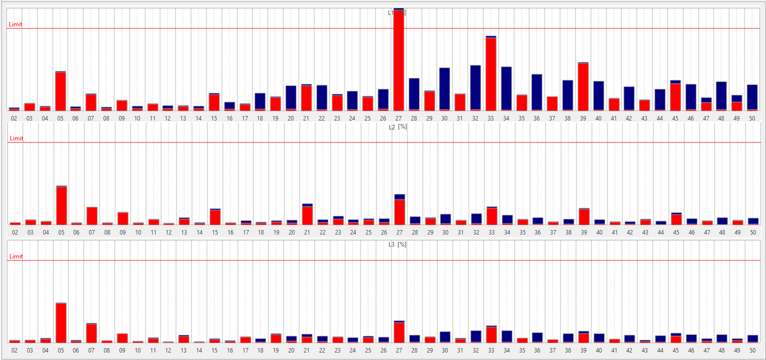
1f – BEV – 20 min of full charge

Slide 15
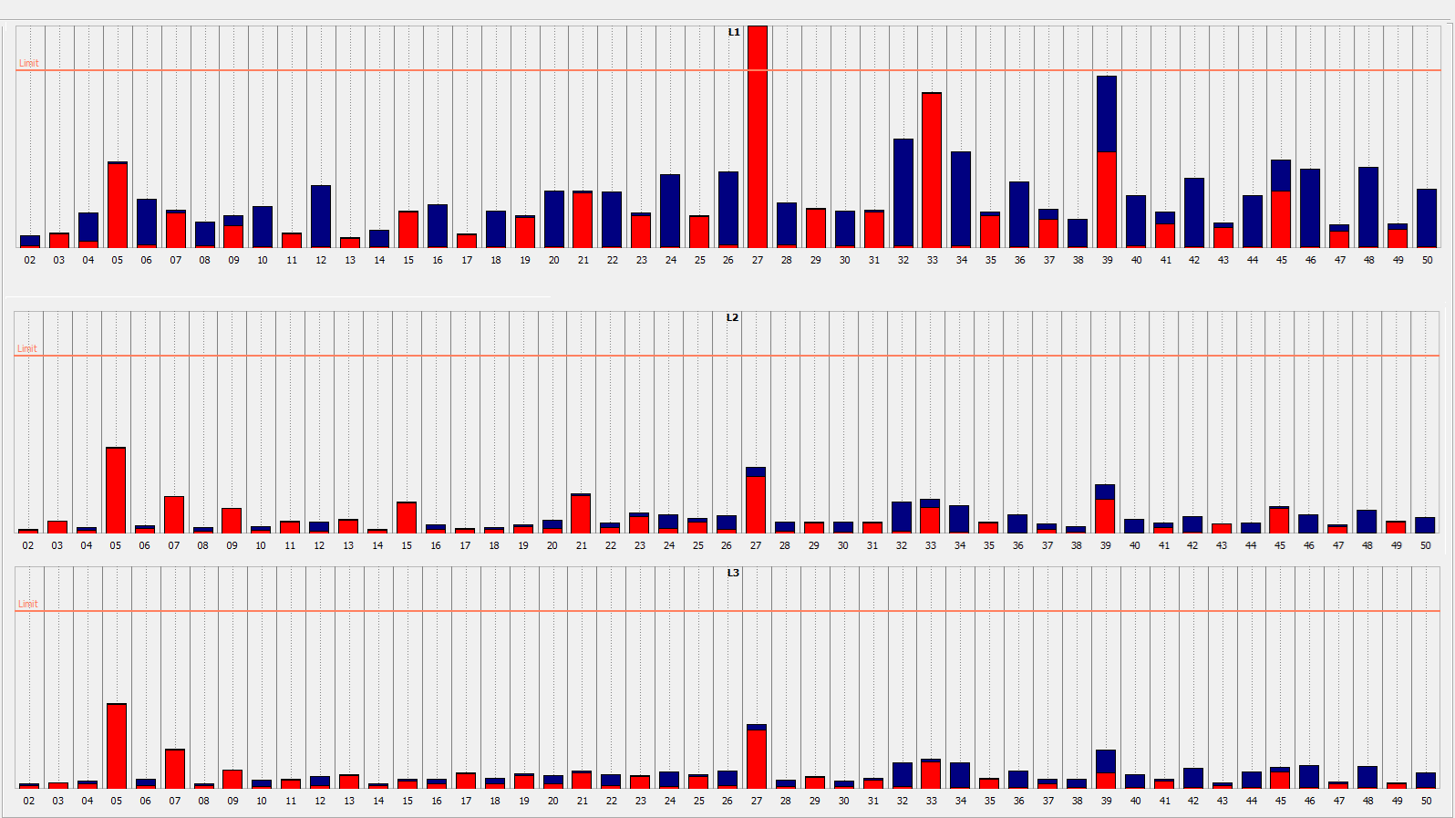
1f – BEV – regulation max → min

Slide 16
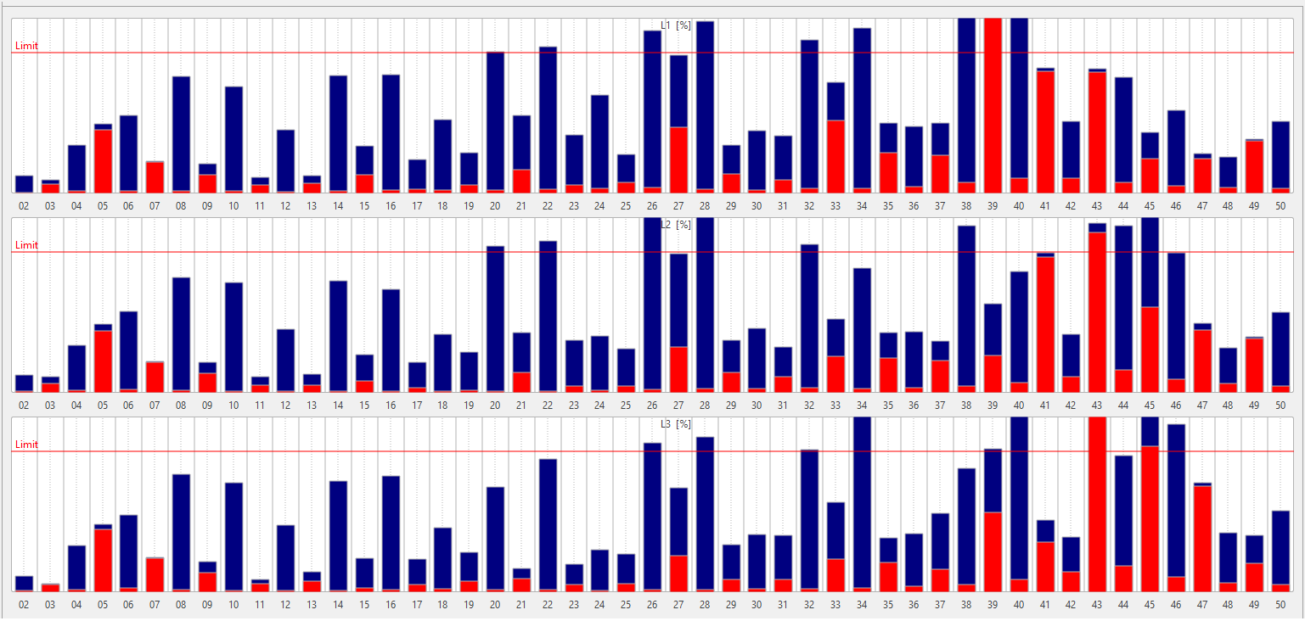
3f – BEV – 20 min of full charge

Slide 17
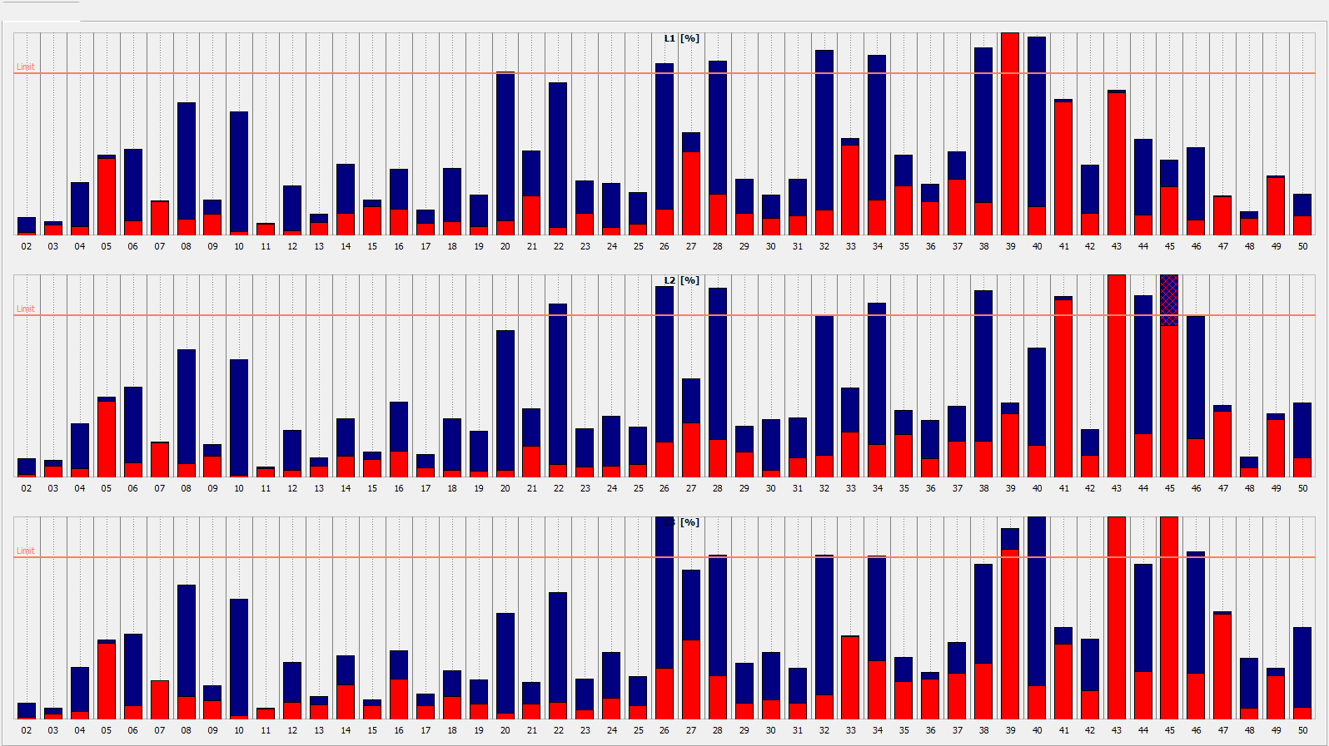
3f – BEV – regulation max → min

Slide 18
Start of charging processes of 3 BEV

Slide 19
Conclusion
  3f EV
  symmetrical load for ES,
  THD limits exceeded from 20H
  1f EV
  unbalance arises
  higher than recommended by EN 50160 (>2%)
  THDV better than 3f EV
  Other challenges: new generation EV measurement, V2G, education of new generation for new technologies

Slide 20
Thank you for your attention
Dušan Medveď
Department of Electrical Power Engineering
Faculty of Electrical Engineering and Informatics
Technical University of Košice
Mäsiarska 74
042 01 Košice
E-mail: kee.fei@tuke.sk
https://kee.fei.tuke.sk
Tel: +421 / 55 / 602 3550

