Slide 1
Analyzing the Association between Solar and Wind Generation and Electricity Prices in Germany using GUHA Association Rules
František Kurimský
V4 EnergyNet online workshop
07.09.2026
Department of Electric Power Engineering,
Technical University of Košice
Notes:
Hello everyone, my name is František Kurimský, I am from the Department of Electric Power Engineering at the Technical University of Košice in Slovakia. Today I will present our work on analyzing the relationship between solar and wind energy generation and electricity prices in Germany, using a data mining method called GUHA. This research covers ten years of data, from 2015 to 2024.

Slide 2
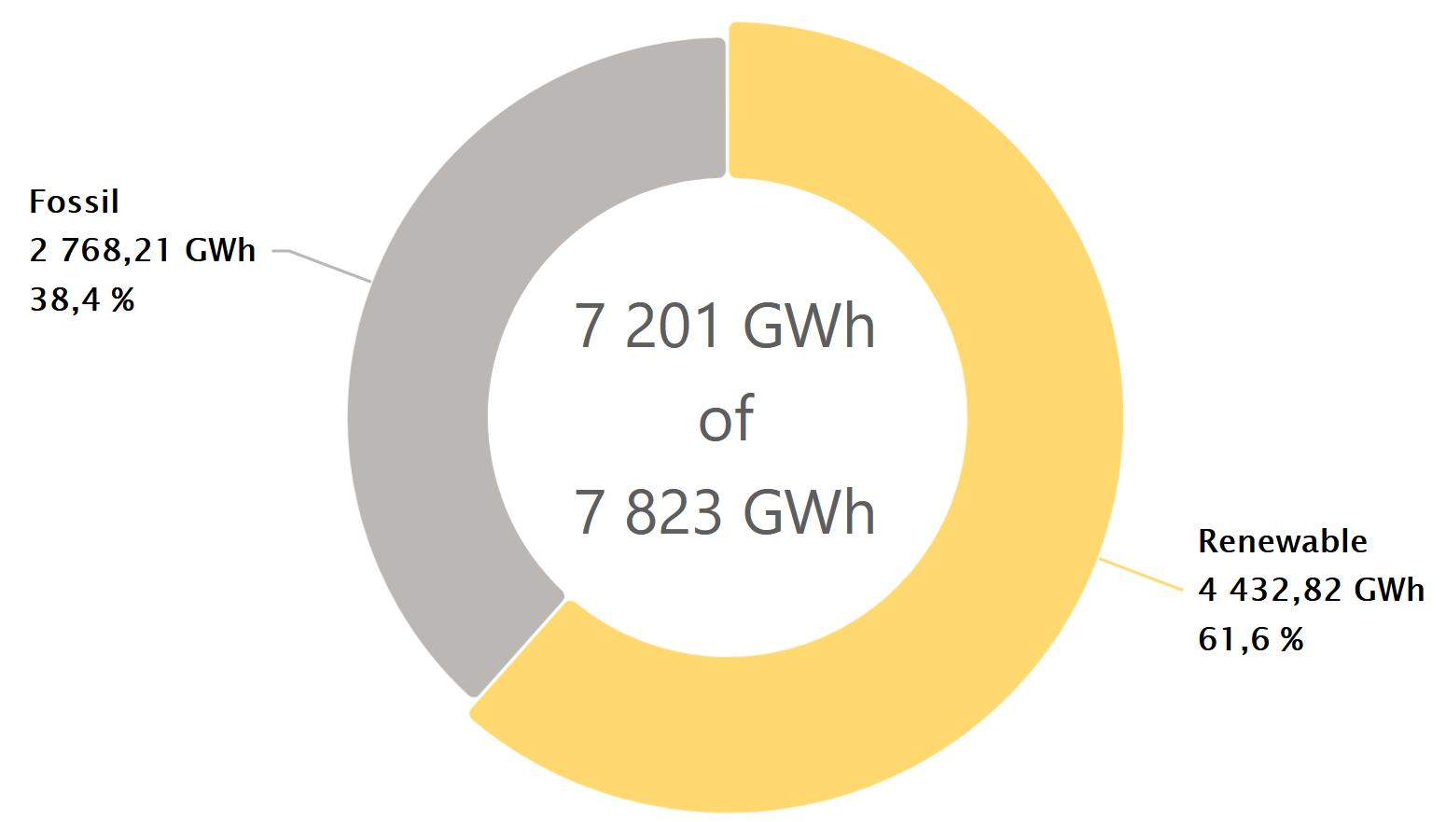
Motivation
Europe is adding wind and solar
fast - driven by Fit for 55
  EU target: 55% less
  greenhouse gas emissions
  by 2030
  Forces rapid growth of
  wind and solar across Europe
~60% of German electricity from
renewables in 2026
Solar and wind power now cover a large share of electricity supply
Renewable energy changes how electricity prices behave
Traditional methods rely on pre-set assumptions - they can miss hidden patterns
Data-driven approach to explore these relationships freely
Notes:
"Europe is rapidly expanding wind and solar, and this is being driven by the Fit for 55 package — the EU's commitment to cut greenhouse gas emissions by 55% by 2030. This is forcing every member state, including Germany, to grow renewables fast."
"Germany is leading this transition. As you can see on the right, renewables already account for over 61% of electricity generation — that is 4,400 gigawatt hours out of roughly 7,800. Fossil fuels are now the minority at just 38%."
"But this shift changes how electricity markets work. When a lot of wind and solar generate at the same time, prices behave very differently than in a fossil-fuel dominated market. Prices can drop sharply, sometimes even go negative, or spike during low generation periods."
"Traditional analysis methods rely on pre-set assumptions about what patterns to look for — and because of that, they can easily miss hidden or time-specific relationships in the data. Our study takes a data-driven approach — we let the data reveal these patterns freely, without deciding in advance what we expect to find."

Slide 3
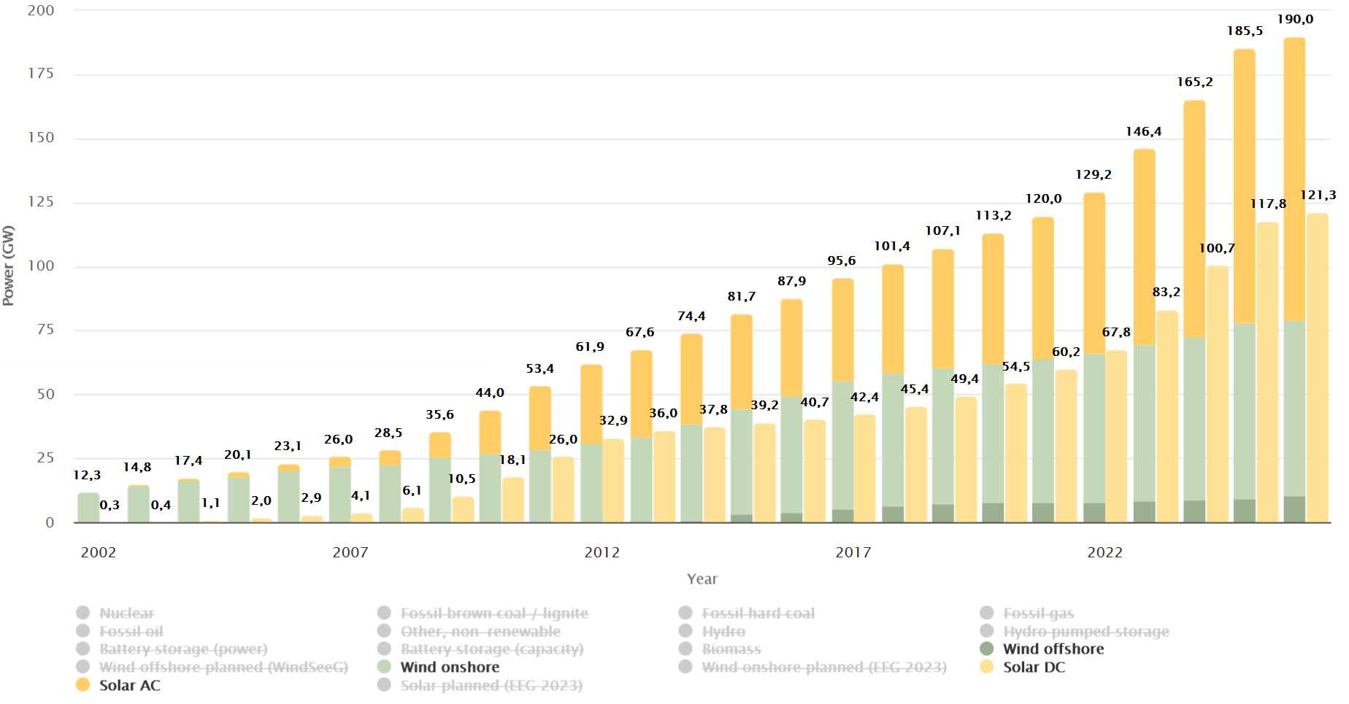
Growth of Renewable Capacity in Germany
Notes:
"Europe is rapidly expanding wind and solar, and this is being driven by the Fit for 55 package — the EU's commitment to cut greenhouse gas emissions by 55% by 2030. This is forcing every member state, including Germany, to grow renewables fast."
"Germany is leading this transition. As you can see on the right, renewables already account for over 61% of electricity generation — that is 4,400 gigawatt hours out of roughly 7,800. Fossil fuels are now the minority at just 38%."
"But this shift changes how electricity markets work. When a lot of wind and solar generate at the same time, prices behave very differently than in a fossil-fuel dominated market. Prices can drop sharply, sometimes even go negative, or spike during low generation periods."
"Traditional analysis methods rely on pre-set assumptions about what patterns to look for — and because of that, they can easily miss hidden or time-specific relationships in the data. Our study takes a data-driven approach — we let the data reveal these patterns freely, without deciding in advance what we expect to find."

Slide 4
What Makes This Different
Econometric models rely on pre-defined model assumptions
Forecasting models are data-driven but optimized for prediction
GUHA
  Free from pre-defined assumptions
  Focused on interpretable relationships
  Explores all possible combinations systematically
Notes:
"Existing research on renewables and electricity prices falls into two groups. Econometric models rely on pre-defined model assumptions — they are built around a specific structure before even looking at the data. Forecasting models are more data-driven, but their goal is purely prediction accuracy — they are not designed to help us understand what is actually happening in the market."
"Neither of these approaches is designed to freely discover conditional, time-specific patterns. For example — what specifically happens at hour 18 in a low-wind year, or during a midday solar peak in summer. These patterns exist in the data, but traditional methods are not built to find them."
"In this study we use an exploratory approach with no pre-defined assumptions. We focus on interpretable and readable results, and we systematically explore all possible combinations of conditions. The patterns emerge directly from the data."

Slide 5
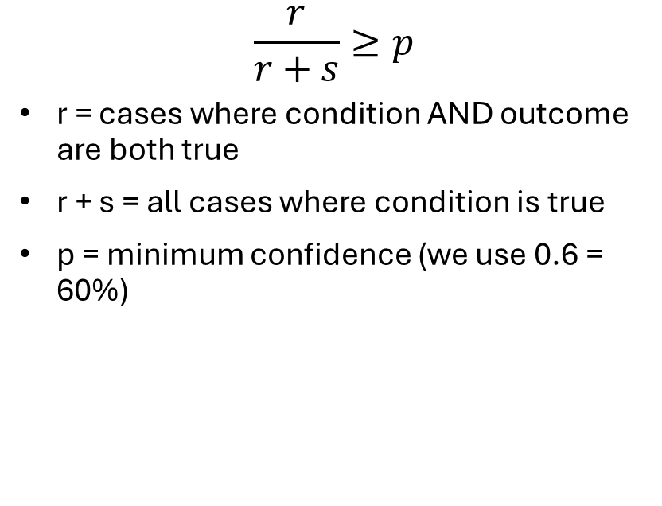
What is GUHA?
General Unary Hypotheses Automaton Hájek et al., 1966
One of the earliest data mining methods
Automatically generates and tests all possible patterns
No pre-formulated hypotheses
Results are simple IF-THEN association rules
$$\frac{r}{r+s}≥p$$
r = cases where condition AND outcome are both true
r + s = all cases where condition is true
p = minimum confidence (we use 0.6 = 60%)
IF solar is high AND wind is high → price is low (confidence 100%)
Notes:
"GUHA was developed in 1966 and is one of the earliest data mining methods. Instead of testing what you already expect, it automatically generates and tests all possible patterns in the data."
"The results are simple if-then rules. The math behind it is also simple — out of all hours where the condition is true, at least 60% of them must also show the expected price outcome. That is what we call confidence."
"For example — every single time solar was high and wind was high, the price was in the lowest category. 100% confidence."

Slide 6
Literature Overview
94
767
14
8.16
Publications
analyzed
Total
citations
h-index
(corpus)
Avg citations
per paper
Keyword co-occurrence bibliometric analysis
Central topics: data mining, association rules, GUHA method
195 distinct keywords - majority appear only once
GUHA applied across wide range of domains
Unique keywords related to financial markets, behavioral finance, customer equity
Notes:
"To understand how established GUHA is in the scientific community, we did a bibliometric analysis. We found 94 publications with 767 citations total and an h-index of 14 — which shows the method has a solid position in data mining research."
"We also did a keyword co-occurrence analysis. Out of 195 distinct keywords, most appear only once — which tells us GUHA has been applied across a very wide range of domains. Not just data mining, but also financial markets, behavioral finance, and customer equity."
"As you can see in the network, the three central topics are data mining, association rules and GUHA method — which is exactly what our study builds on."

Slide 7
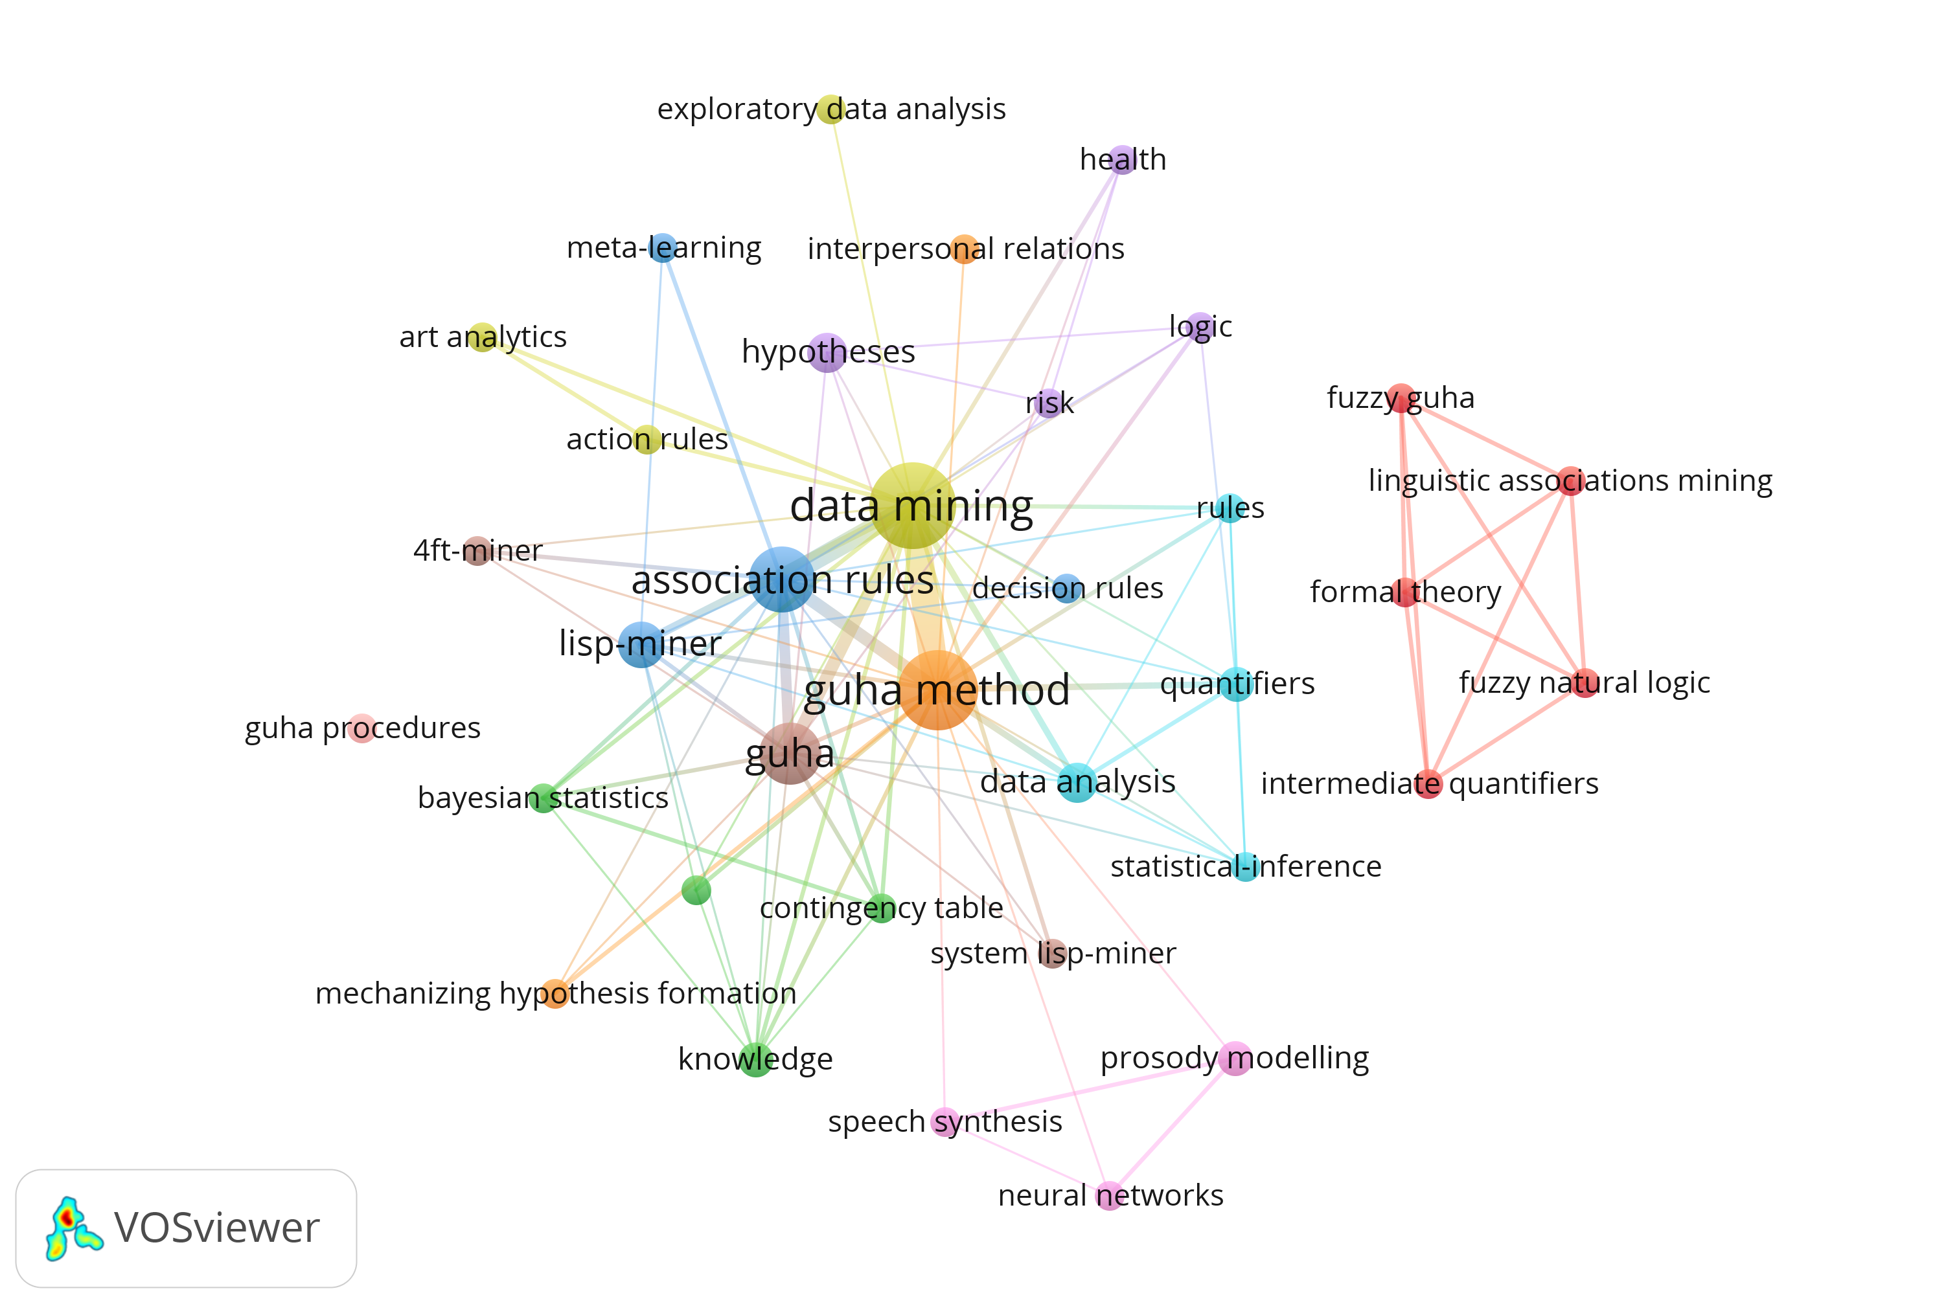
Literature Overview
94
767
14
Publications
analyzed
Total
citations
h-index
(corpus)
Notes:
"This is the keyword co-occurrence network from our bibliometric analysis. The three dominant nodes are data mining, association rules and GUHA method — the core of the research field."
"Around them you can see methodological tools like lisp-miner, 4ft-miner and statistical inference. The wide spread of keywords across very different domains confirms that GUHA has been applied across many scientific fields — which motivates our application to energy market data."

Slide 8
Data Source & Preprocessing
Source
Energy-Charts portal (public API)
Solar
10 equal-width categories
(per year)
Period
2015 – 2024 (10 years)
Wind Onshore
5 equal-width categories
(per year)
Country
Germany
Wind Offshore
5 equal-width categories
(per year)
Resolution
Hourly (CET/CEST)
Price
5 quantile-based categories (per year)
Key vars
Solar, Wind Onshore, Wind Offshore, Price, Hour, Year
Hour / Year
Already categorical
4ft-Miner: antecedent length 3 - 5 | min. support 30 | min. confidence 60%
Consequent fixed to price_cat
Notes:
"For our analysis we used data from the Energy-Charts portal — a public platform providing hourly electricity generation and price data for Germany. We used ten years of data, from 2015 to 2024."
"We selected six key variables — solar, wind onshore, wind offshore, price, hour and year. Hour and year are already categorical, so no conversion was needed for them."
"For solar we created 10 equal-width categories per year, and for both wind onshore and offshore we created 5 equal-width categories per year. For price we used quantile-based categories — meaning each category contains roughly the same number of observations. All categories were created separately for each year to capture how the market changed over time."
"For the GUHA mining we used 4ft-Miner. Each rule must have between 3 and 5 conditions in the antecedent, minimum support of 30 cases, and minimum confidence of 60%. The consequent is always fixed to the price category."

Slide 9
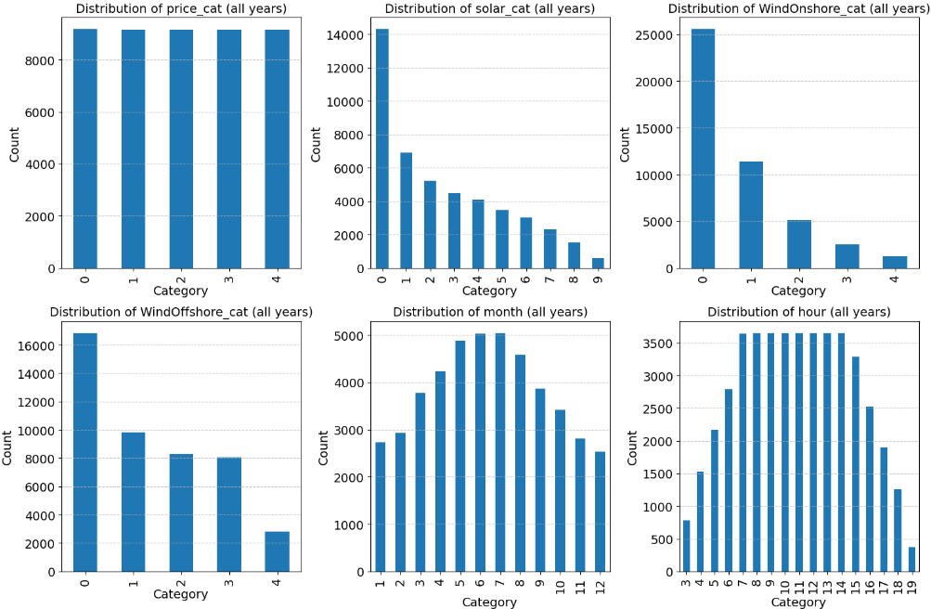
Notes:
"This figure shows the distribution of all categorical variables across the full dataset. Let me quickly walk you through the key observations."
"Price categories are almost perfectly balanced — that is expected because we used quantile-based discretization, so each category has roughly the same number of observations."
"For solar, category 0 is by far the most frequent — even though we filtered for solar-active hours, in many of those hours solar is not generating at full capacity due to clouds and other factors."
"For wind onshore and offshore, most observations fall in the lowest categories — meaning low wind production is the most common condition in our dataset."
"The hour distribution starts at 3 and ends at 19 — directly reflecting our solar filter. And for months, summer months appear more frequently than winter — again because of the solar filter."

Slide 10
Results
Abundance → Low Price
High solar + wind combinations dominate rules. Midday hours reinforce the merit-order compression effect.
Scarcity → High Price
Low renewable output, especially at peak evening hours in 2024, produces high-price signals.
Middle Categories
Only 21 rules for price_cat 1 - 3. These are year- and hour-specific (early morning, 2016 - 2021).
Notes:
"Under our defined constraints — minimum support of 30 cases and minimum confidence of 60% — we extracted 248 association rules in total. The first and most striking observation is how unevenly these rules are distributed across price categories."
"125 rules describe the lowest price category — price_cat 0. 102 rules describe the highest price category — price_cat 4. Together that is 227 rules out of 248 — almost 90% of all rules describe only the extreme price categories. The middle categories — price_cat 1, 2 and 3 — have only 5, 6 and 10 rules respectively."
"This is already a very interesting finding on its own. It tells us that extreme price behavior — both very low and very high prices — is structurally more predictable and more rule-dense than moderate price levels. The market behaves most consistently under extreme renewable conditions."
"On the right side you can see the two dominant patterns we found. When renewable generation is abundant — high solar combined with high wind — prices are pushed to the lowest category. This is the classic merit-order effect. On the other hand, when renewable generation is scarce — especially during evening peak hours in recent years like 2024 — prices are pushed to the highest category. The middle categories are much more complex and year-specific, concentrated in early morning hours in years like 2016 and 2021."

Slide 11
Results: Rules associated with LOW Prices
solar_cat(5) ∧ WindOnshore_cat(3) ∧ WindOffshore_cat(2)
100%
n = 31
Deterministic — high solar + moderate-high wind → always lowest price
solar_cat(3) ∧ WindOnshore_cat(4) ∧ WindOffshore_cat(2)
94.6%
n = 35
Near-deterministic renewable abundance configuration
solar_cat(5) ∧ WindOnshore_cat(2) ∧ WindOffshore_cat(3)
85.5%
n = 100
Highest-support low-price rule (100 cases)
solar_cat(5) ∧ WindOnshore_cat(2) ∧ hour(13)
93.3%
n = 56
Intra-day effect: solar peak at noon → price compression
solar_cat(6) ∧ WindOnshore_cat(2) ∧ hour(12)
92.9%
n = 39
Midday solar-intensive hour linked to systematically low prices
Notes:
"Let me walk you through the most important rules associated with low prices. We found 125 rules in total for this category. The most striking one is solar_cat 5, wind onshore category 3 and wind offshore category 2 — this rule achieves 100% confidence in 31 cases. This means every single time these conditions occurred in our ten year dataset, the price was in the lowest category. No exceptions."
"The second and third rules are near-deterministic as well — 94.6% and 85.5% confidence. These all share the same characteristic — high solar combined with moderate to high wind production. The message is very clear — when renewables are abundant, this consistently co-occurs with the lowest price category."
"The last two rules introduce a time dimension. Solar_cat 5 with wind onshore category 2 at hour 13 — 93.3% confidence in 56 cases. Solar_cat 6 with wind onshore category 2 at hour 12 — 92.9% confidence in 39 cases. These midday rules show that the association with low prices is not just about how much renewable energy is generated — it is also very specifically linked to the midday solar peak hours. This is direct evidence of the intra-day merit-order effect in our data."

Slide 12
Results: Rules associated with HIGH Prices
solar_cat(0) ∧ WindOnshore_cat(0) ∧ year(2024)
66.9%
n = 463
Highest-support rule — renewable scarcity in 2024 → high prices
solar_cat(0) ∧ WindOnshore_cat(0) ∧ WindOffshore_cat(0) ∧ year(2024)
74.3%
n = 260
Triple-zero renewable → even stronger high-price signal
solar_cat(0) ∧ WindOnshore_cat(0) ∧ year(2024) ∧ hour(18)
95.8%
n = 91
Evening peak hour + scarcity → near-deterministic high price
solar_cat(0) ∧ WindOnshore_cat(0) ∧ WindOffshore_cat(0) ∧ year(2024) ∧ hour(18)
98.0%
n = 50
Most extreme high-price rule — 98% confidence at evening peak
solar_cat(0) ∧ WindOnshore_cat(0) ∧ hour(8)
71.7%
n = 193
Morning low-renewable hours also systematically expensive
Notes:
"Now the opposite picture — rules associated with the highest price category. We found 102 rules here. The pattern is completely symmetric to what we saw for low prices — but this time it is about renewable scarcity, not abundance."
"The highest support rule is solar_cat 0, wind onshore category 0 and year 2024 — 463 cases with 66.9% confidence. This is by far the most frequent rule in our entire dataset. In 2024, when both solar and wind were in their lowest category, the price was in the highest category almost 67% of the time."
"When we add wind offshore category 0 as well — so all three renewables at their minimum simultaneously — the confidence jumps to 74.3% in 260 cases. When all three renewables are scarce at the same time, the association with high prices becomes even stronger."
"But the most extreme rules involve the time dimension. Solar_cat 0, wind onshore 0, year 2024 and hour 18 — evening peak hour — shows 95.8% confidence in 91 cases. And when we add wind offshore 0 to that same condition, confidence reaches 98% in 50 cases. During the evening peak in 2024, when no renewables were generating, the price was almost always in the highest category."
"Even outside of 2024, morning hours show this pattern. Low solar and low wind at hour 8 is associated with the highest price category with 71.7% confidence across 193 cases — showing this is not just a 2024 phenomenon but a recurring structural pattern across the full ten years."

Slide 13
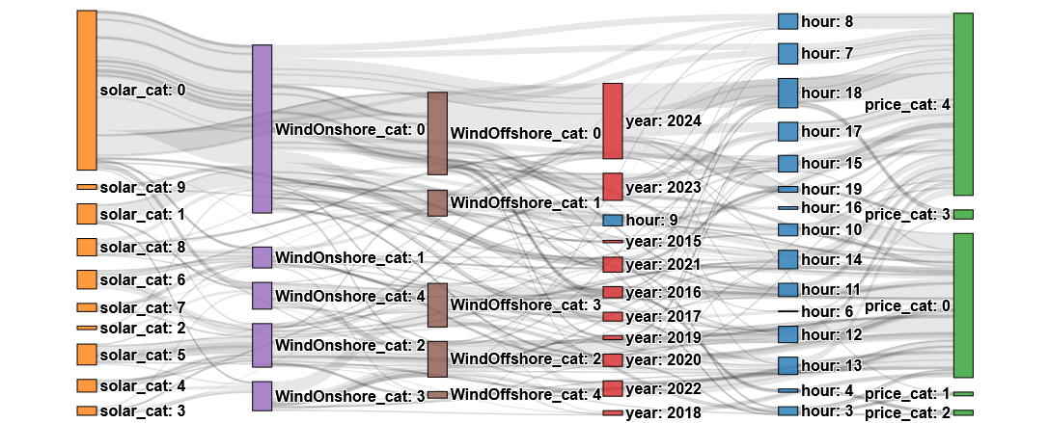
GUHA Association Rules - Sankey Diagram
Notes:
"This Sankey diagram visualizes all 248 association rules we extracted. Each flow represents a chain of conditions — starting from solar category on the left, through wind onshore, wind offshore, year and hour — all flowing into the price category on the right."
"You can immediately see two dominant patterns. The large orange block at the top is solar_cat 0 — low solar — and most of its flow goes to the right side towards price_cat 4 — the highest prices. On the other hand, the lower solar categories with higher wind categories flow towards price_cat 0 — the lowest prices."
"The width of each flow represents how many cases that rule covers — so the thicker the line, the more frequently that combination occurred in our ten year dataset."
"This diagram is mainly descriptive — it gives a complete overview of all discovered associations at once.

Slide 14
Conclusions & Future Work
High solar + wind output is strongly associated with the lowest price category, including deterministic rules at 100% confidence
Low renewable output during evening peak hours (e.g. hour 18, year 2024) is associated with HIGH prices (up to 98% confidence)
GUHA produces interpretable, hypothesis-free rules that complement regression and ML forecasting approaches
Extend to nighttime and winter periods (remove solar filter)
Include demand-side and cross-border trading variables
Multi-market comparison beyond Germany
Notes:
"To summarize our key findings — high solar and wind generation is strongly associated with the lowest price category, with some rules reaching 100% confidence. On the other side, low renewable output during evening peak hours — specifically hour 18 in 2024 — is associated with the highest price category, up to 98% confidence."
"Year-specific patterns also show that the market structurally evolved over the decade — price volatility peaked in 2021 and 2022 and partially normalized in 2024."
"Importantly, GUHA produced fully interpretable, hypothesis-free rules that complement existing regression and forecasting approaches — not replacing them, but adding a different perspective."
"For future work we plan to extend the analysis to nighttime and winter periods, include demand-side and cross-border variables, and apply formal validation. We also want to extend the analysis beyond Germany to other European markets."

Slide 15




Thank you
Questions and discussion
František Kurimský
Department of Electric Power Engineering
Technical University of Kosice, Slovakia
Notes:
Thank you for your attention. To summarize the key messages: wind value decline is real and growing in high-penetration markets like Germany. Poland still has good conditions but needs to prepare. Capture price and capture rate are essential tools for evaluating wind projects. The success of Fit for 55 depends on improving market design - not just building more turbines, but also building storage, better cross-border grids, and smarter contract mechanisms. I am happy to answer any questions.

