Slide 1
Research on electrical discharges in nanofunctional transformer oil
Ing. Kristián Glajc
KEE FEI

Slide 2
Motivation and Significance of the Research
• Power transformers are key components of electrical power systems.
• Liquid insulation provides both electrical insulation and cooling.
• Electrical discharges are among the main degradation mechanisms of oil insulation.
• The reliability of the insulation system directly affects the service life of the equipment.

Slide 3
Electrical Discharges in Liquids
Liquid dielectrics differ in their properties from gaseous and solid insulating materials.
The high density and molecular interactions within the liquid influence the motion of charge carriers.
Under an applied electric field, dynamic local processes occur, such as:
                Increase in liquid temperature
                Formation of gaseous cavities and microbubbles
                Electrostrictive phenomena

Slide 4
Effect of Nanoparticles on Streamers
• The presence of nanoparticles leads to a reduction in streamer propagation velocity.
• Changes in the morphology of streamer channels are observed.
• The extent of these effects depends on the type and concentration of nanoparticles.

Slide 5
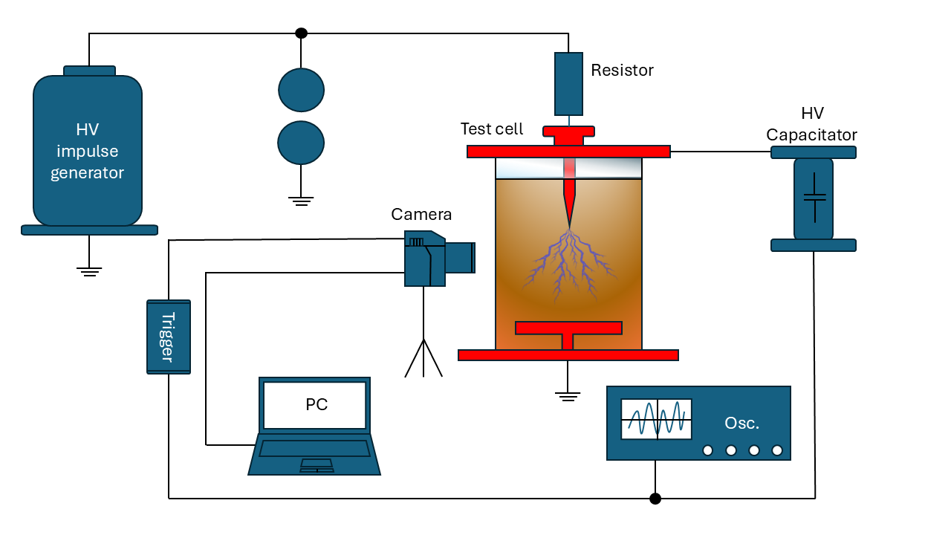

Measurement Procedure
• needle-to-plane electrode configuration.
• Controlled oil temperature.
• Application of lightning impulse voltage.
• Positive and negative polarity.
• Determination of breakdown voltage and time to breakdown.
• High-speed ICCD camera.
• Time synchronization of the camera and impulse generator.
• Evaluation of streamer morphology.
• Determination of streamer propagation length and velocity.
• Comparison of pure oil and nano-functionalized oil.
Fig. 1 Illustrative schematic of the measurement setup.

Slide 6
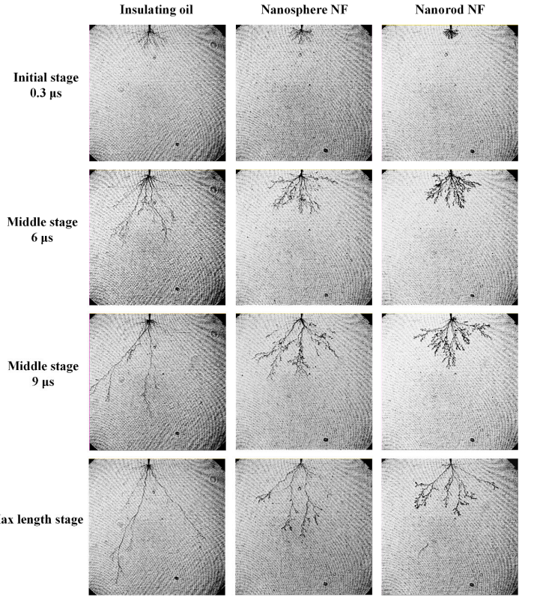
High-Speed Camera Images
Illustration of high-speed images showing the propagation and development of pre-breakdown streamers in pure oil and nanofluids at different stages of propagation.
The study will mainly compare:
• Different types of nanoparticles
• Different nanoparticle concentrations
• Pure oil
Fig. 3. Images of streamer propagation in the pre-breakdown region for insulating oil and nanofluids containing nanospheres and nanorods [1].

Slide 7
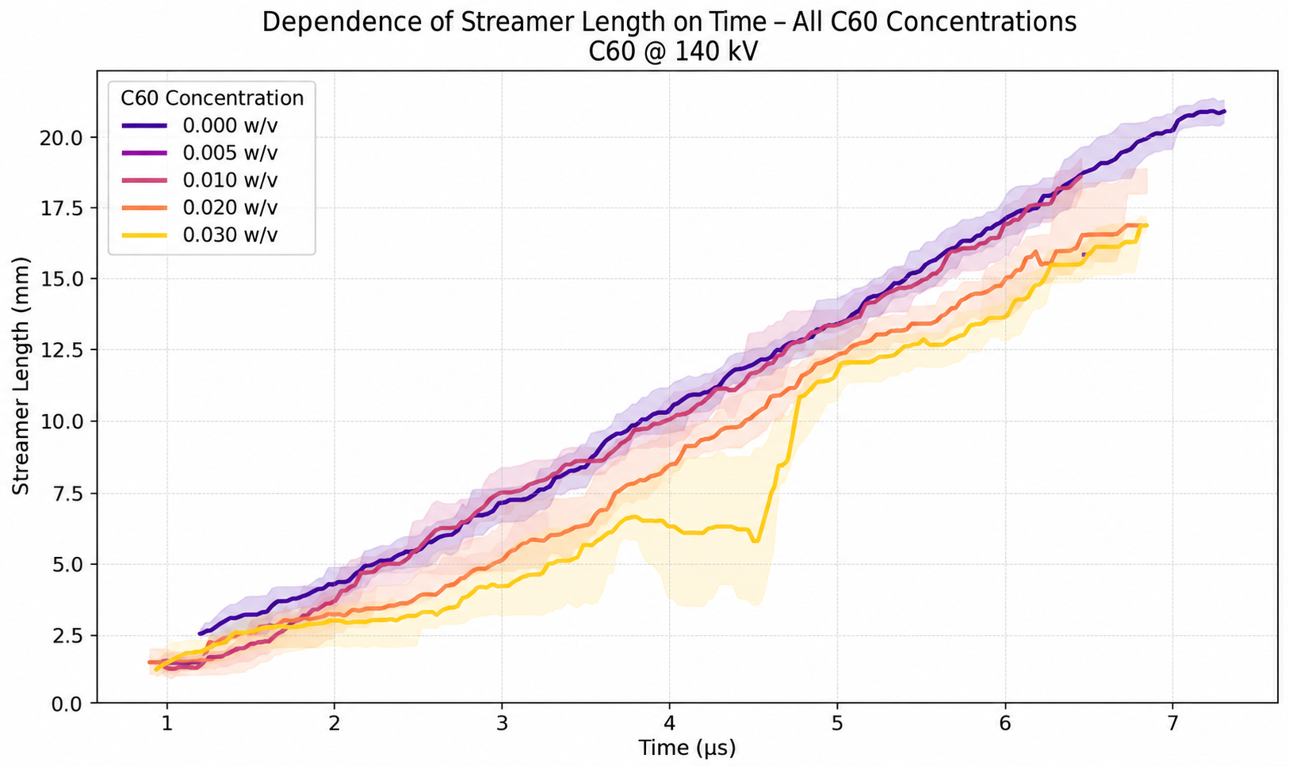
Dĺžka šírenia strímra (mm)

Slide 8
Thank you for your attention
2026 Ing. Kristián Glajc

