Slide 1
Development of Decentralized Energy in the Context of Low-Voltage Distribution Networks
Ing. Kristián Eliáš
Technical University of Košice
Department of Electric Power Engineering
07.09.2026

Slide 2
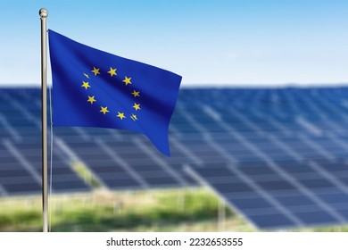
Introduction
EU energy policy is driving a rapid increase in the use of renewable energy sources
As a result of EU energy policy, the number of PV systems in low-voltage distribution networks is constantly increasing
Advantages of PV systems
  electricity generation from clean solar energy
  consumer protection against high energy prices
  increasing independence from the public power supply
Disadvantages of PV systems
  potential negative impact on grid operation

Slide 3
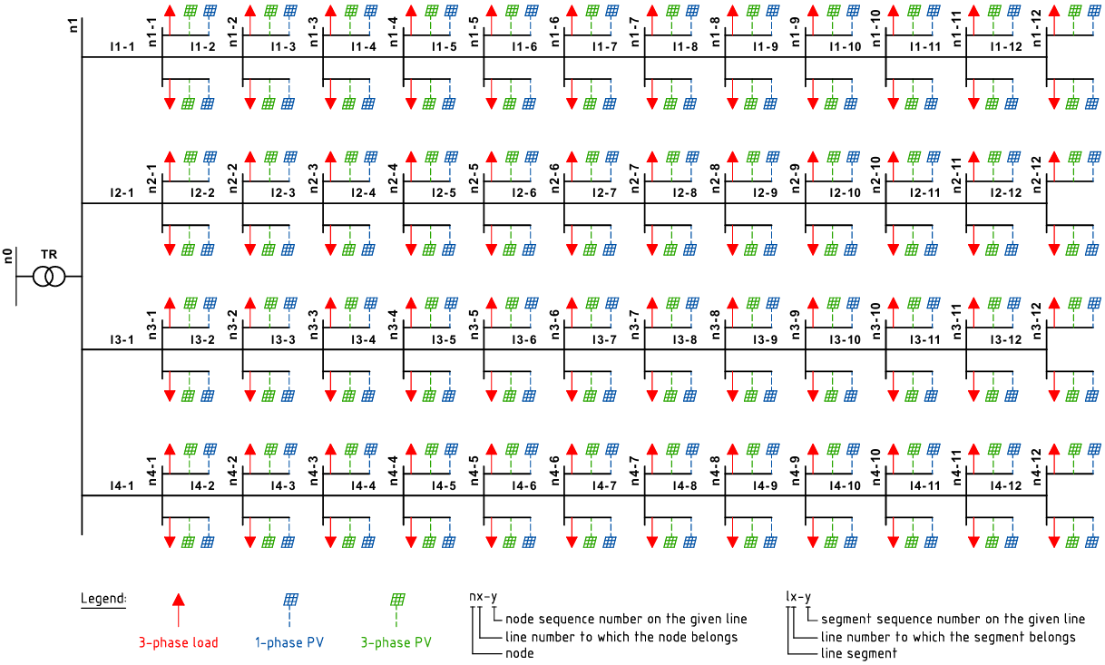
Simulation Methodology
Topology of the modeled network
Approach: Deterministic (worst-case scenarios)
Software: EA-PSM
Number of lines: 4
Line length: 600 meters
Number of nodes per line: 12
Number of consumption points per node: 2
Consumption point: balanced load 3.464 kW, PF 1

Slide 4
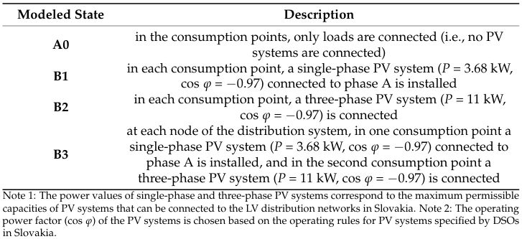
Simulation Methodology
Modeled scenarios

Slide 5
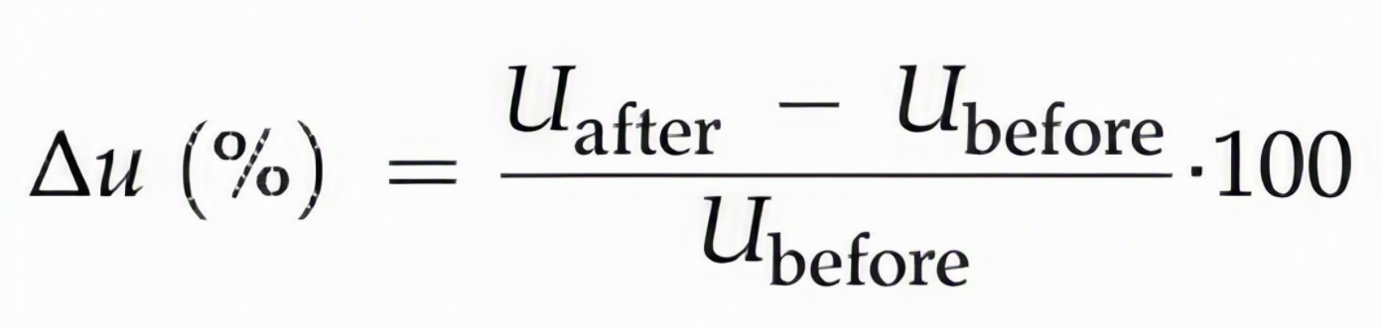
Simulation Methodology
Monitored parameters
Voltage magnitude, which according to the EN 50160 standard should stay within the range of 230 V ± 10%, i.e., between 207 V and 253 V
Voltage unbalance, which according to the EN 50160 standard should stay within the range of 0% to 2%
Relative voltage change, which, in accordance with the conditions of distribution system operators in Slovakia, should not exceed ± 3%
Current flowing through sections of individual lines

Slide 6
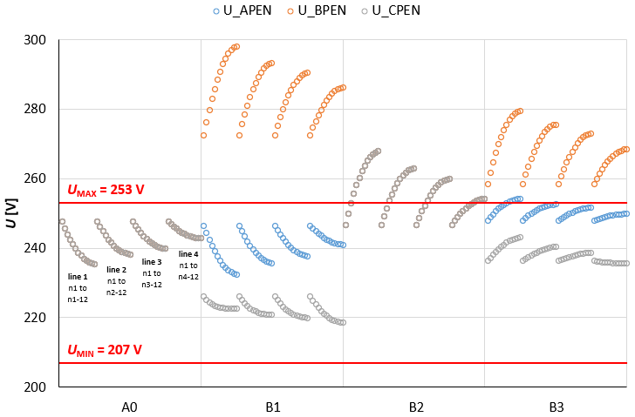
Simulation Results
Impact of PV systems on voltage magnitude

Slide 7
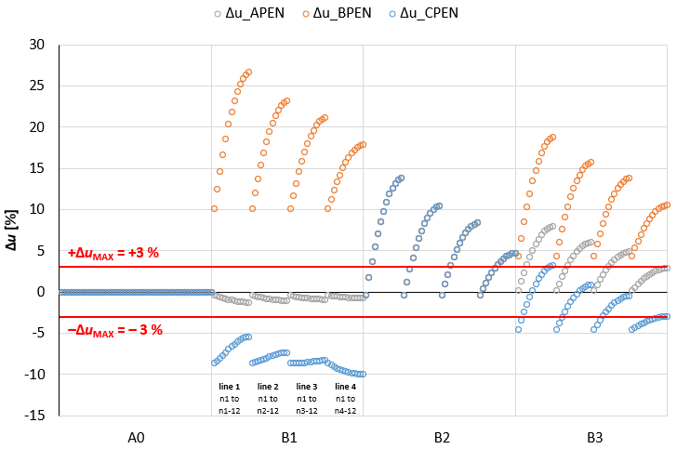
Simulation Results
Impact of PV systems on relative voltage changes

Slide 8
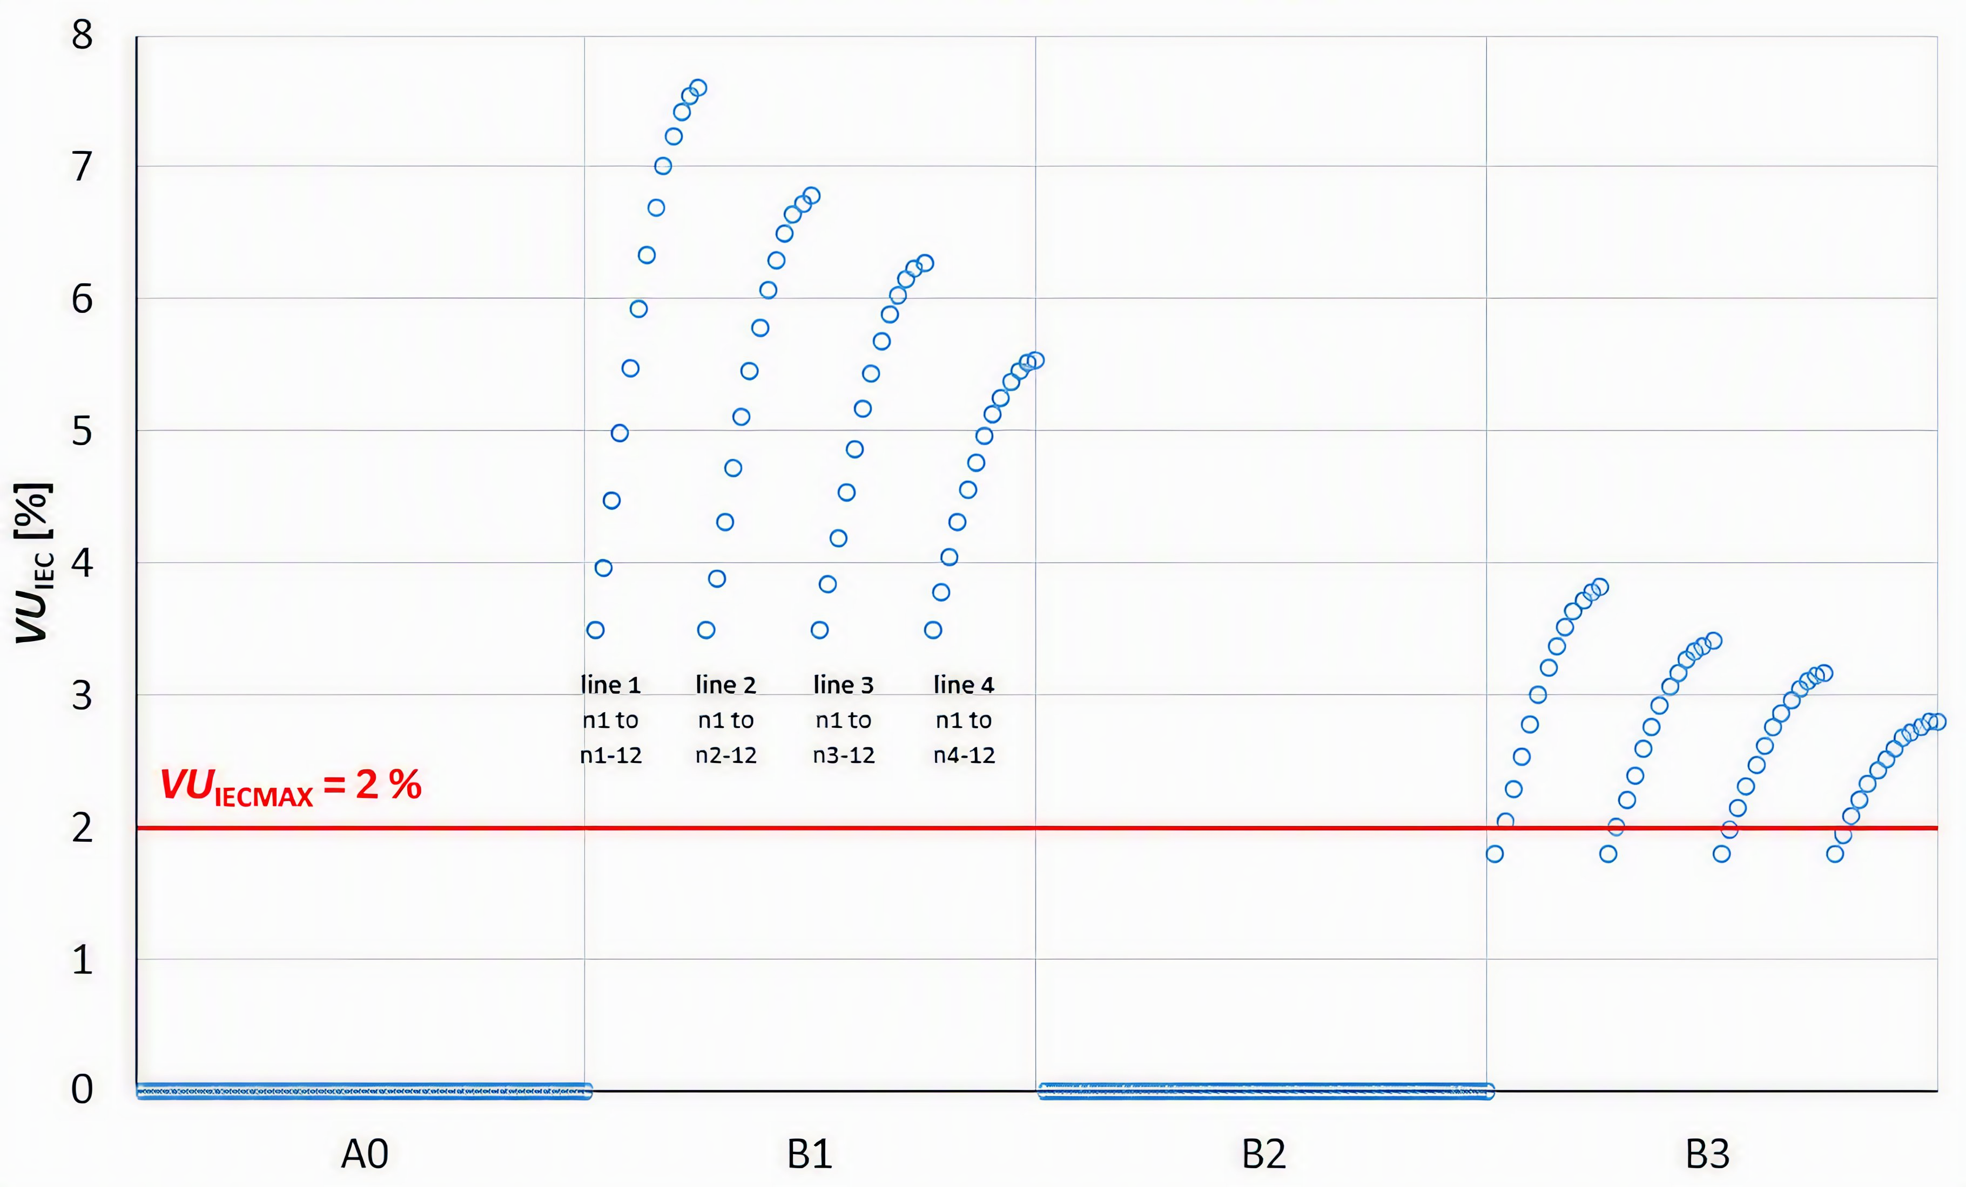
Simulation Results
Impact of PV systems on voltage unbalance

Slide 9
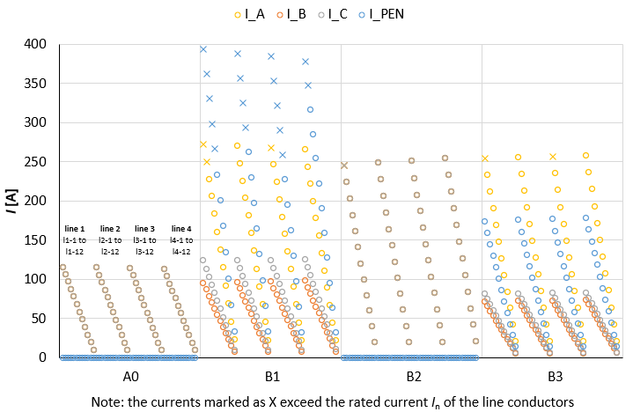
Simulation Results
Impact of PV systems on current loading of lines

Slide 10
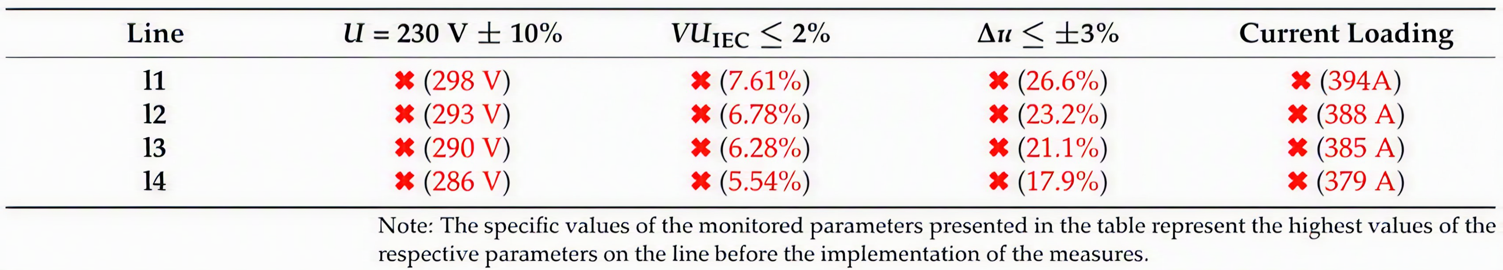
Mitigating the Impact of PV Systems on the Distribution System
Scenario B1
Level of PV systems impact in scenario B1 before the application of measures

Slide 11
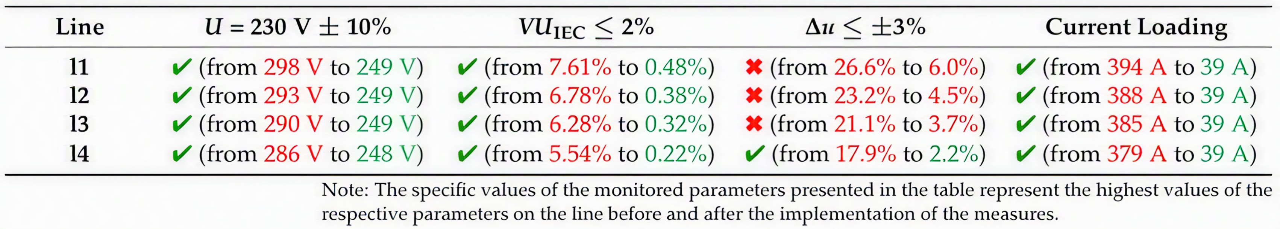
Mitigating the Impact of PV Systems on the Distribution System
Scenario B1
Level of impact of single-phase PV systems after symmetrization
Possible supplementary measures:
Changing the operating mode of the PV systems (PF adjustment)
Reduction in the number of consumption points with PV systems connected to the lines

Slide 12
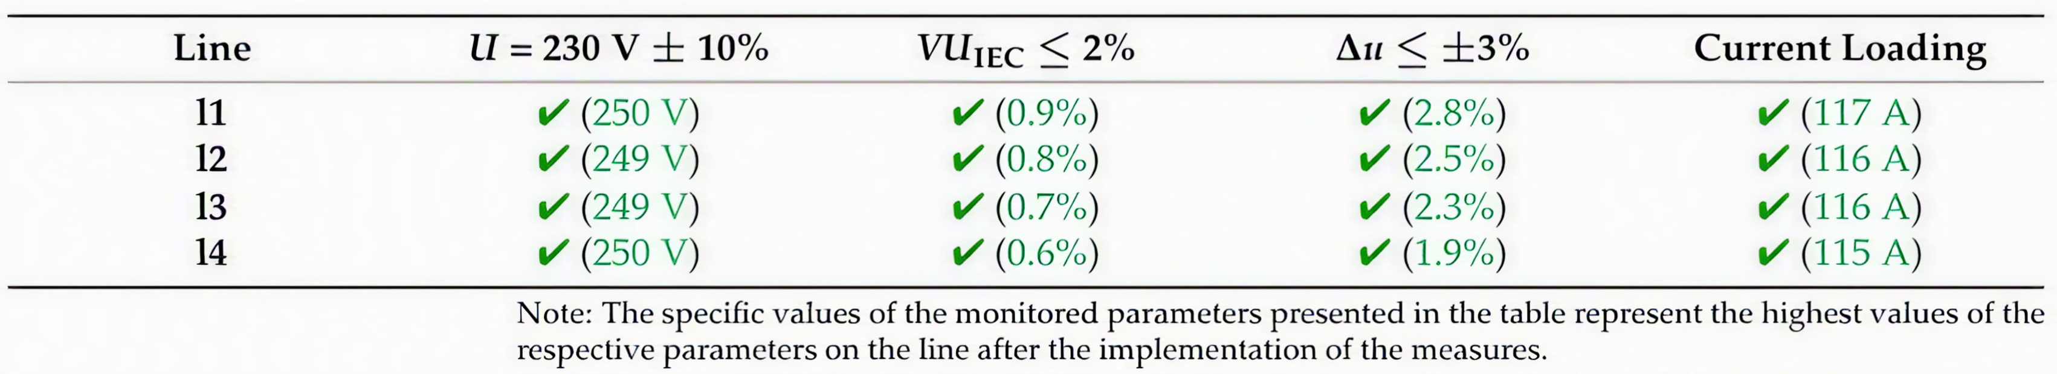
Mitigating the Impact of PV Systems on the Distribution System
Scenario B1
Level of impact of single-phase PV systems with a power rating of 0.4 kW

Slide 13
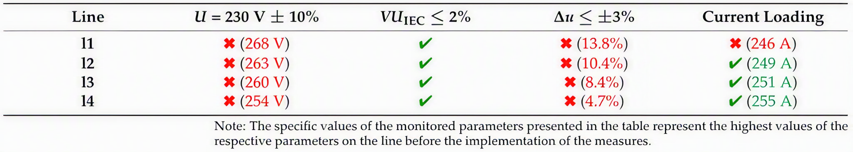
Mitigating the Impact of PV Systems on the Distribution System
Scenario B2
Level of PV systems impact in scenario B2 before the application of measures

Slide 14
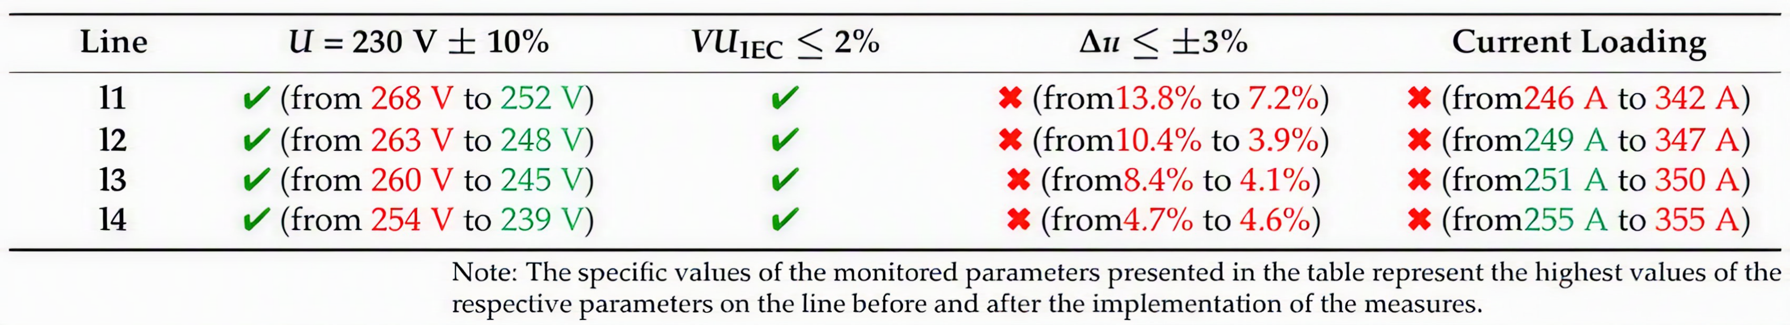
Mitigating the Impact of PV Systems on the Distribution System
Scenario B2
Level of impact of three-phase PV systems after PF adjustment

Slide 15
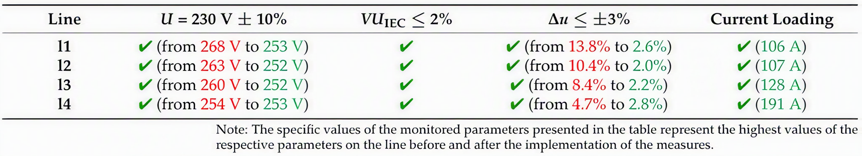
Mitigating the Impact of PV Systems on the Distribution System
Scenario B2
Level of impact of three-phase PV systems after reduction in the number of consumption points with PV systems connected to the lines

Slide 16
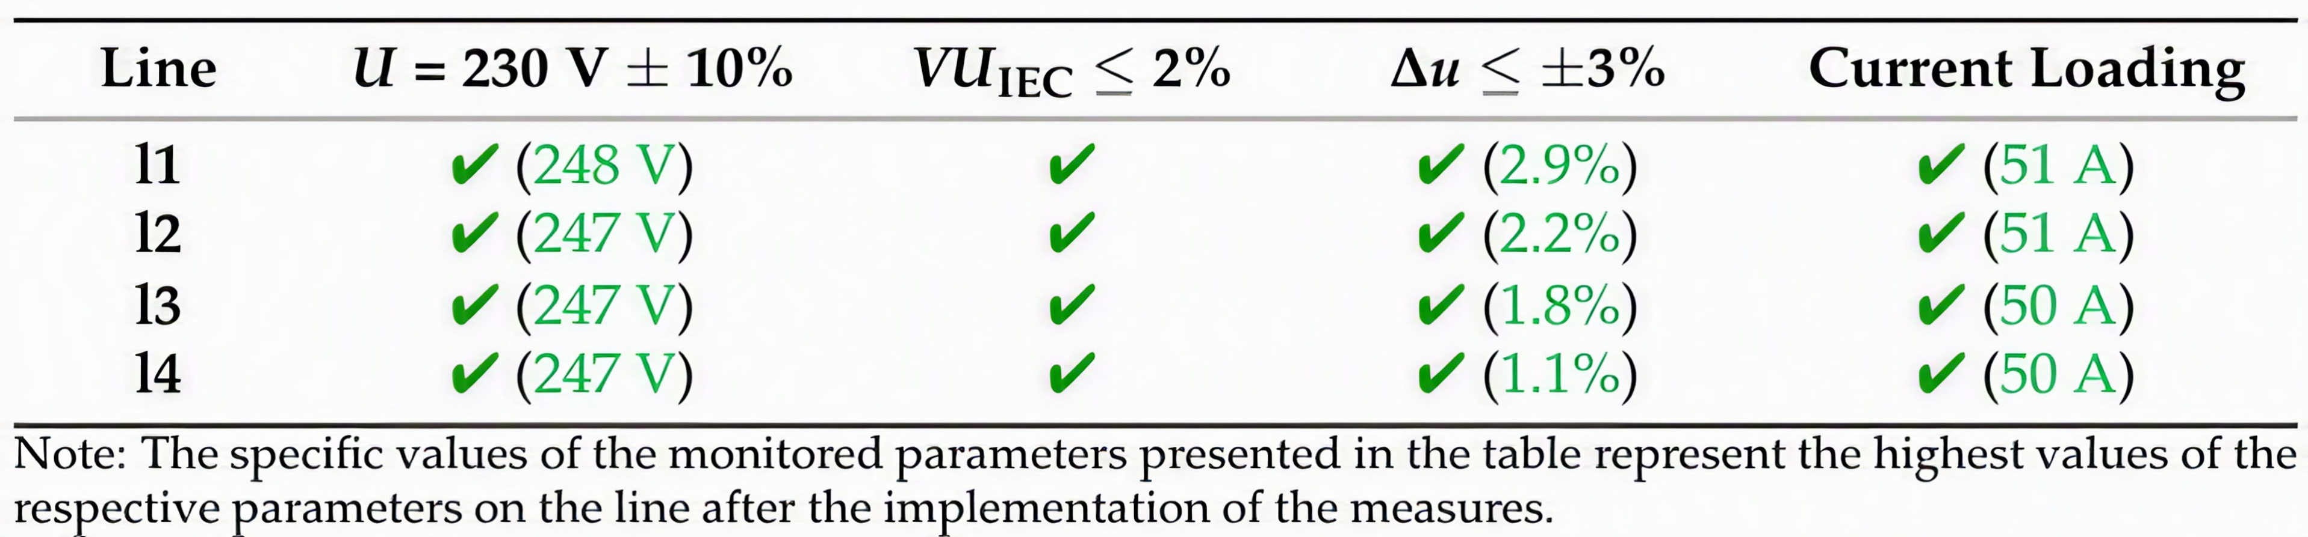
Mitigating the Impact of PV Systems on the Distribution System
Scenario B2
Level of impact of three-phase PV systems with a power rating of 2 kW

Slide 17
Conclusions
The cumulative effect of PV systems in the distribution network can degrade power quality
Reduced voltage quality threatens operational safety and system reliability
The negative impact of PV systems can be mitigated by adopting appropriate measures
In the future, it will be necessary to focus on active solutions

Slide 18
Thank you for your attention

