Slide 1
Interreg CENTRAL EUROPE No. CE0200803 – V4GRID
DATE: 07/09/2026
Assoc. Prof. Zsolt Čonka, PhD.
Technical University of Košice

Slide 2
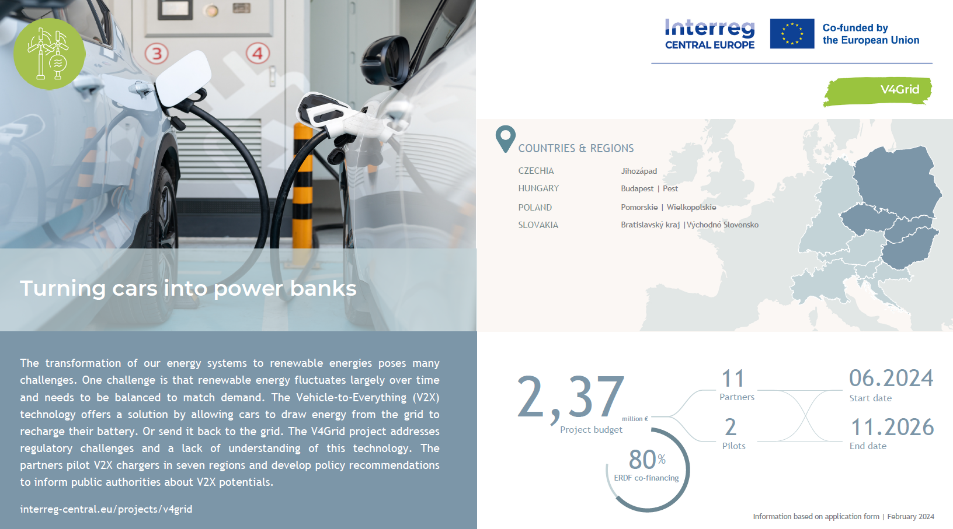

Slide 3
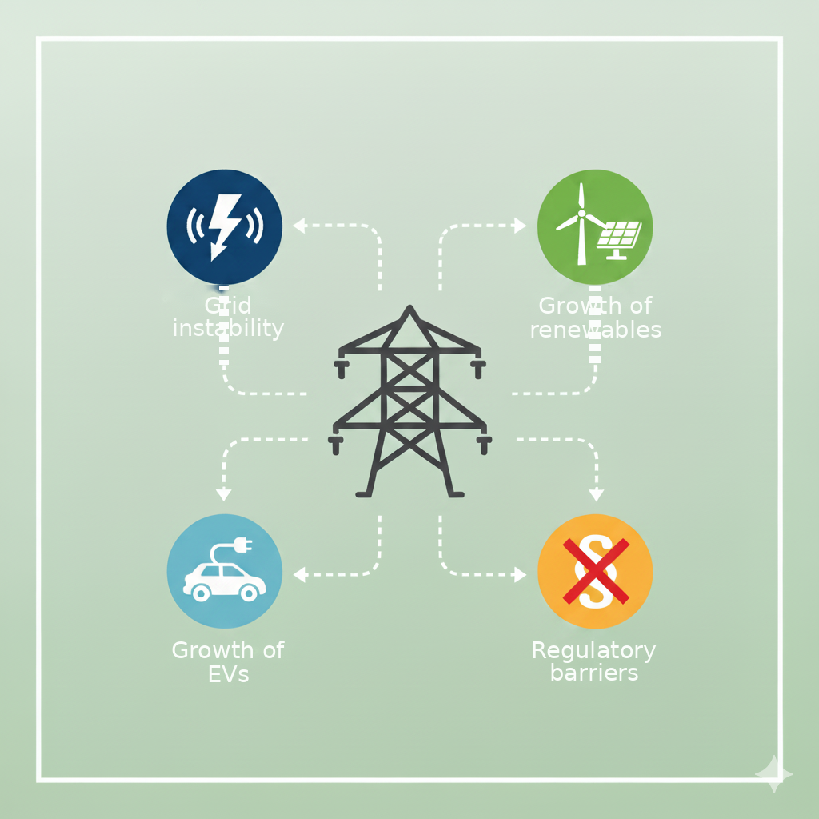
Why is this project crucial for our region?
The grid is under pressure: The rapid growth of renewables is causing swings in electricity generation. Without massive energy storage capacity, we face future blackouts and costly investment in grid reinforcement.
Electric vehicles as a load: The mass shift to e-mobility means a huge increase in electricity demand, which puts even more pressure on local grids.
Regulatory and market barriers: Our region still lacks the legislation, consumer education and proven business models that would enable commercial deployment of V2X technology.

Slide 4

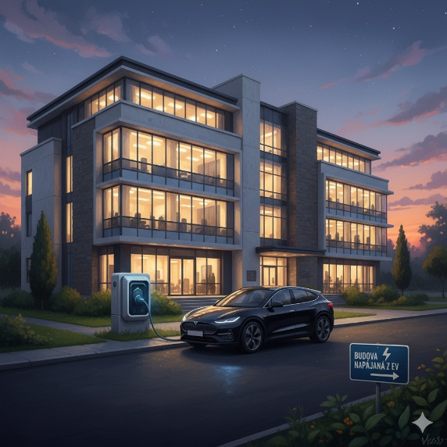
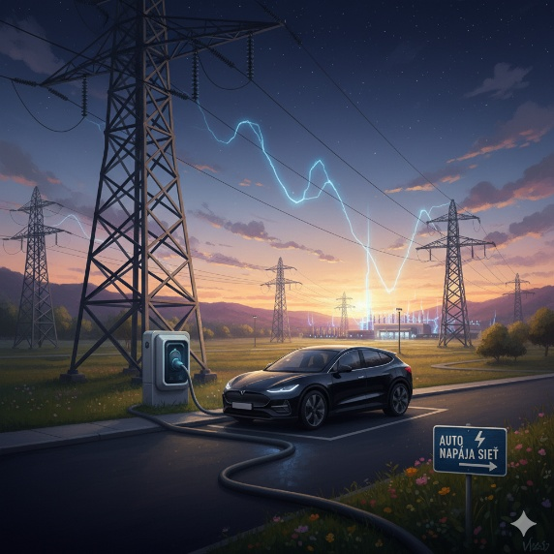

V2X technology and project objectives

Slide 5
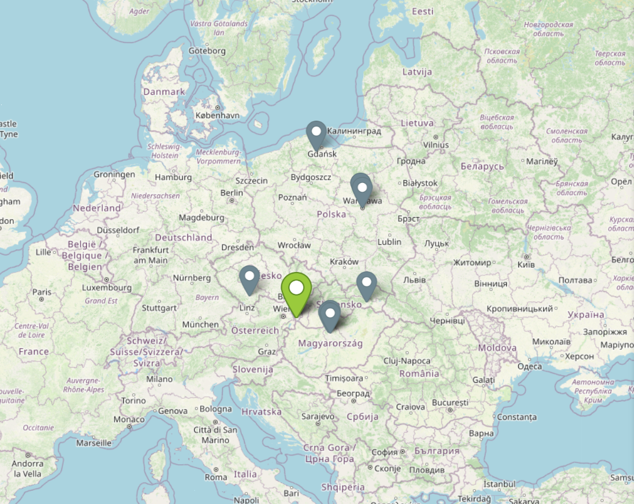
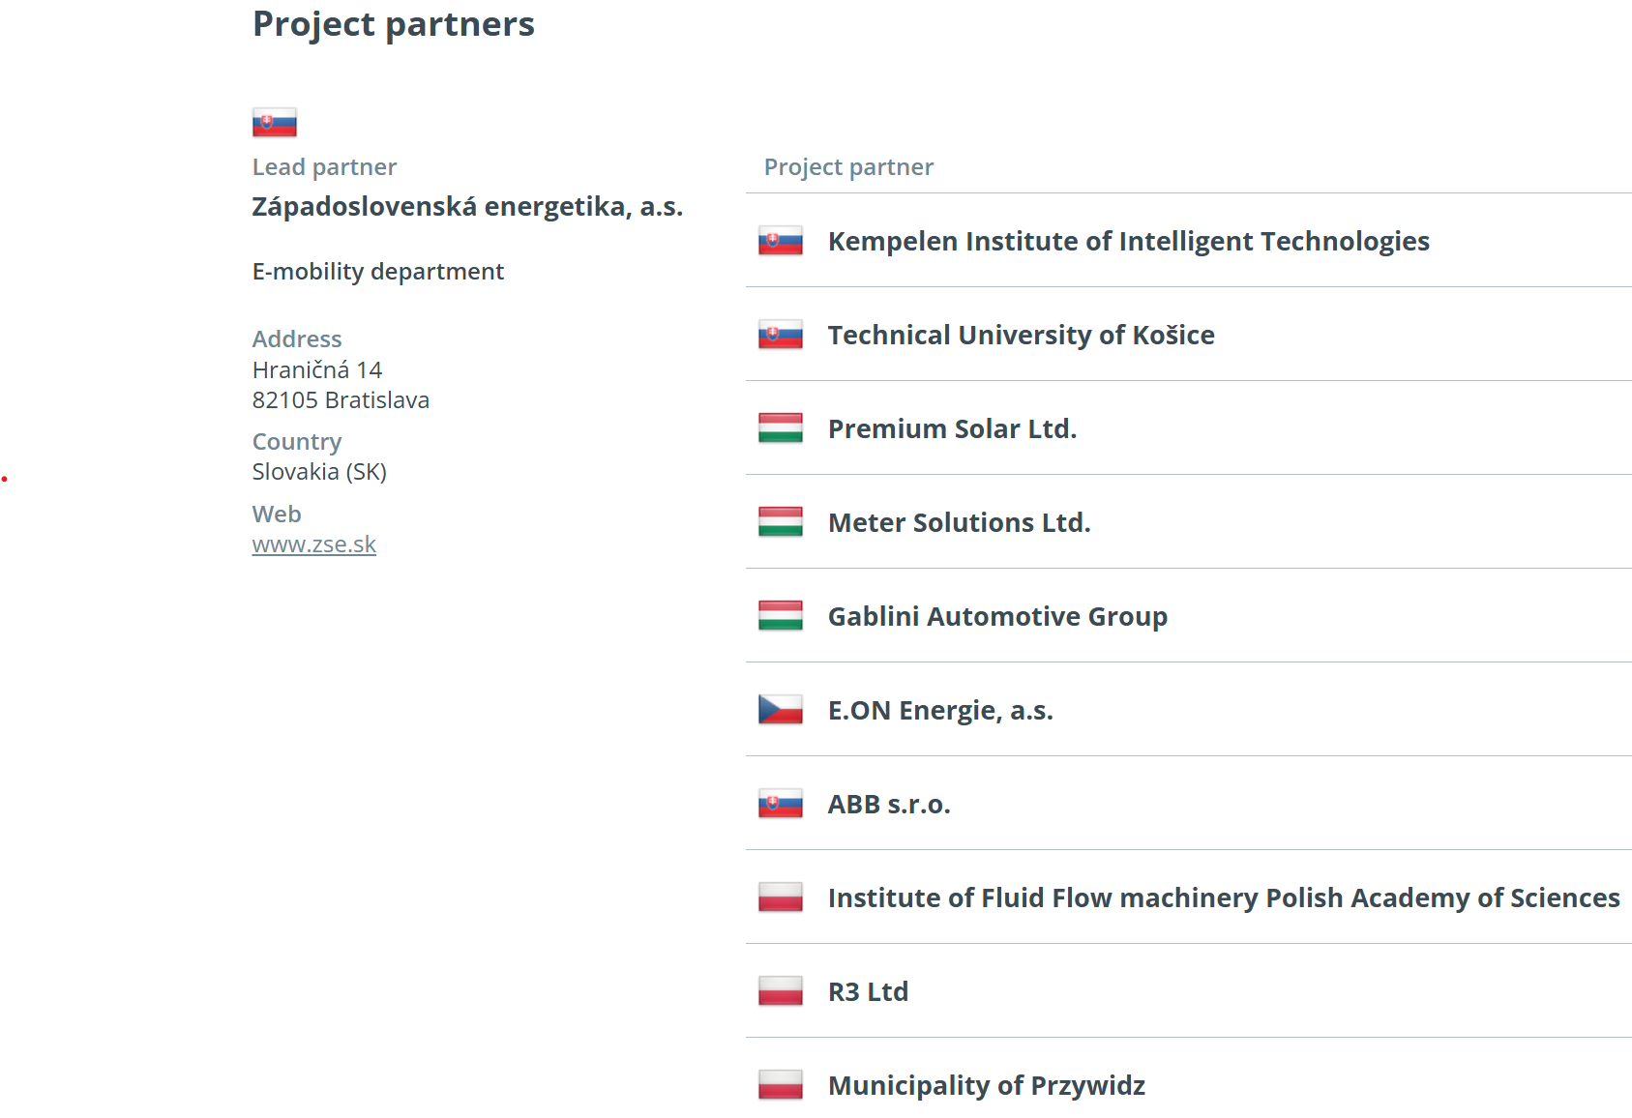
How will we achieve this? Partnership and activities

Slide 6

The project stands on three pillars
Definition and design (WP1): First we analyse market needs, map the regulatory framework and design the technical architecture of the whole V2X system.
Development and pilot operation (WP2): This is the heart of the project. We will install and operate 18 V2X charging stations at 15 pilot sites in four countries. These pilots will give us real-world data on which we will develop and test our algorithms for intelligent energy management.
Business models and legislation (WP3): Based on the data from the pilot operation we will create sustainable business models and prepare concrete recommendations for national regulators, so as to remove the barriers to mass deployment of these services.

Slide 7




Expected results and benefits
Stable grid: A more stable and resilient grid able to integrate more renewable sources.
Financial savings: The chance to lower the total cost of vehicle ownership thanks to new revenue or energy savings.
Green energy: Concrete, data-based proposals for legislative change that will support innovation and help meet climate targets.
Legislative recommendations: Cleaner air, a more efficient energy system and greater energy security for the region.

Slide 8
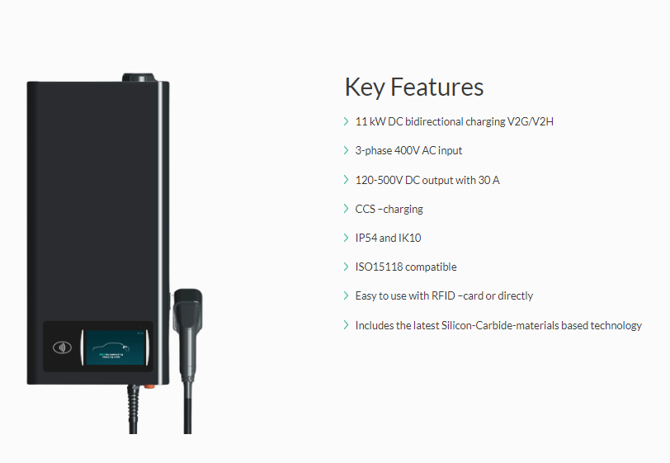
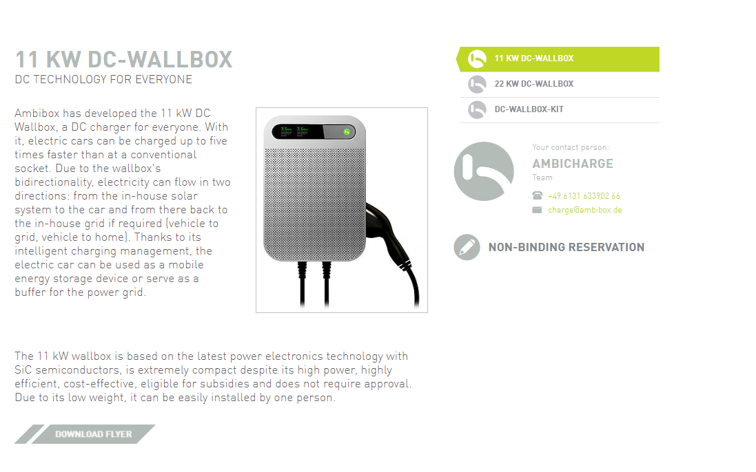
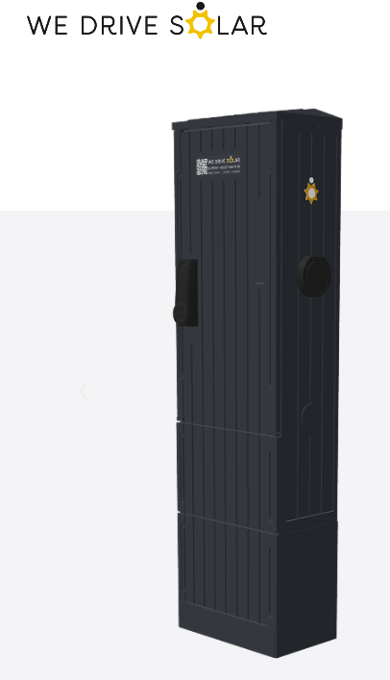
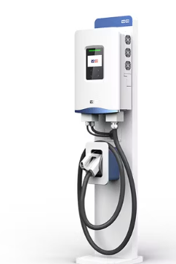
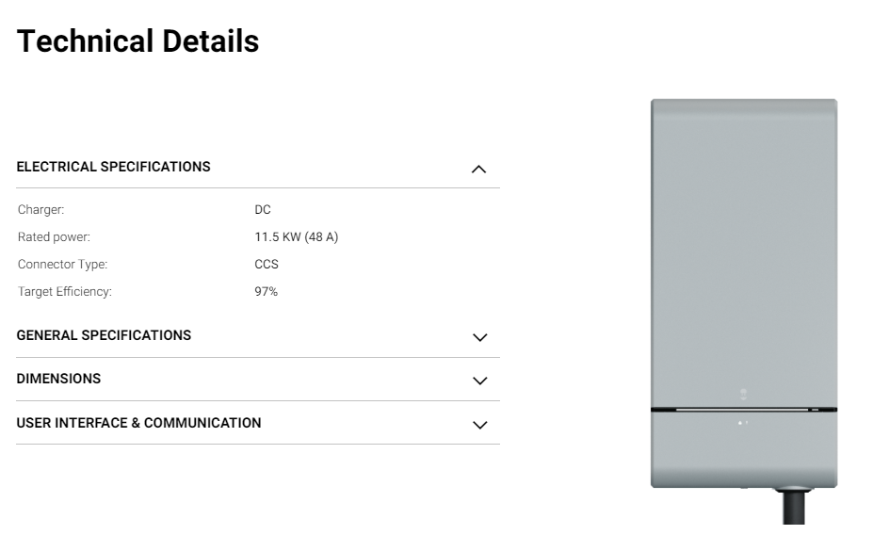
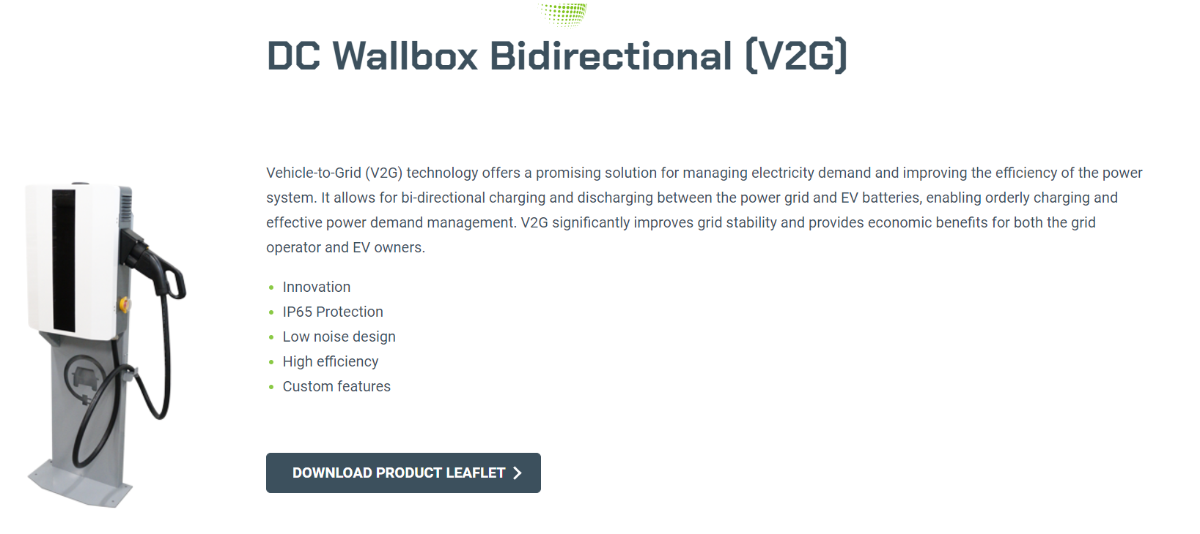
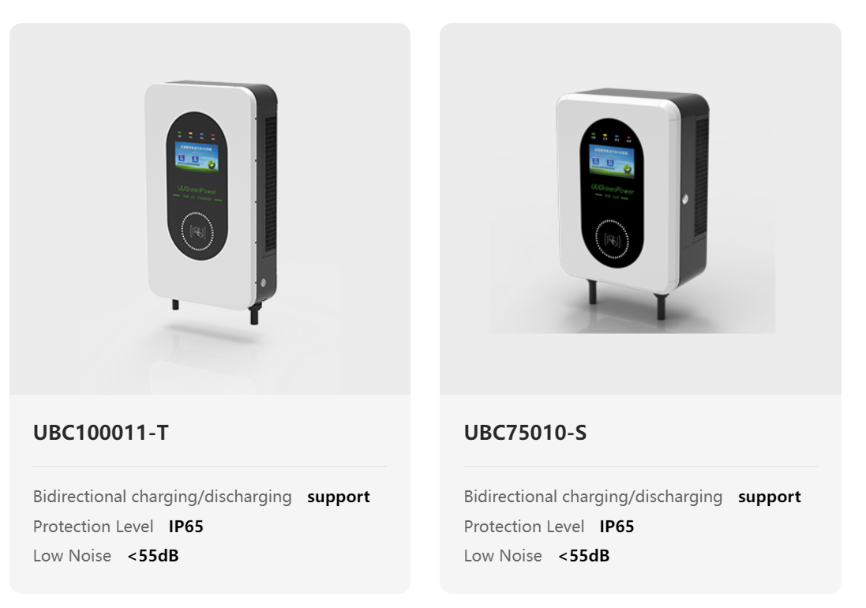

Market research
Udenco
Intercontrol
Compleo
Ambibox
Wallbox
V2C
Alfen
Infypower
Bosch
UUGreenpower
Zaptec
Codibly
WeDriveSolar
Schneider
Beny Energy
Incharge
EVTEC
InfyPower
....

Slide 9
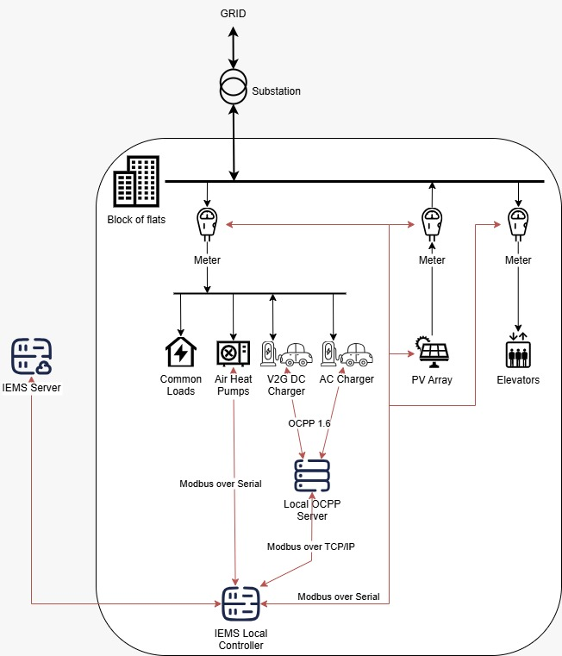
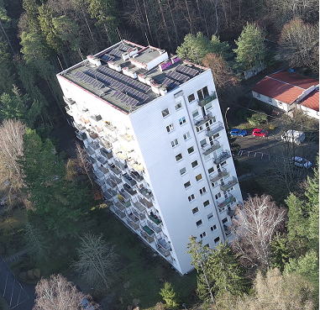
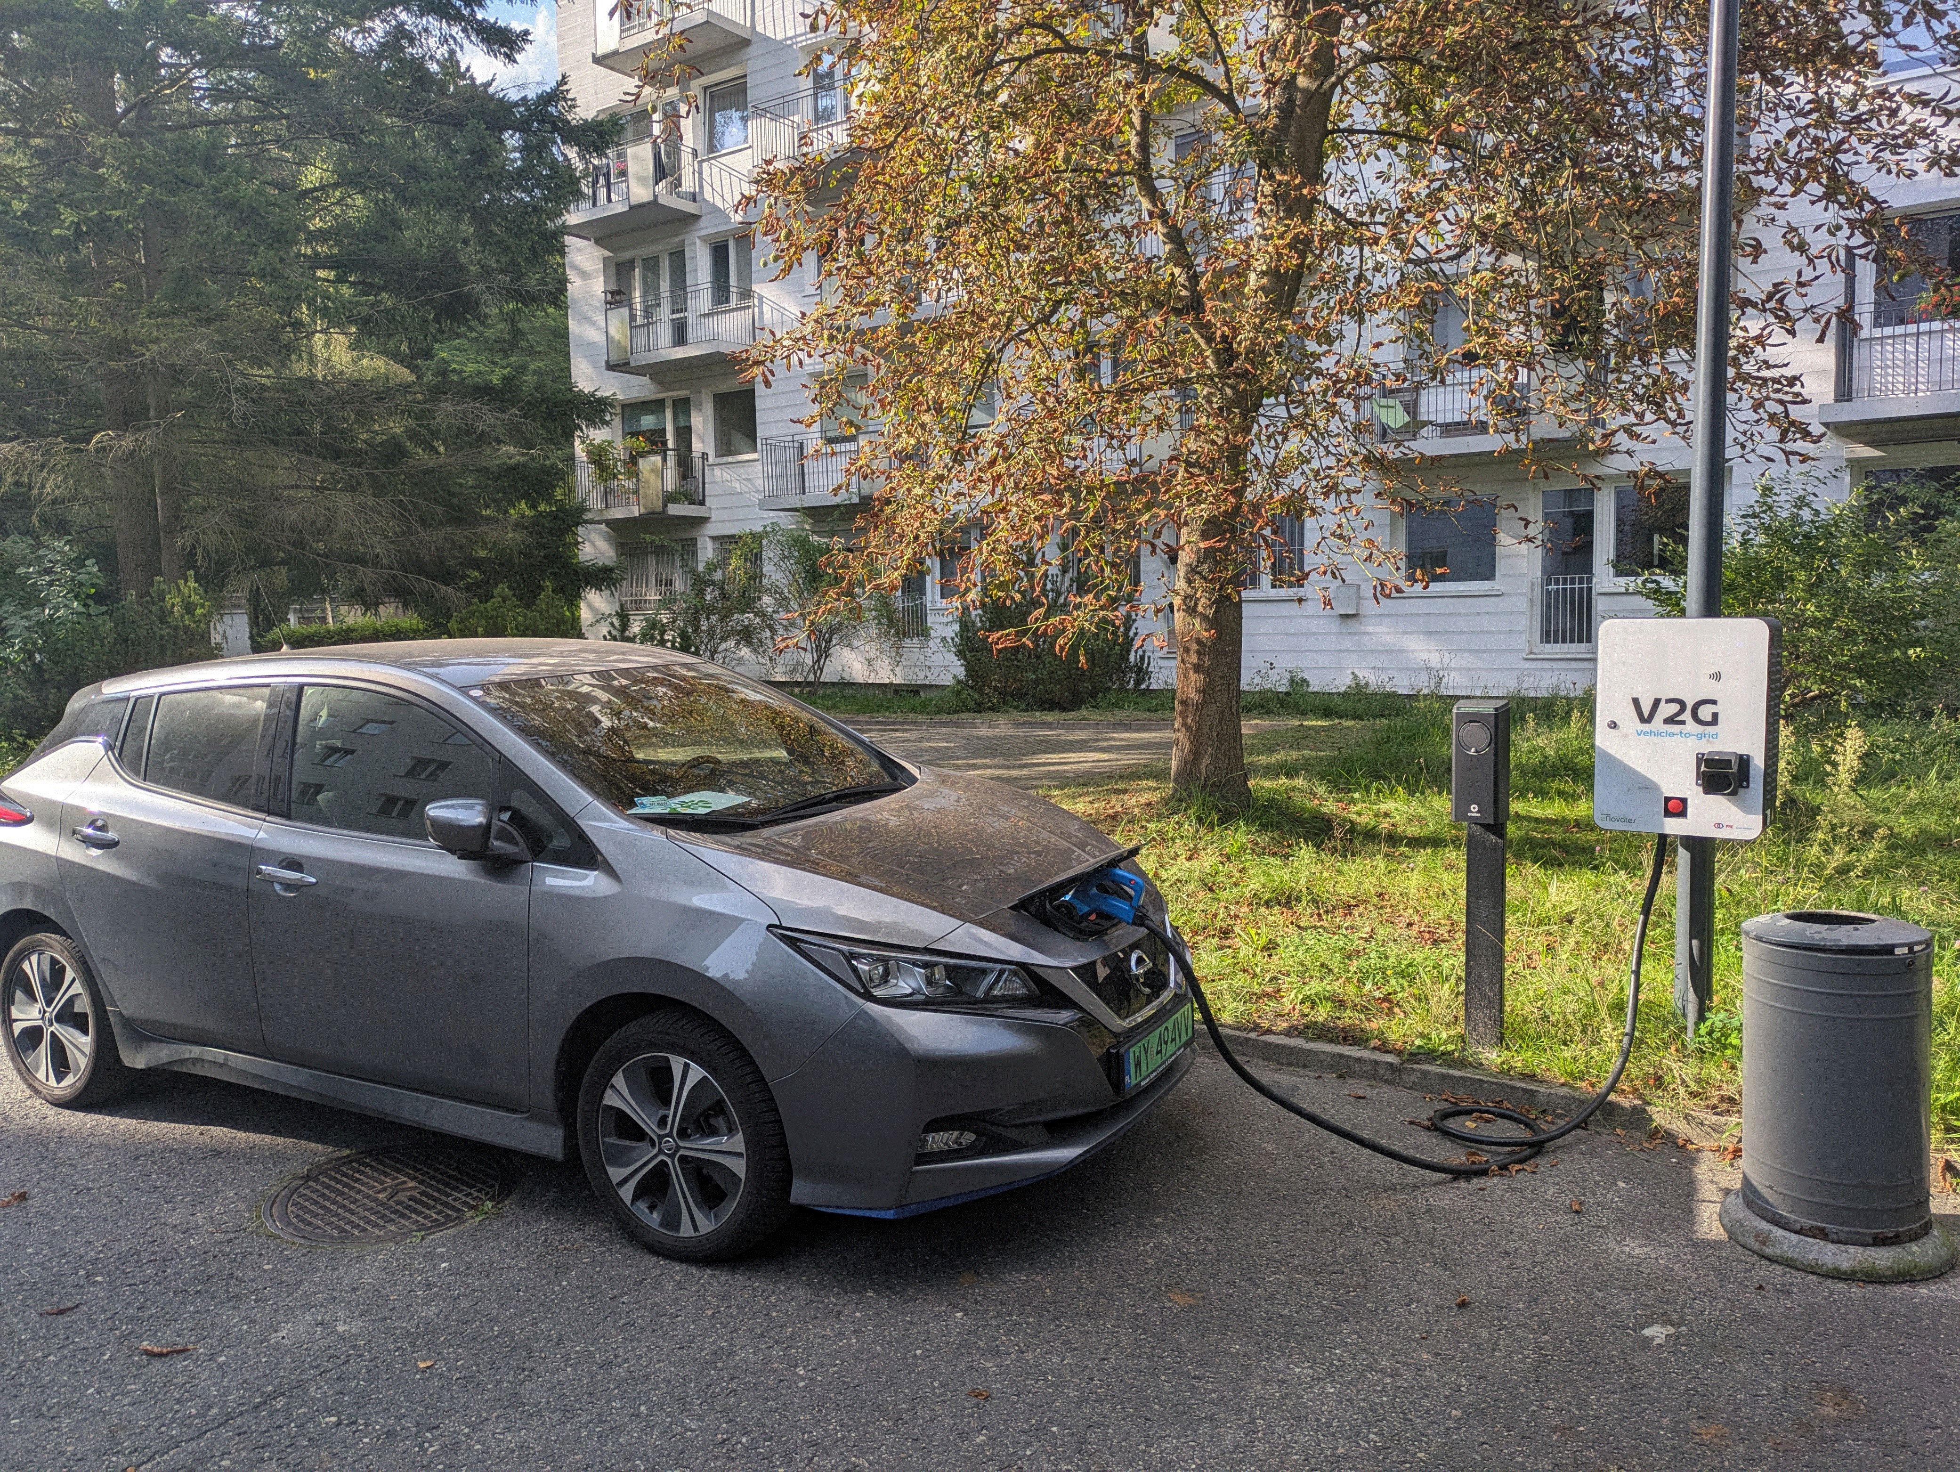
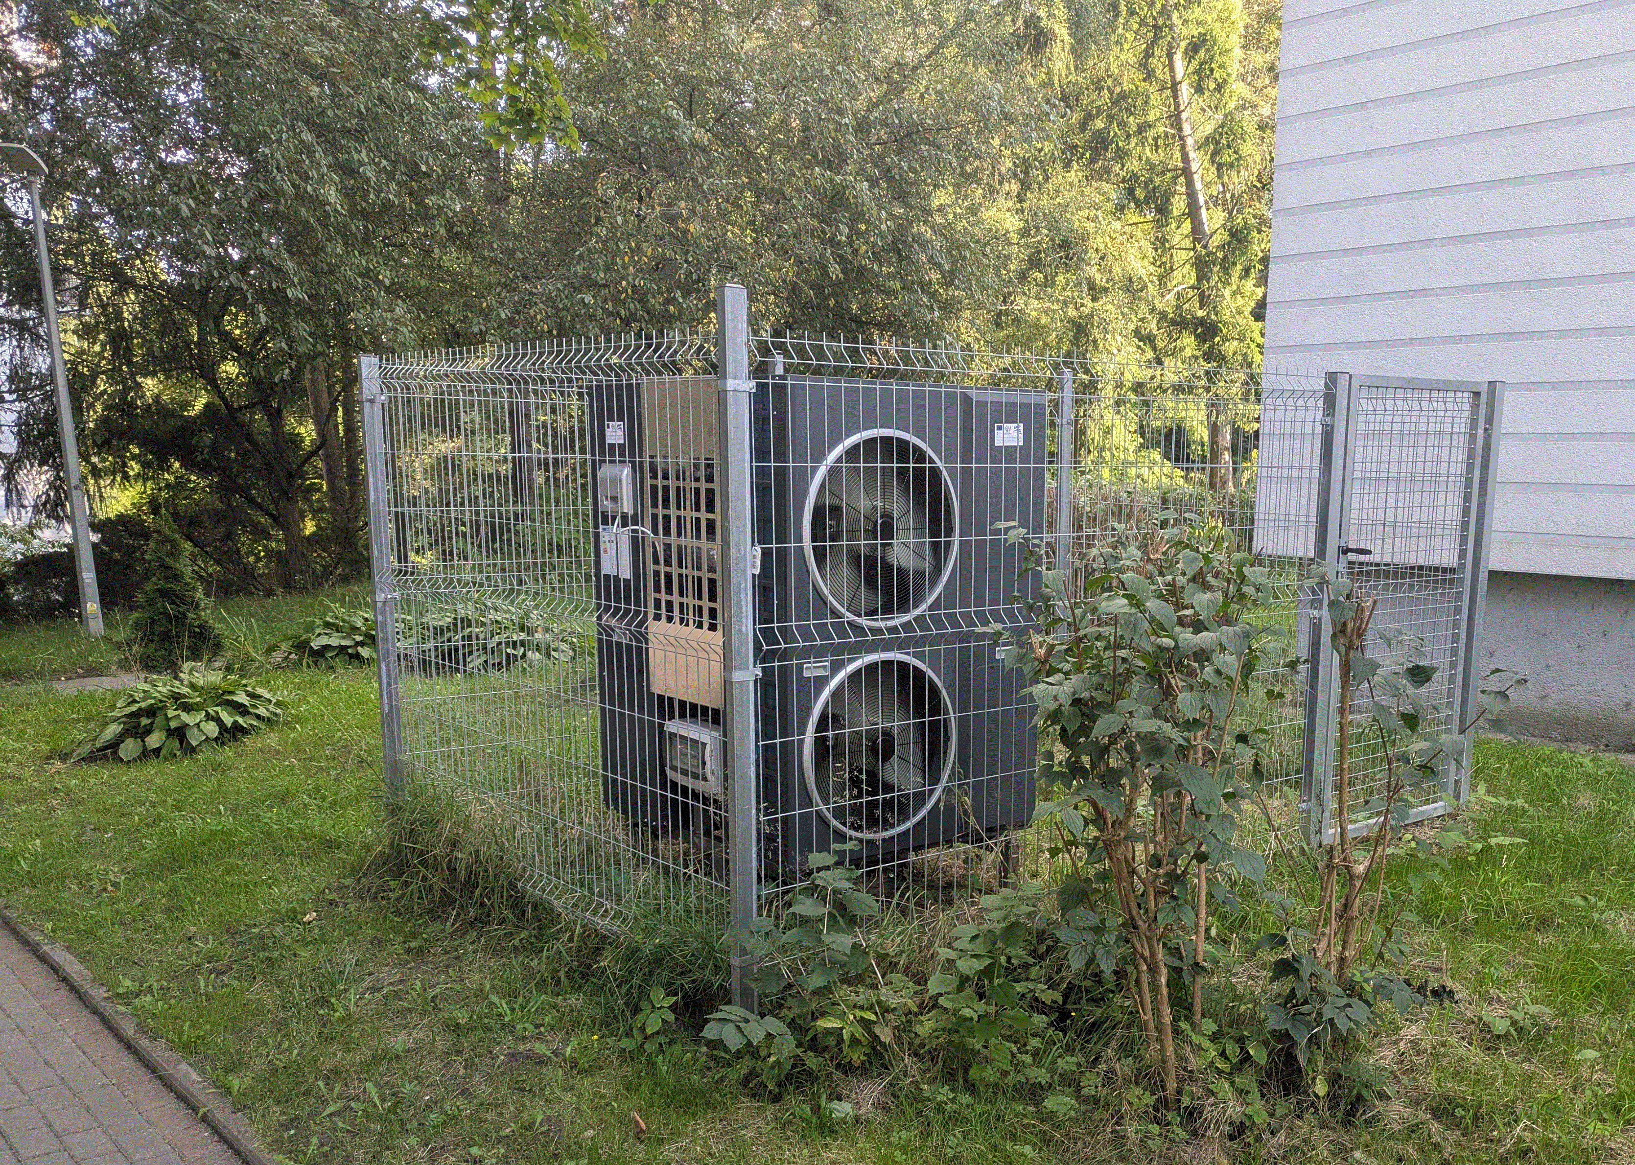
Example of V2B tests in Sopot, Poland – V2B
Stakeholders involved:
IMP PAN
Stay-On EM – energy managements system provider
WSM – housing association – building owner
Energa Operator – local DSO
Tests:
Integration of EV, V2B and HP cooperating with PV – DHW (Domestic Hot Water) production
Communication and control via OCPP and local iEMS controller
preliminary tests of EV, V2B and HP integration using a CHAdeMO charger and a local EMS (energy management system) as part of a use case in Sopot, Poland

Slide 10
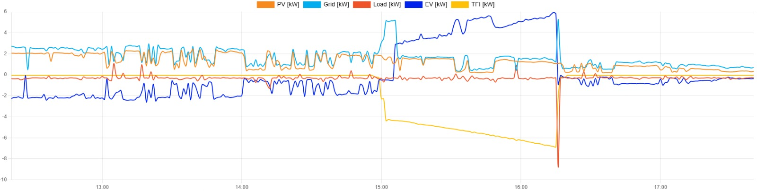
Example of V2B tests in Sopot, Poland – V2B
HP – DHW production
EV charging – „following“ PV
EV discharging – „following“ HP and PV
Tests:
preliminary tests of local EMS
communication and control via OCPP and local iEMS controller

Slide 11
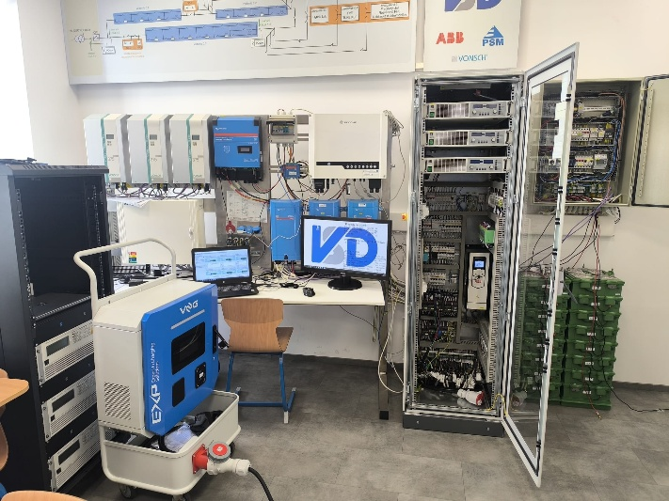
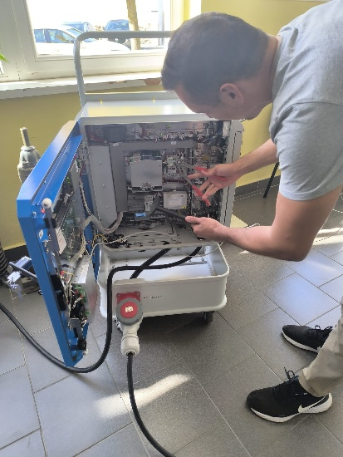
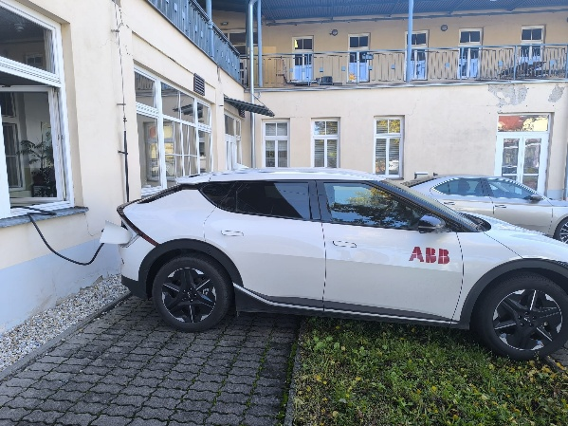
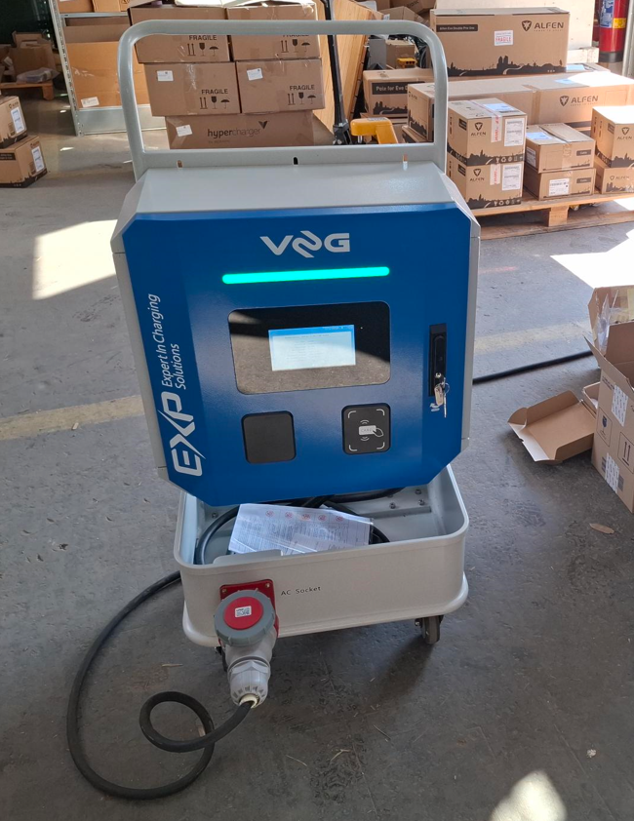
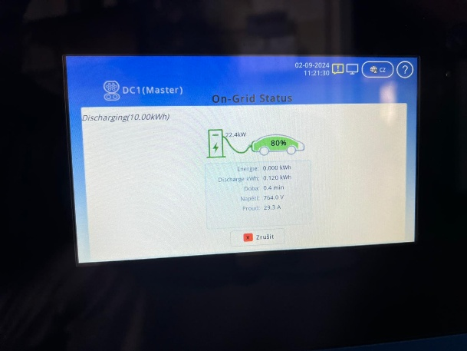
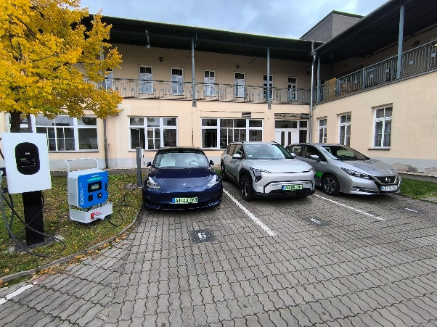

Slide 12
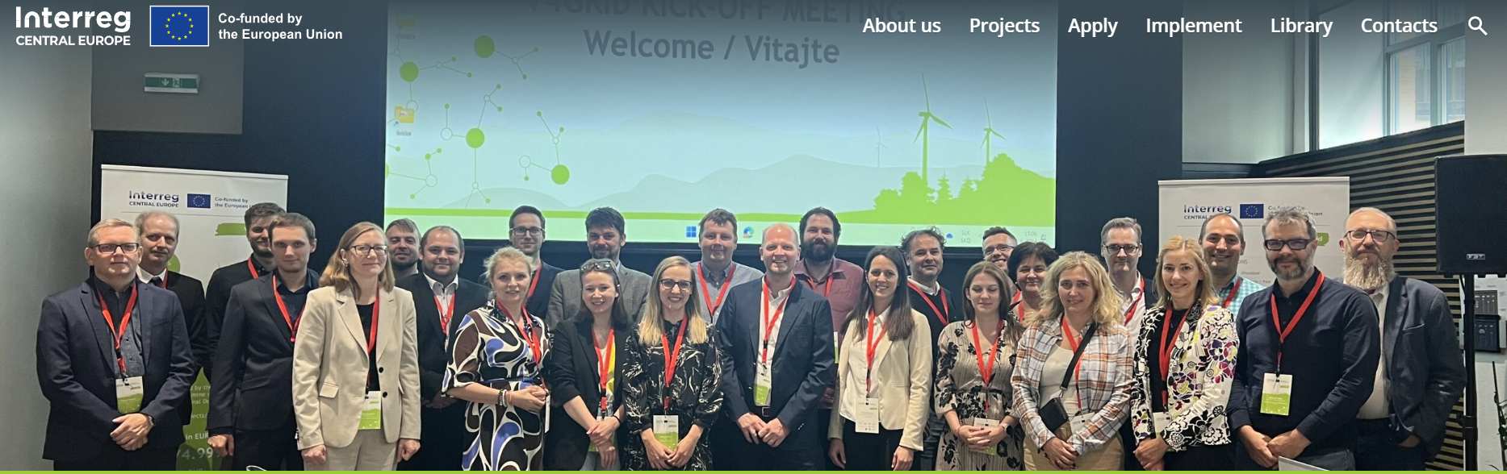
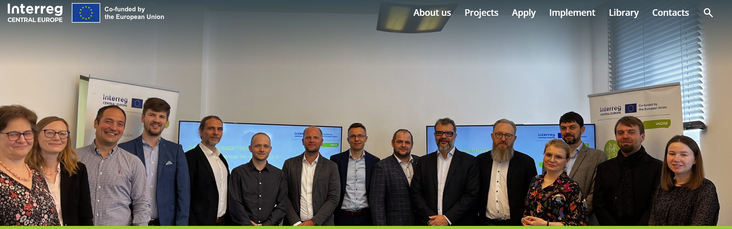
Thank you for your attention

